Slide 1
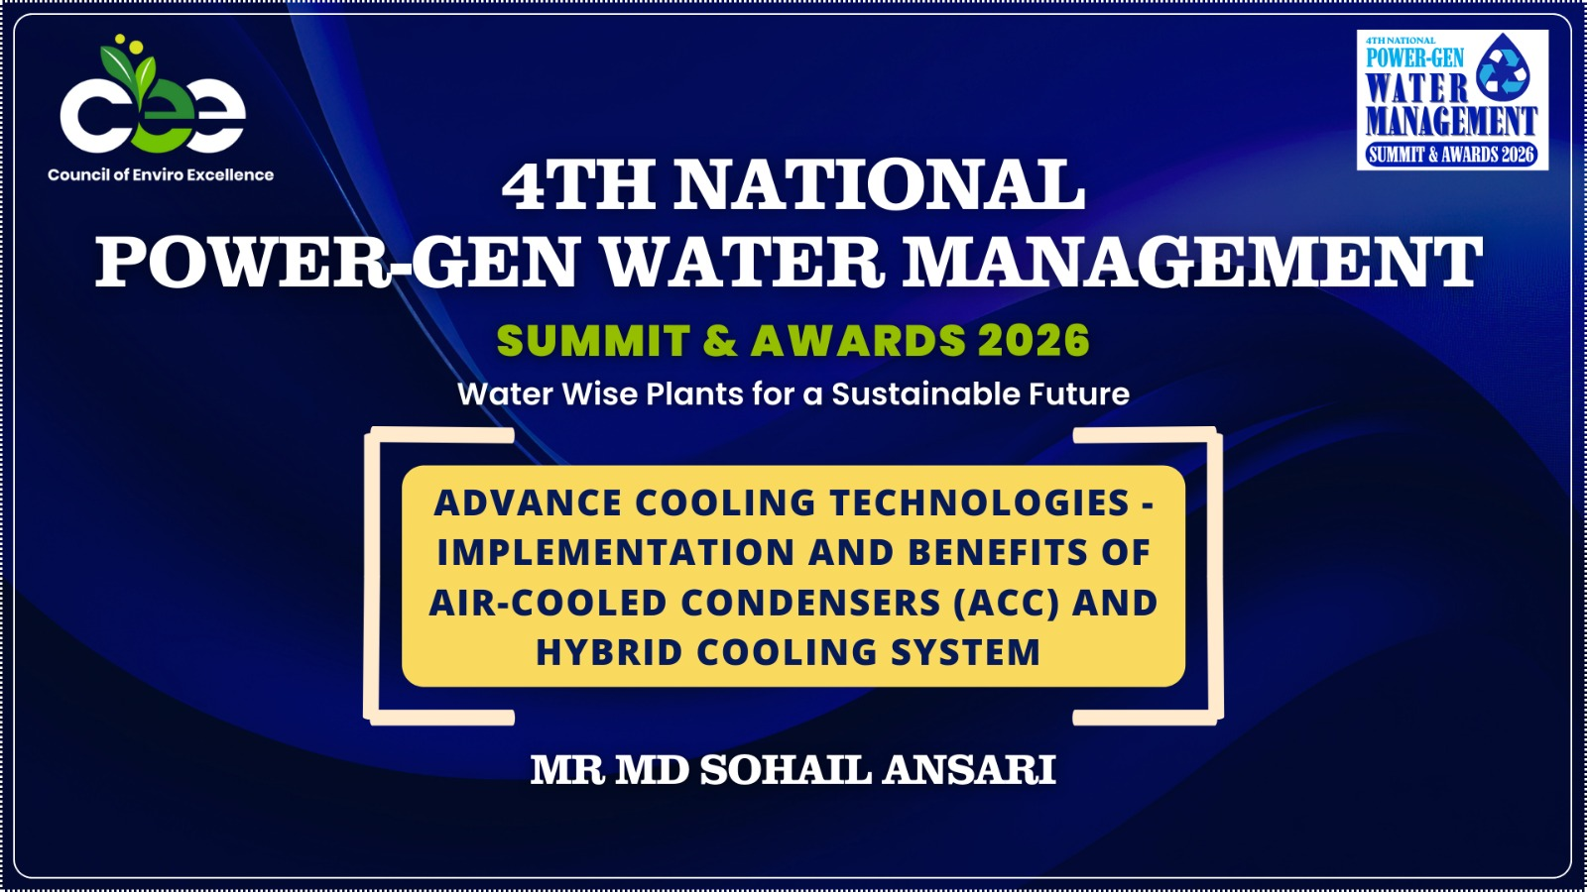

Slide 2
IMPLEMENTATION AND BENEFITS OF AIR-COOLED CONDENSERS (ACC) AND HYBRID COOLING SYSTEMS
Md. Sohail
AGM-Mechanical

Slide 3
Contents
Introduction
The Sustainability Challenge: Current Water Consumption Models
Air Cooled Condensor (ACC)
Design and Performance Standards
Comparative Benefits: ACC & Hybrid vs. Conventional Wet Cooling
Emphasis & Suggestions

Slide 4
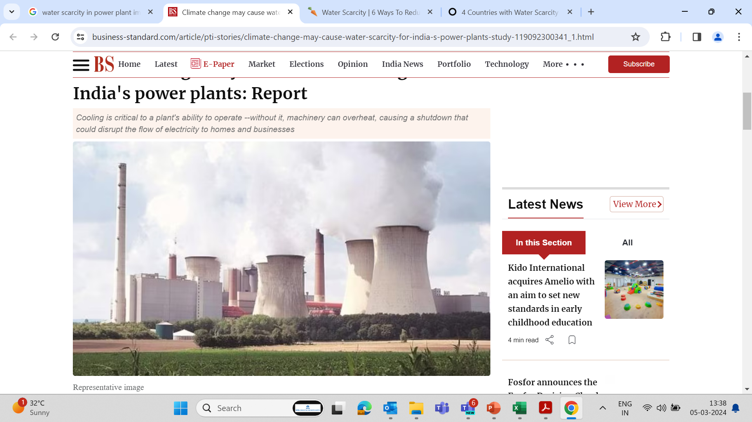
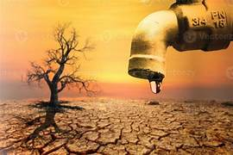
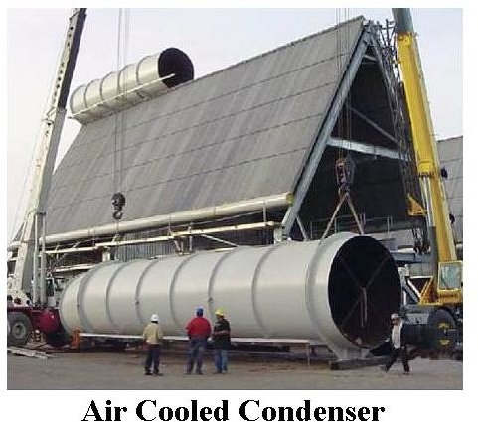
Introduction- “Engineering Reliability in a Water-Constrained World”
Evaporative Losses in Conventional Systems
Declining Water Availability
ACC as a Sustainable Cooling Alternative
Water Scarcity and Thermal Power Generation
Recognize the pressing challenge of water scarcity, particularly in thermal power plants specific water consumption (SCW), as a critical concern amid rising global water demands.
Techno-Economic Impacts
Understand the trade-offs through techno-economic analysis: decrease in plant efficiency, rise in per-MW capital costs in some solutions, While these solutions may address extreme water scarcity, their economic and operational constraints demand careful assessment and due diligence.
Balanced Decision-Making
Highlight the importance of a balanced approach, carefully evaluating the interplay between water conservation goals and economic feasibility to ensure sustainable power generation.
Innovative Solutions for Sustainability
Advocate for innovative strategies to optimize water use in thermal power plants, addressing the dual challenge of water scarcity and sustainable energy production, with an emphasis on long-term benefits for humanity and the environment.

Slide 5
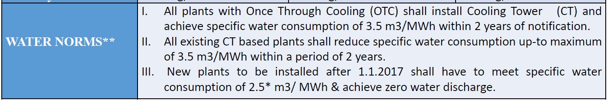
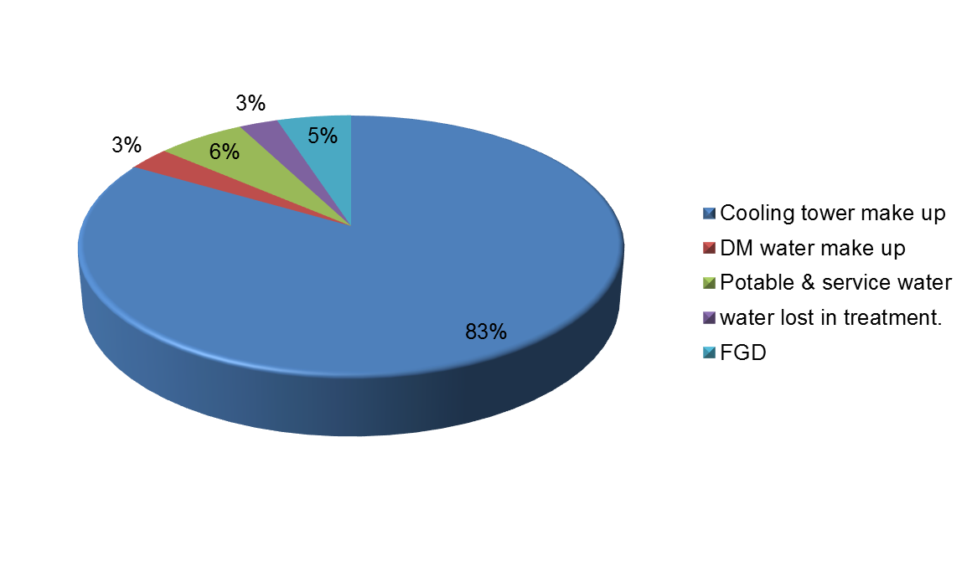
The Sustainability Challenge: Current Water Consumption Models
Currently the TPP’s with cooling towers consume Make-up to wet cooling water system ranges 83% to 85% of total plant consumption water flow with COC 5 to7.
Condenser Cooling system
Flue gas desulphurization unit
De mineralized water consumers such as Power cycle make up Condensate polishing Unit (CPU) regeneration Demineralization (DM) plant regeneration
Service water for Ash handling system Coal handling system Miscellaneous requirements
Potable water
Environmental Norms (CEA)

Slide 6
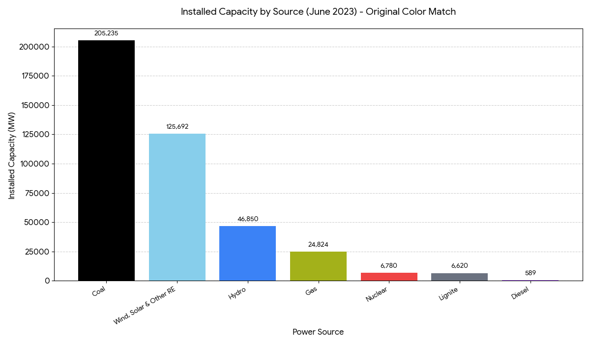
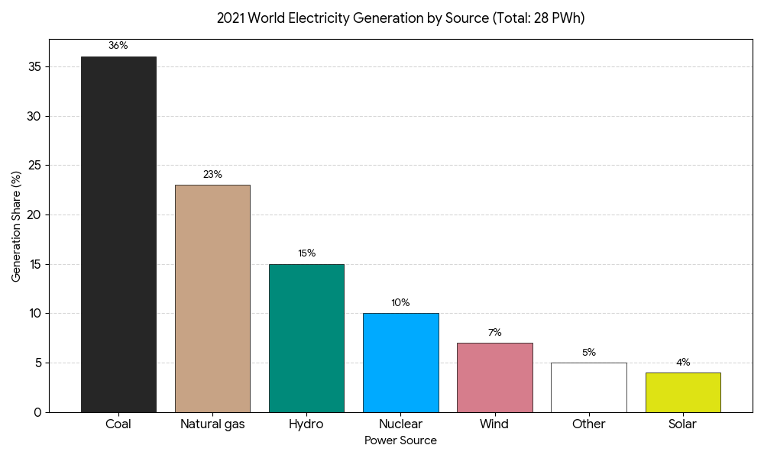
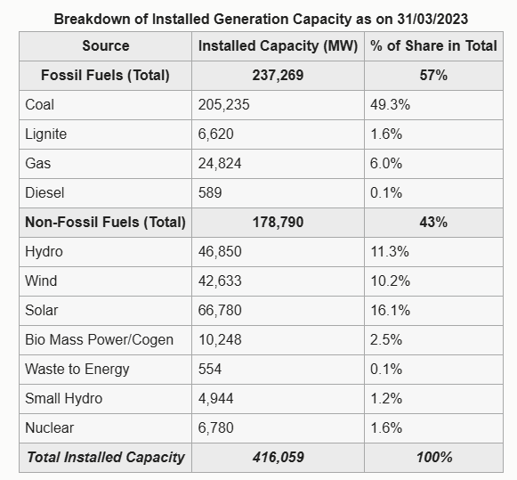
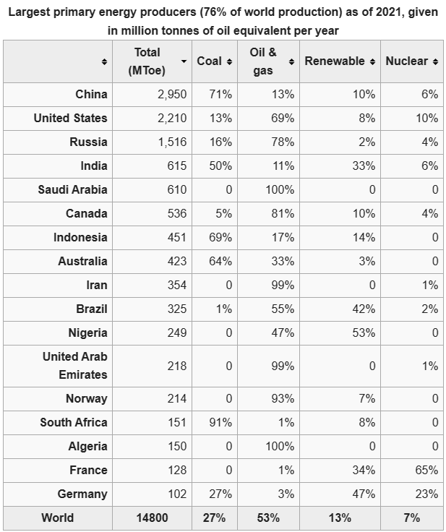
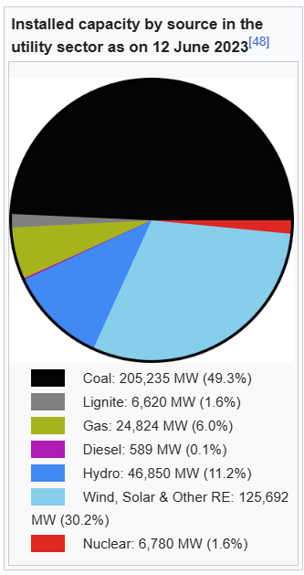
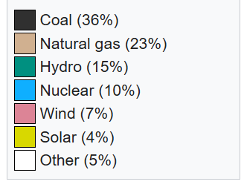

Energy Landscape – The Thermal Reality
2021 world electricity generation by source. Total generation was 28 pentawatt hours
Installed capacity by source in the utility sector as on June 2023

Slide 7
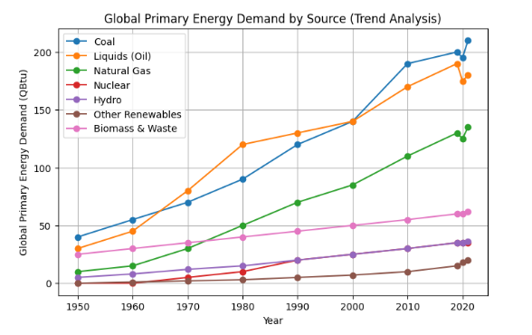
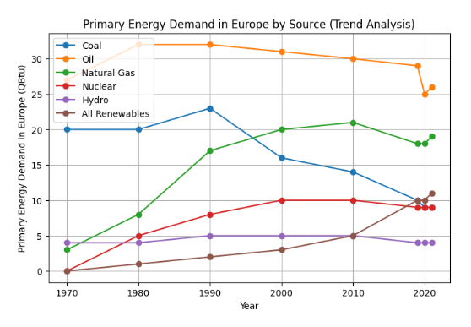
Energy Landscape – The Thermal Reality
Despite global pledges from governments and major corporations to adopt clean energy, the world continues to rely heavily on older energy sources.
While some leaders have initiated efforts towards energy transition, more action is urgently needed.
To avert the worst effects of climate change, energy transition must occur at a larger scale and faster pace
Policymakers and private sector leaders are committing to net-zero emissions, shifting energy systems in developed economies like Europe and North America.
However, experts emphasize the need for concrete actions to meet the target of limiting global warming to 2°C, let alone 1.5°C by the end of the century.
Despite global emissions and fossil fuel consumption remaining high, some regions, especially Europe, are progressing in energy transition, replacing fossil fuels with cleaner technologies.
The energy insecurity caused by Russia’s invasion of Ukraine has accelerated Europe’s move away from fossil fuels.

Slide 8
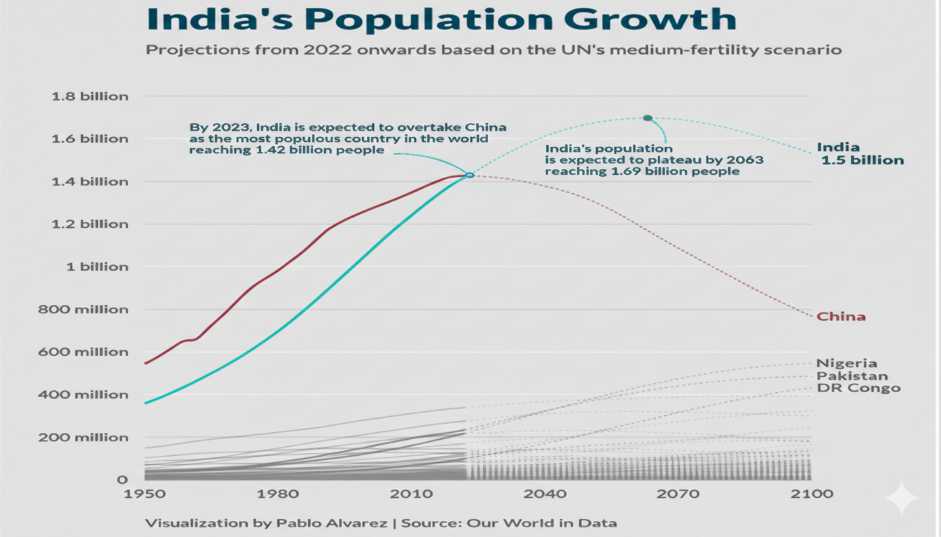
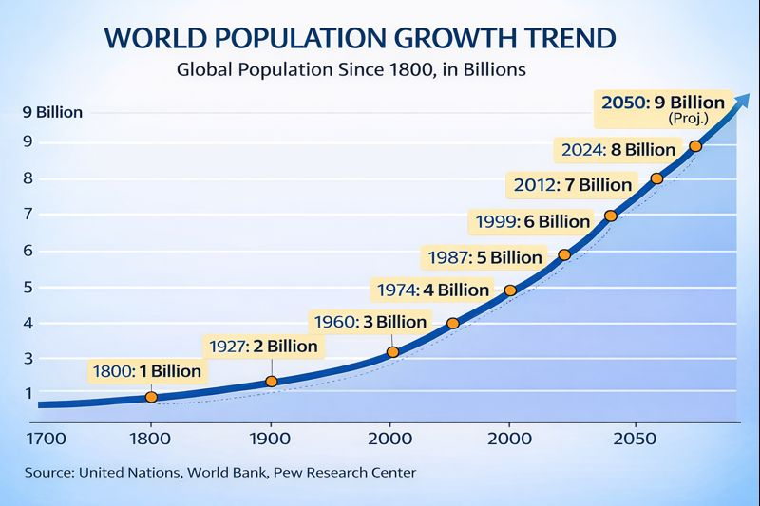
The Water-Energy Nexus: Driving Demand in an Era of Rapid Population Growth
India’s population trajectory
World population trajectory
Global Increase Index
Implications of Population Growth on Water Demand in India
Global Population Growth: The global population is expected to reach approximately 9 billion by 2048, marking a significant increase.
Population Increase Percentage: This represents a 12.5% increase in the global population over the period leading up to 2048.
Pressure on Resources: With such an increase in population, there will be greater demand for essential resources, including food, water, energy, and infrastructure.
India’s Population Growth: By 2048, India’s population is projected to reach approximately 1.62 billion, marking a 15% increase in the country’s population.
Population Growth by 2035: India’s population is expected to grow by 7.5% by 2035, adding an estimated 120 million people.
Increased Water Demand: By 2035, an additional 8.4 million cubic meters of water per day will be required to meet the needs of the growing population.
Pressure on Water Resources: The increase in population will intensify pressure on India’s already strained water resources, necessitating enhanced water management and conservation strategies.

Slide 9
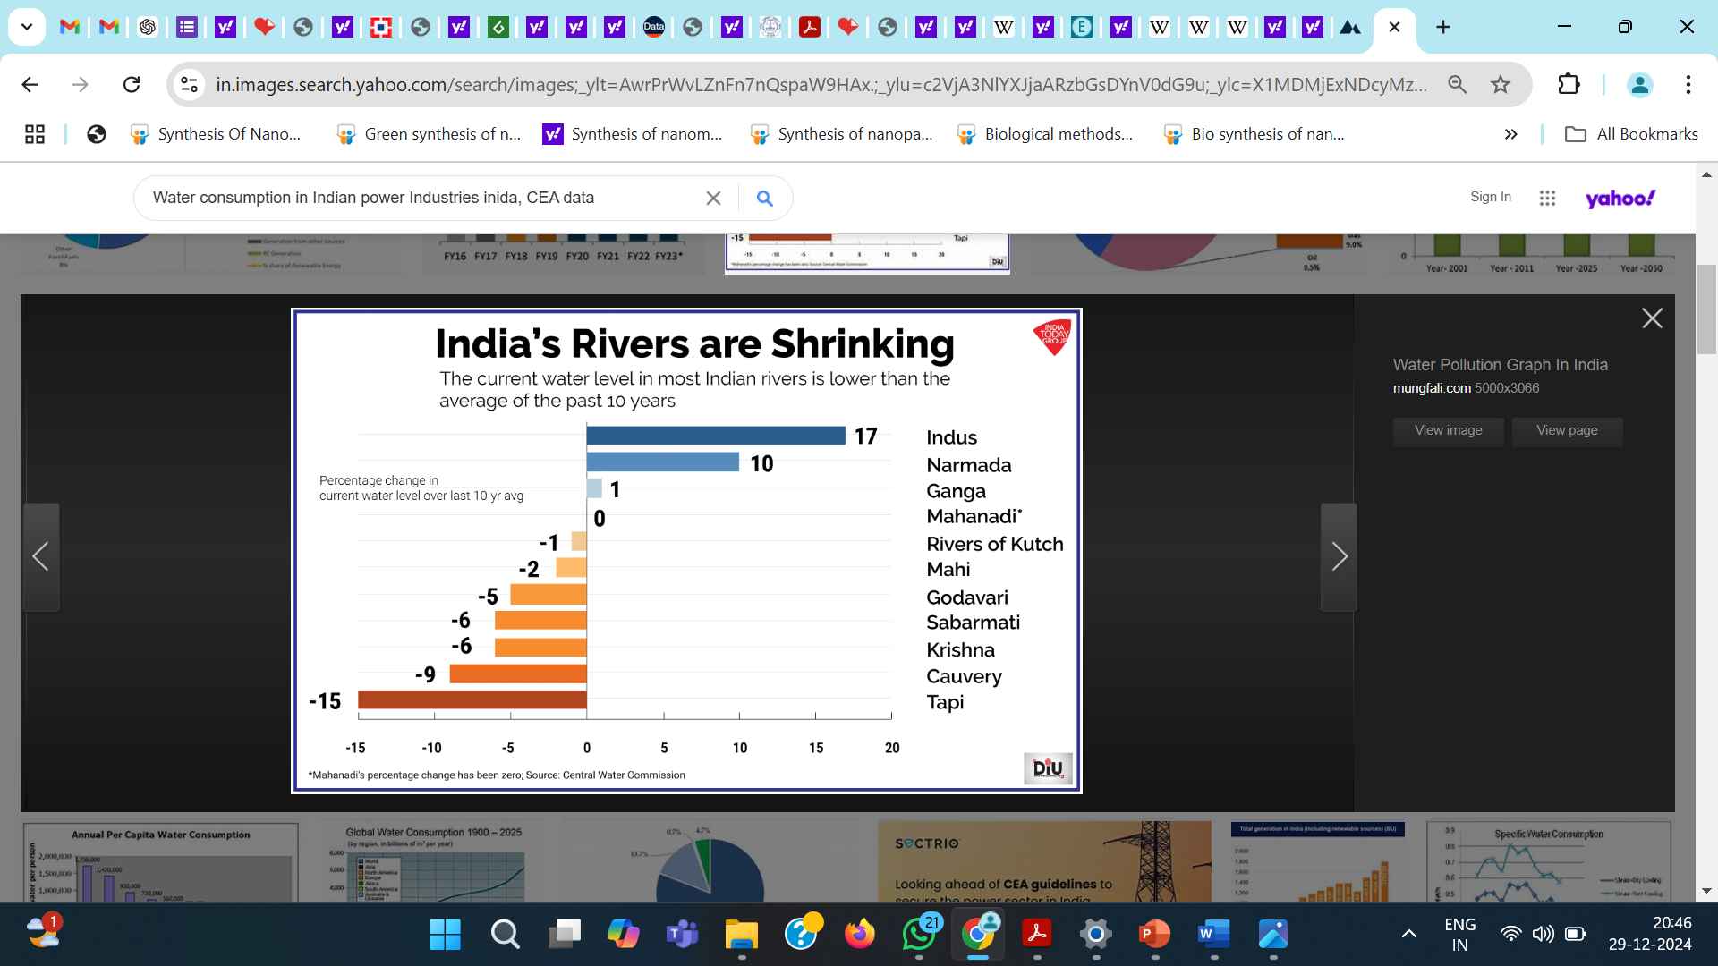
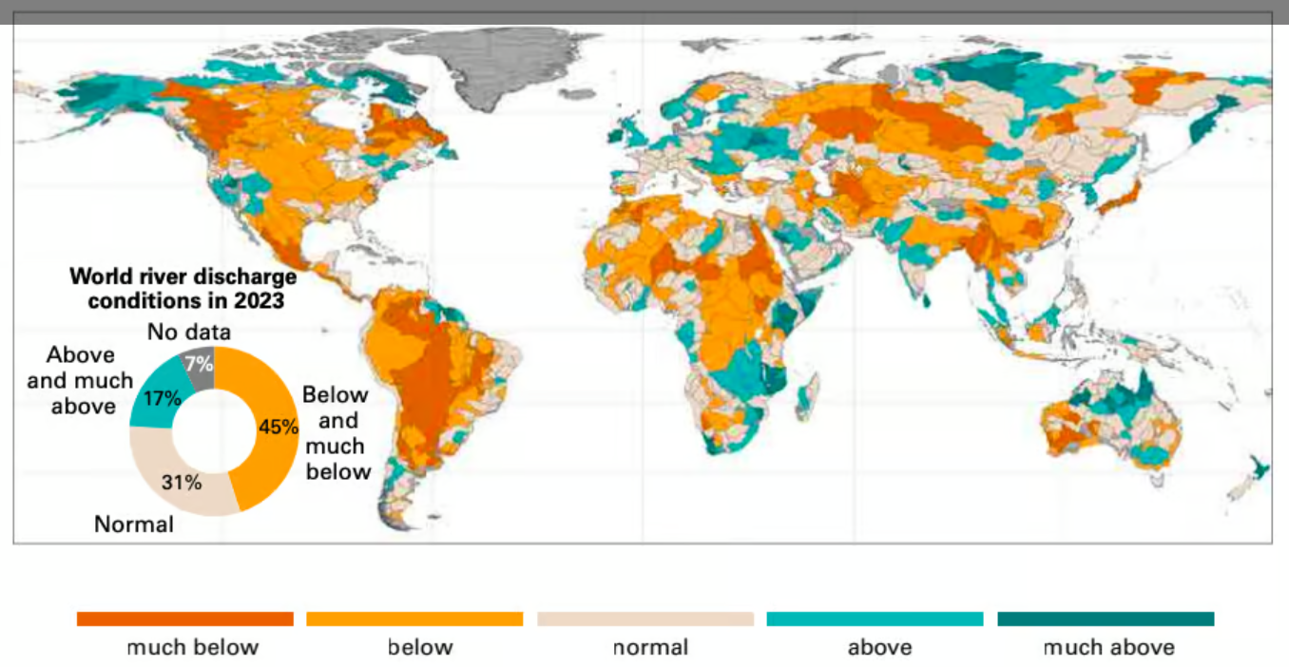
The Global & National Water Crisis
Global Water Resources Under Stress: Alarming Trends Highlighted by WMO Report 2024
The state of global water resource by the World Metrological Organization (WMO) 7Oct 2024,
The report highlighted severe stress on global water supplies.
Increasing temp & widespread dry condition resulted in rivers mostly facing conditions that were drier-than-average to average for river discharge.
More than half of global catchment areas in 2023 showed deviations from near-average conditions for river discharge, predominantly lower than average
Between 2015-2021 below- and much-below-average conditions affected North America (except Alaska), Central America and South America unstable management amid global challenges
Water for Prosperity and Peace: Ensuring Sustainable Management Amid Global Challenges
Large river basins such as those of the Ganga and Brahmaputra experienced lower-than-average conditions across almost their entire territories, Other Indian rivers also faces similar shrinking conditions
In an unstable world where security threats are growing, we must all recognize that ensuring the availability and sustainable management of water and sanitation for all – the aim of Sustainable Development Goal 6 – is essential for global peace and prosperity
The United Nations World Water Development Report 2024: Water for prosperity and peace highlights the wider significance of water for our lives and livelihoods. It explores water’s capacity to unite people and serve as a tool for peace, sustainable development, climate action and regional integration for securing sustainable management amid global challenges
Source: State of Global Water Resources, 2023

Slide 10
India’s Growing Water Stress
As per latest report by Ministry of Power, PIB Delhi, 25 July 2024
80000MW is to be implemented by 2032-2035.
Additional water demand for energy & community upto 2035
Water required for 80000 MW = 80000 MW *2.75 M3/HR/MW*24 = 5280000 M3/day= 5.2 Million M3/day (Source: MOEF 2.5 M3/hour/MW- 3 M3/hour/MW)
Water required for 12 Cr addiontal population = 12*10^6*70 liter/person/day 8.4 Million M3/day (50 litres to 100 litres) Source WHO
By 2035 – Total additional water demand for (Additional energy requirement + Indian Population growth) = (Approx) 13.6 Million m3/day.
Almost a tank of size 4.5KM (L) X 0.5KM (W) X 6M (H)
Projected Electricity Demand: By 2031-32, India’s electricity demand will necessitate significant expansion in power generation capacity.
Coal and Lignite Capacity Requirement: The required coal and lignite-based installed capacity by 2032 is projected to be 283 GW, a substantial increase from the current capacity of 217.5 GW.
Planned Capacity Expansion: To meet this demand, the Government of India plans to set up an additional 80 GW of coal-based power generation capacity by 2031-32.
Base Load Dependence: The expansion is aimed at addressing the base load requirements of the country, ensuring stable and reliable power supply for industrial, commercial, and residential needs.
Strategic Planning by CEA: The Central Electricity Authority (CEA) has conducted detailed generation planning studies to determine the necessary capacity expansion and to guide future investments in the energy sector.
Energy Security and Challenges: While addressing electricity demand, this expansion also highlights the importance of balancing energy security with environmental sustainability and exploring clean coal technologies to reduce emissions.

Slide 11
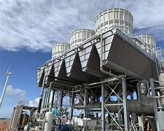
NEED OF THE HOUR
“Air-Cooled Condensers — A Sustainable Solution for Water-Stressed Power Plants”
https://youtu.be/-kq9ubk4sTE

Slide 12
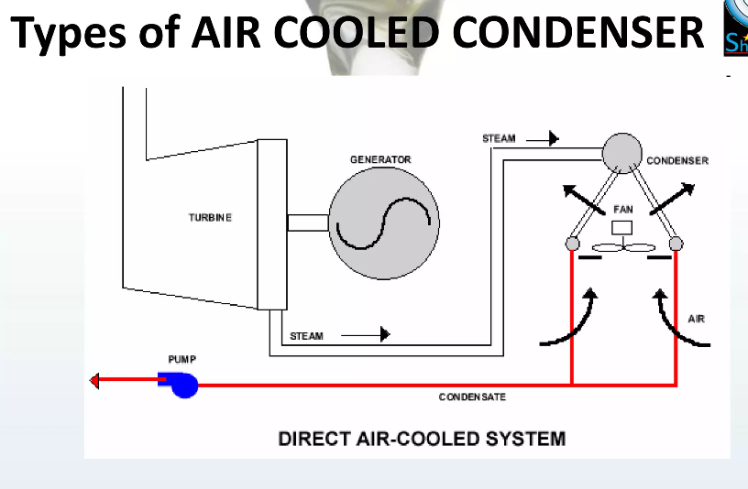
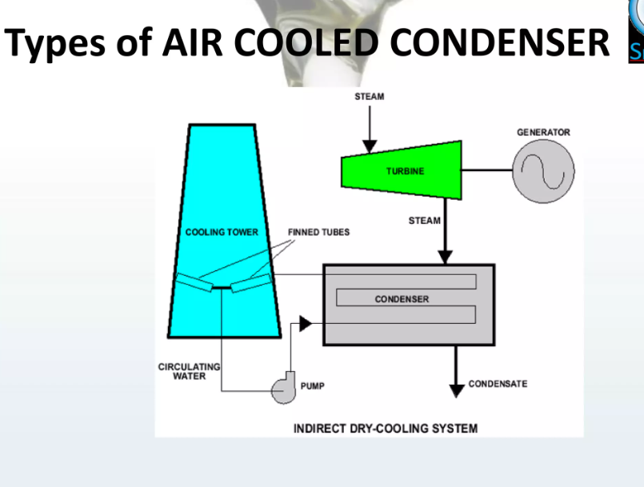
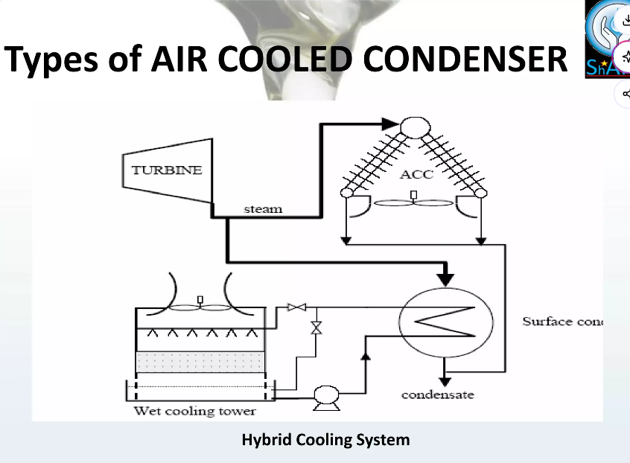
Air Cooled Condensers
Direct Air-Cooled Condenser (Direct ACC): Most common type in thermal power plants
Working principle:
Exhaust steam from turbine flows directly into finned tubes
Axial fans force ambient air over tubes
Steam condenses inside tubes and flows back as condensate
Features:
No cooling water required
Large A-frame structure
Suitable for water-scarce regions
Applications: Coal, gas, biomass, and CSP power plants
Direct air cooled system
Indirect Air-Cooled Condenser (Indirect ACC)
Working principle:
Steam is first condensed in a surface condenser
Cooling is provided by air-cooled heat exchangers using circulating water
Works like a dry cooling tower system
Features:
Better vacuum control than direct ACC
Less sensitive to wind
Higher capital cost
More compact than direct ACC
Applications: Large utility plants where better performance control is needed
Indirect dry cooled system
Hybrid Air-Cooled Condenser (Wet–Dry System)
Working principle:
Combination of air cooling + evaporative cooling
Operates dry during normal conditions
Uses wet cooling during peak temperature periods
Features:
Reduces water consumption by 70–90%
Maintains performance in hot weather
Higher system complexity
Applications: Regions with seasonal water availability
Indirect dry cooling system

Slide 13
Air Cooled Condensers
Potential Assumptions and Positions of the Purchaser
Potential Assumptions and Positions of the Supplier
The purchaser or their representative assumes that the supplier of the equipment is fully aware of and has incorporated in their bid the features and impacts of the site and process wherein the equipment must perform, and that they have sufficient experience and design expertise to extrapolate from one site or experience to the next.
The purchaser assumes that all suppliers have the same understanding of the technology they are proposing and are essentially offering the same solution or performance, albeit potentially at different price points.
The purchaser or their representative may unwittingly discourage technology innovation by requiring a minimum number of installations or years of experience for such offerings.
The purchaser assumes that the equipment proposed to meet their specification will perform in accordance with their expectations under a variety of ambient and plant conditions.
The purchaser concludes that the lowest priced option is the best long-term selection for their plant.
The purchaser attempts to assign all of the risk of performance and operation to the supplier of the equipment, despite the lack of operating experience for such equipment at the purchaser’s site and under circumstances that might be present there.
Based on historical precedent, if the supplier does not submit a low-price offering, they will not be successful in their bidding efforts.
The suppliers/bidders assume that they must meet all requirements of the specification or otherwise be disqualified from the bid process (i.e., make no exceptions to the specification).
They may assume that any features or safety margins added to their bid offering would render them less competitive, even though these features or safety margins may ultimately be in the best interest of the purchaser.
They may be less apt to offer innovative solutions or advancements in the technology for fear of adding costs to their offering or exposing themselves to additional risk in execution or performance.
They must seek any opportunity to reduce risk in an environment where profit margins are typically low and performance penalties may be significant.

Slide 14
Design aspects : Lack of Consolidated Design Guidance
Air-Cooled Condenser: Design and Performance Standards
Problem
No unified industry guideline exists for wind-aware ACC design
Architect/engineers rely on vendor claims or past projects
Lessons learned are not codified into specifications
Impact
Repeated design mistakes across projects
Inconsistent performance from plant to plant
Difficult performance troubleshooting
Solution
Providing a validated input required to establish simplest ACC design point at duty point
Develop wind-inclusive ACC specification clauses
Use standardized checklists for bid evaluation
Require vendors to submit:
  Wind CFD reports
  Mitigation design drawings
  Performance degradation curves vs wind speed
Adopt best-practice documents from EPRI, ASME, or site-specific studies
Minimum amount of authentic input required to establish simplest ACC design point at duty point
  Steam flow kg/sec
  Steam quality %
  Turbine back pressure (in HgA/kPa)
  Ambient dry-bulb temperature T_{amb} ℉/℃
  Site elevation, ft (m) above sea level
Reference

Slide 15
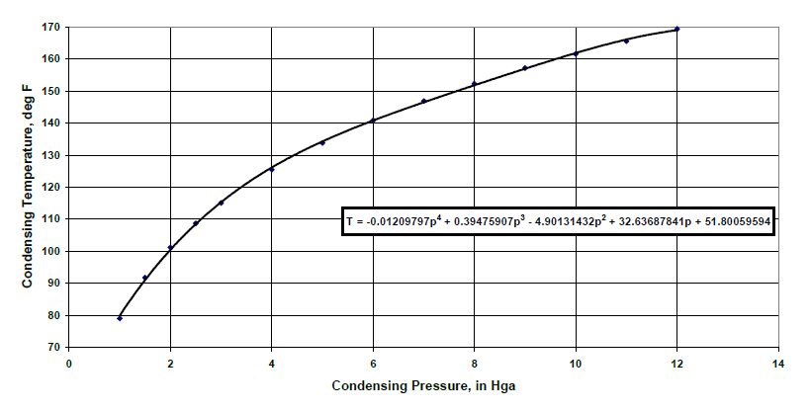
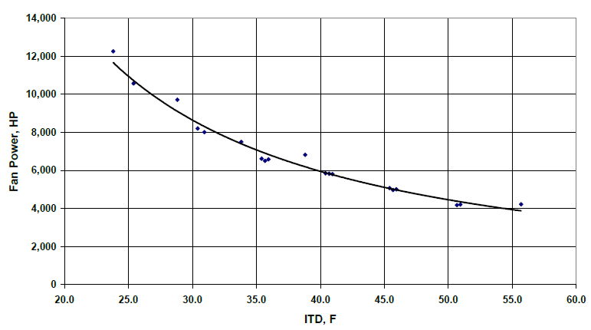
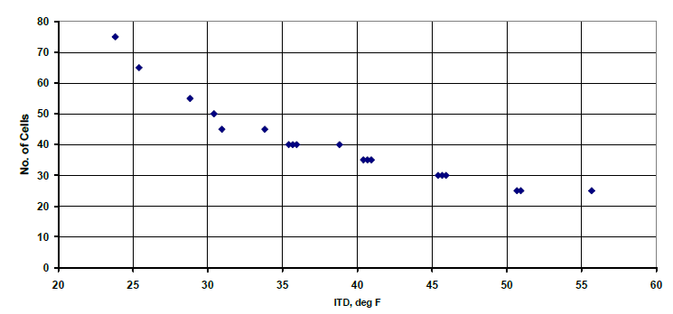
Air-Cooled Condenser: Design and Performance Standards
Condensing Temperature vs. Condensing Pressure
Design Fan Power vs. Initial Temperature Difference
ACC Performance Characteristics
The ACC design point is frequently characterized by the difference between the condensing
temperature (Tcond) and the entering air temperature (Ta inlet), known as the initial temperature
difference (ITD).
ITD = Tcond – Ta inlet
For a given ACC, the heat load Q [Btu/hr (W/s)] is related to the ITD by
Q/ITD = Constant
Alternatively, for a given heat load, the size (number of cells, heat transfer surface) is inversely
related to the ITD as
ACC “Size” α 1/ITD β
where a low ITD corresponds to a large ACC.
Air-Cooled Condenser Size vs. Initial Temperature Difference

Slide 16
Design aspects related to Ambient Wind Impact on ACC Performance & Their Solutions
Air-Cooled Condenser: Performance Deviation under Adverse Ambient Conditions
Problem
ACC performance is usually specified using ISO design conditions (no wind or uniform airflow assumption).
Bidders often optimize designs assuming ideal airflow, ignoring real site wind profiles.
Owner/operators lack access to validated wind-performance correction data.
Wind effects are rarely included in performance guarantees, leading to disputes post-commissioning.
Impact
Actual turbine backpressure higher than design
Failure to meet guaranteed output during windy conditions
Financial losses and operational dissatisfaction
Solution
Include site-specific wind rose data in tender documents
Require wind sensitivity analysis as part of bid evaluation
Mandate CFD-based airflow modeling for all shortlisted bidders
Specify performance guarantees with wind correction factors

Slide 17
Design aspects: Hot Air Recirculation Due to Prevailing Winds Problem
Air-Cooled Condenser: Performance Deviation under Adverse Ambient Conditions
Design aspects : Airflow Maldistribution Across ACC Modules Problem
Problem
Crosswinds and oblique winds cause:
  Recirculation of hot exhaust air into fan inlets
  Local temperature rise of 3–10°C
ACC layout orientation often ignores dominant wind direction
Impact
Sudden loss of vacuum
Uneven module performance
Fan power increases with no heat transfer benefit
Problem
Wind causes uneven air mass flow across different ACC cells
Some fans operate in stall while others are underutilized
Leads to non-uniform steam condensation and tube stress
Impact
Reduced effective heat transfer area
Long-term tube fatigue and leaks
Increased maintenance frequency
Solution
Install wind walls, louvers, and flow guide vanes
Optimize ACC orientation based on dominant wind direction
Elevate ACC structure to reduce ground-level turbulence
Use CFD-based retrofit design for existing plants
Solution
Use fan inlet bells and flow straighteners
Apply VFD-based fan control to balance airflow
Install module-level performance monitoring
Redesign steam distribution headers for uniform flow

Slide 18
Design aspects : No Evaluation of Mitigation Methods During Bid Stage
Air-Cooled Condenser: Performance Deviation under Adverse Ambient Conditions
Design aspects : Absence of Performance Monitoring for Wind Effects
Problem
Mitigation options (wind walls, guide vanes, hybrid layouts) are treated as add-ons
Not evaluated in L1 bidding
Leads to lowest-cost but underperforming designs
Impact
Higher lifetime O&M costs
Reduced plant efficiency
Expensive post-installation retrofits
Problem
Most plants lack:
  Inlet temperature mapping
  Wind speed/direction correlation with backpressure
  Real-time ACC performance diagnostics
Impact
Operators cannot distinguish wind impact from fouling or load issues
Incorrect operational decisions
Delayed corrective actions
Solution
Evaluate bids on lifecycle performance, not just CAPEX
Assign technical weightage to:
  Wind mitigation strategy
  Demonstrated similar site performance
  Proven CFD validation
Make mitigation mandatory, not optional
Solution
Install wind sensors integrated with DCS
Develop ACC performance dashboards
Use AI/analytics to correlate wind data with backpressure
Enable predictive fan control based on wind direction

Slide 19
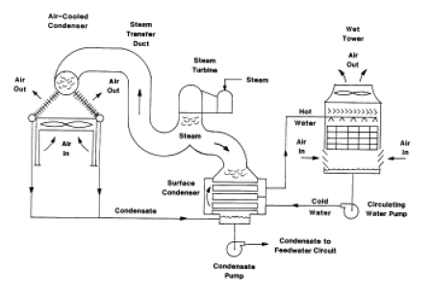
Optimal Design Selection for Air-Cooled Condenser Systems
System Design: Features a shell-and-tube surface condenser and wet cooling tower operating in parallel with an Air-Cooled Condenser (ACC).
Self-Balancing Operation: Steam flow automatically divides to equalize condensing pressures across both the ACC and the surface condenser.
Peak Load Mitigation: During high-ambient periods, the wet tower draws steam load away from the ACC to significantly lower turbine backpressure.
CAPEX Optimization: Permits a smaller, more cost-effective ACC footprint compared to an all-dry design.
Infrastructure Requirement: Incurs costs for a scaled-down wet-cooling circuit, including pumps, piping, and water treatment systems.
Hybrid (Dry/Wet) Cooling System

Slide 20
Challenges, Impact And Techno-commercial Aspects
Dry Cooling System
Wet Cooling System
Techno-Economic Aspects
Sl. No. | Challenges | Impact
1 | Temperature limitations | Temp rise
2 | Large foot print area | Require 15% larger surface areas
3 | Seasonal variability | Slight Efficiency variation.
4 | Potential for heat Island | Localized increases in ambient air temperatures,
5 | Air Emissions: | pollutants need to be monitored and controlled.
6 | Land use Impact | Impact local ecosystems and habitats.
Sl. No. | Challenges | Impact
1 | Water Consumption | Make-up water concerned- Sustainability threat
2 | Water Quality Maintenance | water quality challenges & mitigation.
3 | Freezing in Cold Climates | Freezing of water within the cooling system.
4 | Blowdown Discharge | The discharge must comply with environmental regulation
5 | Air Emissions: | Adequate control measures.
6 | Space Requirements | Require substantial space.
Sl. No. | Wet Cooling | Dry Cooling | Remarks | Way Forward
Generation output | 500MW | 465MW | 7% reduction in dry cooling system | Hybrid Cooling system
Thermal efficiency | 38% | 35.5% | 2.5% reduction In dry cooling system | Hybrid Cooling system
Coal consumption | less | High | 7 % increase Dry cooling System | Coal transportation through proper site selection
CO2 emission | 0.9 kg/kWh | 0.96kg/kWh | 7% increase in CO2 emission | Green belt
Foot print | less | high | 10% higher in dry cooling system | Reduction in Cooling System structures
Capex | less | high | 15% higher in dry cooling system | Reduction is Cooling system & reduced treatment, reduced raw water reservoir and Intake system
Tariff | less | high | 8% to 9% high for dry cooling system | Offset

Slide 21
Comparative Benefits: ACC & Hybrid vs. Conventional Wet Cooling
Feature | Conventional Wet Cooling | Air-Cooled Condenser (ACC) | Hybrid Cooling (Parallel)
Water Conservation | Poor: High evaporation and blowdown losses (~2.5 $m^3/MWh$). | Excellent: Zero water used for cooling. | Balanced: Saves 70-90% water vs. wet systems.
Siting Flexibility | Limited: Must be near rivers/canals to ensure intake. | Total: Can be installed in arid/remote areas close to fuel sources. | High: Needs only minimal makeup water for peak periods.
Fuel/Coal Logistics | Higher Cost: Often requires transporting coal to water-rich sites. | Lowest Cost: Plants can be located at the coal mine head (Pit-head plants). | Reduced Cost: Strategic siting is possible near fuel sources.
Intake Infrastructure | Requires intake wells, pump houses, and deep piping. | Eliminated: No intake systems or discharge lines required. | Minimized: Scaled-down pumps and smaller piping.
Raw Water Reservoir | Large footprint required for storage/drought buffers. | Eliminated: No requirement for a cooling water reservoir. | Small: Minimal storage for "wet-trim" operation only.
Cooling Tower & Circulation | Large wet towers, massive basins, and high-volume CW pumps. | Eliminated: Replaced by fan-driven air heat exchangers. | Hybridized: Compact wet section used only during heat peaks.
Maintenance & Scaling | High: Regular descaling, chemical dosing, and biofouling control. | Low: No water contact; no chemical treatment or fouling issues. | Moderate: Reduced chemical usage due to limited wet mode runtime.

Slide 22
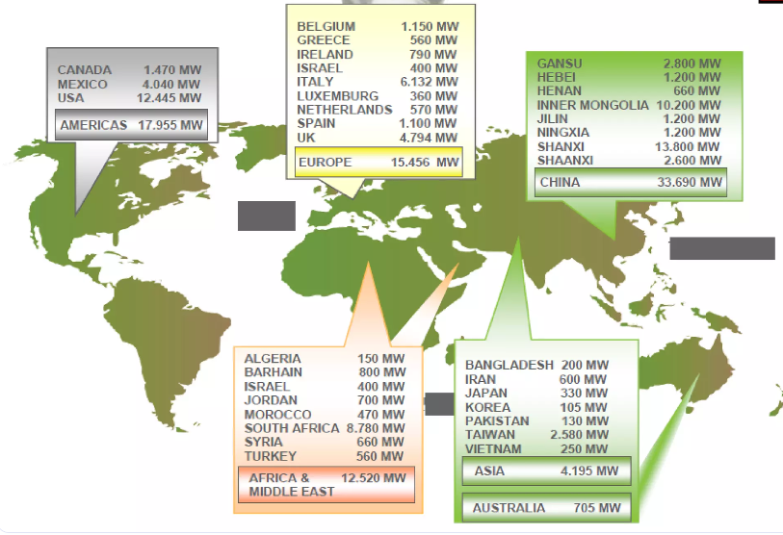
Emphasis And Recommendations
Global Stations Running on Air Cooled Condensers
Promote proactive collaboration among utilities, technology providers, EPC contractors, and policymakers to accelerate innovation and ensure effective deployment of air-cooled condenser systems.
Prioritize investment in research and development to improve ACC performance under high ambient temperatures, varying wind conditions, and part-load operation.
Encourage and incentivize the adoption of ACCs as a sustainable alternative to water-intensive cooling, supported by policies that facilitate the deployment of advanced materials, designs, and digital monitoring tools.
Undertake comprehensive feasibility and site-specific studies, build strategic partnerships with ACC technology suppliers, and invest in capacity building and workforce training to ensure reliable operation and long-term performance.
Establish mechanisms for continuous monitoring, performance evaluation, and knowledge sharing to identify improvement opportunities, optimize operation, and scale successful ACC implementations across the power sector.
Stations Running on Air Cooled Condensers
Power Plants
2X350MW Ind Bharath Power India Ltd., Orissa
135 MW KSK Energy, Rajasthan
81.5 MW Sarda Energy, Siltara plant
Captive Power Plants
Birla White
Jaypee Group
J.K. Laxmi
Shree Cements
Ultratech Cements

Slide 23
Md Sohail@ Mechanical (AGM) _ Bangalore

