Slide 1
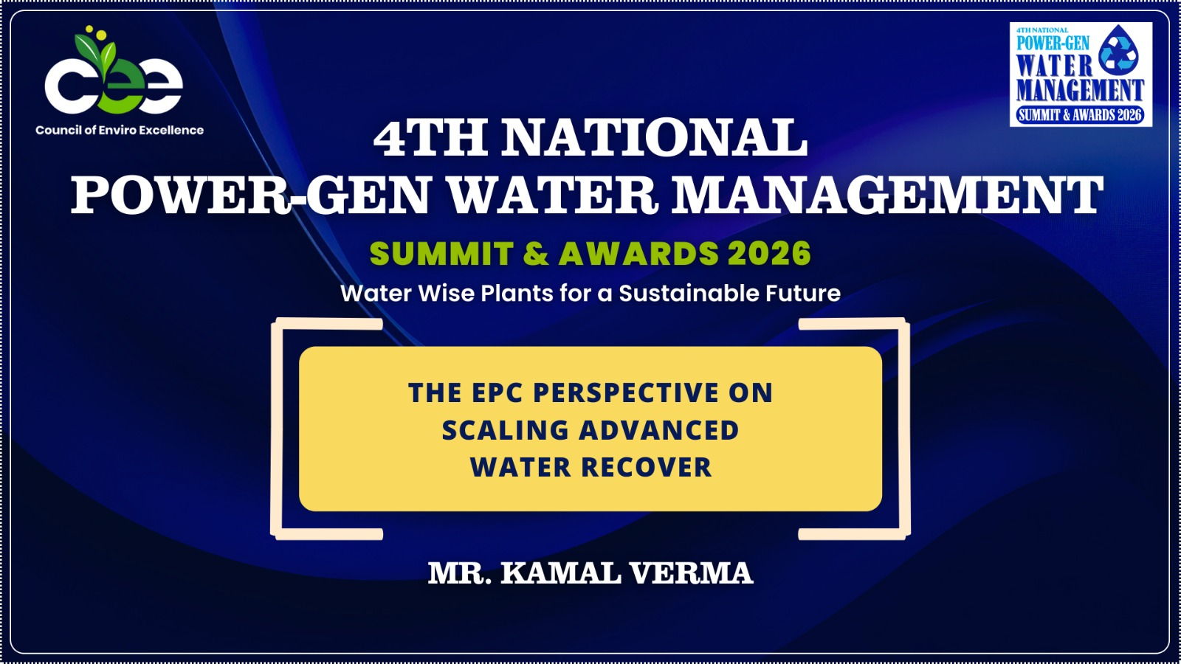

Slide 2
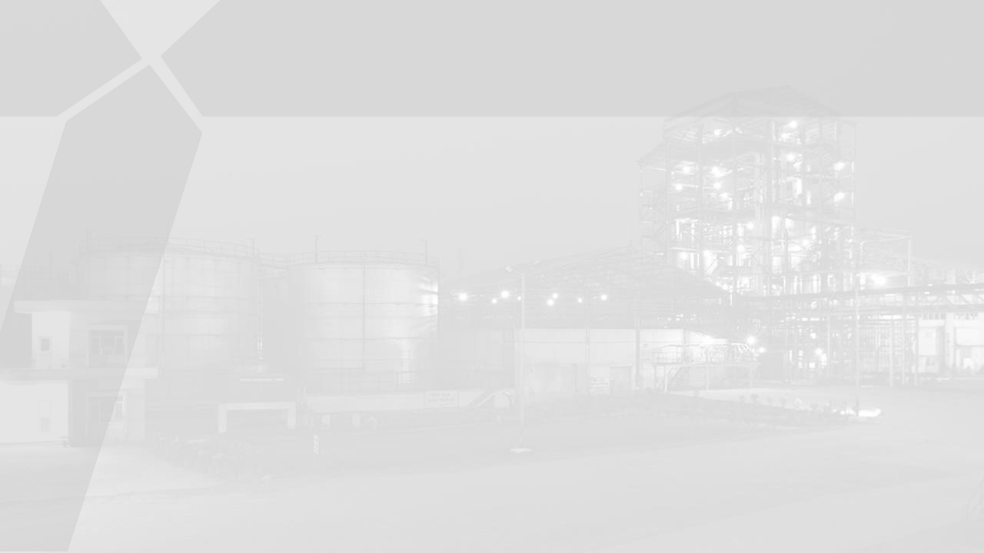

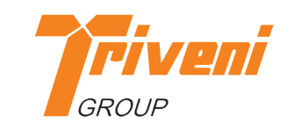
CEE 4th National Power-Gen Water Management Summit and Awards 2026
EPC perspective on scaling advanced Water Recovery
02-February-26

Slide 3
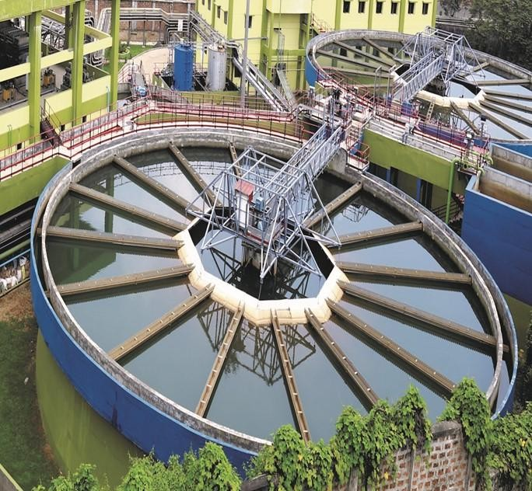
CONTENTS
About Triveni Group
Challenges in Water sector
Water in Circular Economy
Water consumption in Indian Industries & TPPs
Key source of Wastewater generation in TPPs
ZLD- process, technologies, and challenges
MEE and MVR
Triveni’s Expertise in ZLD
Water Business Group
KEY FACTS
1,500 | ~ 12,200 MLD | 2,000 +
Installations across various segments | Water & Wastewater treated through Triveni projects | Process equipment supplied and commissioned ²

Slide 4












About Triveni Group
Triveni Engineering & Industries Limited
Triveni Turbine Limited
Sugar
Engineering
Product
Aftermarket
Market Cap – US$ 3 billion Revenue (FY’25) – US$ 855 millions Employees – 7500+
Credit Rating – AA+
Sugar
Alcohol
Power
Transmission
Water

Slide 5
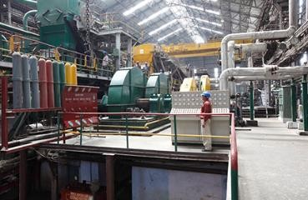
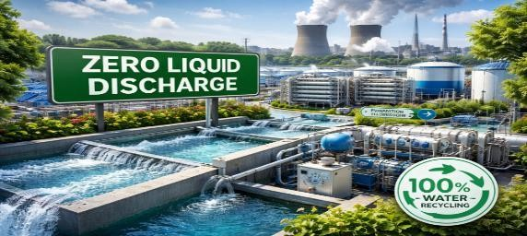
Triveni Group Fact Sheet
Triveni Engineering & Industries Ltd. is a 94 years old Listed Indian diversified Conglomerate with total FY’25 revenue of Rs. 5689 Crores (US$ 665 millions).
Water Business commenced operations in 1984.
One of the leading solution provider for advanced water & wastewater treatment, recycle & reuse of wastewater and Zero Liquid Discharge (ZLD).
Over 2000 numbers of process equipment for water & wastewater treatment applications, supplied & commissioned till date.
Approx. 12,200 MLD of water & wastewater is treated through our EPC projects & equipment.
Inhouse expertise in leading technologies like SBR, Ultra filtration (UF), Reverse Osmosis (RO), Moving Bed Bio Reactor (MBBR), Zero Liquid Discharge (ZLD) & others.
Project offerings on EPC, DBO and PPP/ Hybrid
Annuity Model (HAM) basis.

Slide 6
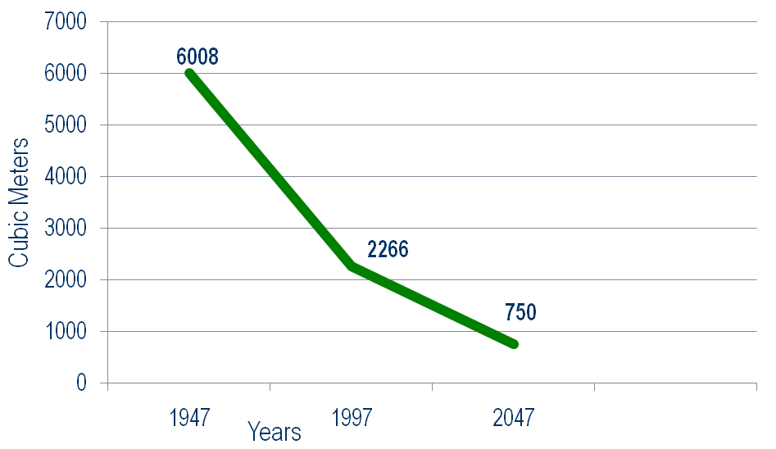
Challenges in Water Sector in India
India is home to 18% of world’s population while it
holds only about 4% of global water stock.
Almost every single city and village in the country has lost its wetlands, water bodies and even rivers to encroachment to meet the needs of rising population.
Over exploitation of Groundwater – India extracts more than China & USA combined. More than 50% of total clean water is met by it.
Wastage of Water - India needs a max. 3,000 BCM of water a year while it receives 4,000 BCM of rain but India captures only 8% of its annual rainfall, among the lowest in the world.
India has also been poor in treatment and re-use of household wastewater. About 80 per cent of the water reaching households in India are drained out as waste flow through sewage to pollute other water bodies including rivers and land.
India, which had enough drinking water in 1947 at 6,008 M³ per person per year, is becoming a water-deficient country.
More than 75% decline in last 74 years
In 2021, Per Capita Water Availability
was 1486 M³ / year

Slide 7


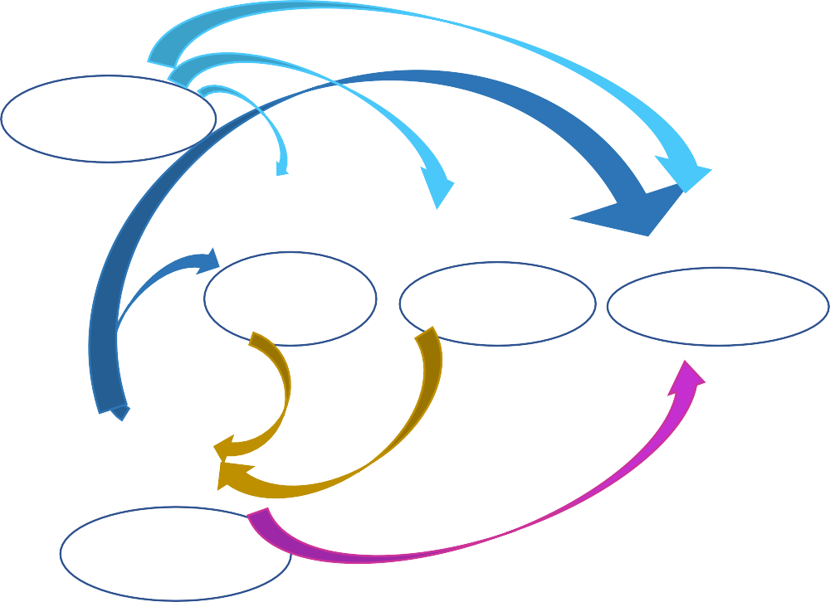







Water in Circular Economy- Recycle & Reuse and ZLD
With stricter regulations from the Central & State Pollution Control Boards (CPCB and SPCB) and growing sustainability mandates, industries are adopting Zero Liquid Discharge (ZLD) systems to recover, recycle, and reuse process water.
A ZLD system is an advanced wastewater treatment process designed to eliminate liquid waste by recovering and recycling water. The goal of ZLD is to ensure that no liquid effluent is released into the environment, thereby minimizing pollution and conserving water resources.
Water in Circular Economy
Potable water Wastewater
Non-Potable water Resources
Raw Water Source
Water Treatment
Industry
Municipal
Agriculture
Nutrients – for Agricultural purpose
Energy - for Industrial & Urban applications
Others - for Industrial & Manufacturing use
Wastewater Treatment

Slide 8
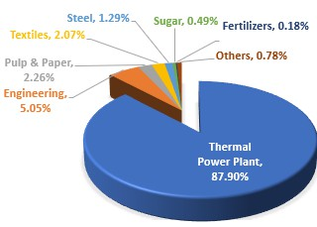
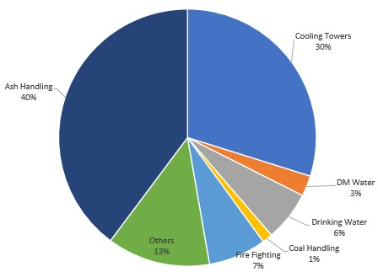
Water consumption in Indian industries and TPPs
TPP (M³/ MW) | Existing Specific Water Consumpti on (SWC) | Achievable Benchmark SWC
 |  | Short-term interventions | Long-term interventions
Small (Up to 1000 MW) | 2.3 - 3.9 | 1.5 – 3.4 | 0.5 – 2.7
Medium (Between 1000 to 2500 MW) | 1.9 – 6.5 | 1.3 – 3.0 | 0.3 – 1.6
Large (2500 MW and more) | 3.0 – 3.2 | 1.5 – 2.0 | 0.6 – 1.7

Slide 9
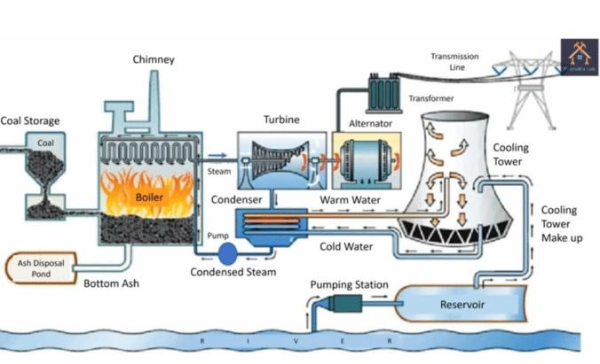
Key source of Wastewater generation in TPPs
Cooling Tower Blowdown: The largest volume of waste, containing high concentrations of dissolved solids due to evaporation.
Flue Gas Desulfurization (FGD) Scrubbers: Produces highly contaminated water containing mercury, arsenic, and selenium.
Ash Handling System: Slurry water used to transport
fly ash to ash ponds.
Boiler Blowdown/DM Plant Waste: Acidic/ alkaline waste from water purification (demineralization) processes.
Coal Pile Runoff: Contaminated stormwater runoff.
Floor/Equipment Washwater: Contains oil, grease, and suspended solids.

Slide 10








ZLD process flow
for recirculation to Industry / Plant
Industry / Plant
Wastewater
Pre Treatment
(Physical/ Chemical)
Reverse Osmosis (RO)
Clean
Water
Sludge
Pre Treatment
(Biological/ Filtration)
Brine
(High TDS)
Ultra Filtration (UF)
Evaporator (MEE/ MVR)
Remaining Solids after
Crystallization & Drying
Clean Water after
Condensate Recovery
9

Slide 11
ZLD - Components
Components | Purpose
Pre-treatment | Main goal of pre-treatment in ZLD is the elimination of Oils, TSS, COD and colour using filtration, sedimentation, or flocculation.
Ultra Filtration (UF) | Removes turbidity, SS, bacteria, colloids, large organic molecules and some viruses. Pore sizes ranging from 0.01 to 0.1 microns.
Reverse Osmosis (RO) | Removes Dissolved Salts. Pore sizes ranging from 0.0001 to 0.001 microns.
Evaporation | MEE/ MVR/ MSF
Crystallization & Drying | Crystallisers
Condensate Recovery | Collection/ Polishing Equipment

Slide 12
ZLD – Brine Treatment Technologies
Brine Treatment Technology | Electrical Energy (KWh/m3) | Thermal Energy (kWh/m3) | Total El. Equivalent (kWh/m3) | Max TDS (mg/L)
Multi-stage Flash (MSF) | 3.68 | 77.5 | 38.56 | 250,000
Multi-Effect Distillation (MED) | 2.22 | 69.52 | 33.50 | 250,000
Mechanical Vapor Re-compression (MVR) | 14.86 | 0 | 14.86 | 250,000
Electrodialysis | 6.73 | 0 | 6.73 | 150,000
Forward Osmosis | 0.475 | 65.4 | 29.91 | 200,000

Slide 13


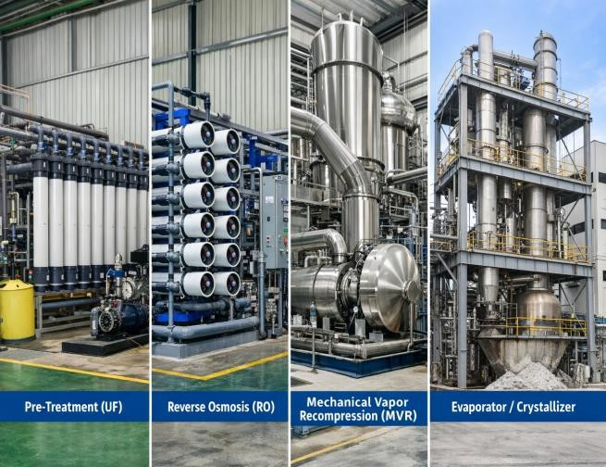

ZLD- Equipment-wise recovery contribution
Equipment | Recovery (%) | Removal
UF | 99% | TSS
RO | 90% | TDS
MEE / MVR | 99% | Evaporation
Overall | 99% | Recovery

Slide 14
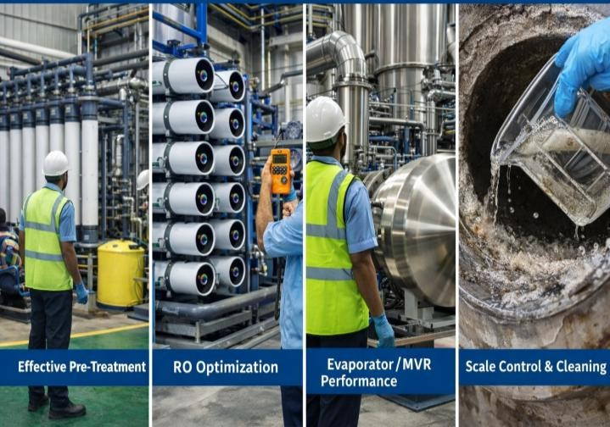
Critical points of Operation & Maintenance of ZLD Plant
UF
Maintain low TSS, BOD & COD.
Control oil & grease.
Ensure timely backwash & CIP.
RO
Maintain recovery within design.
Monitoring SDI , pH & scaling index.
Protects membranes from fouling.
Regular membrane cleaning (CIP).
MEE / MVR
Maintain consistent feed TDS.
Monitor heat transfer efficiency.
Prevent scaling on tubes.
Optimize compressor load.

Slide 15
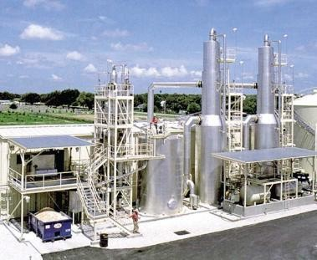
Challenges in ZLD Plants
Required complex pretreatment.
Need skilled operators.
Inconsistent raw effluent parameters.
Limited installation of MVR/MEE in TPPs.
High Capex for ZLD.
High Operating cost of MVR/MEE.

Slide 16
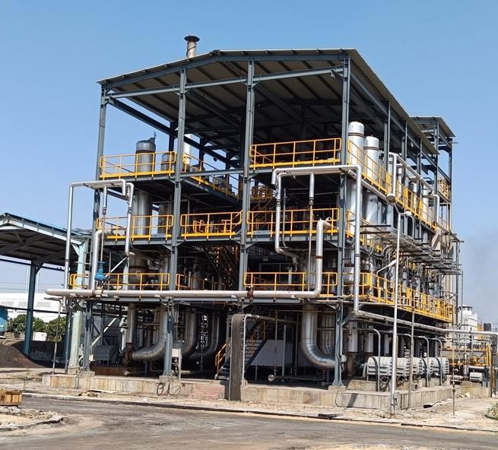
Multiple Effect Evaporator (MEE)
MEE offers superior energy efficiency by reusing latent heat from vapor in subsequent stages, reducing steam consumption by 30–60% compared to single-effect units. These systems significantly lower operational and capital costs, allow for high-capacity, continuous production, and enable sustainable, eco-friendly processing with reduced carbon footprints.
Benefits of MEE
Multi-stage evaporation
Steam economy improvement by utilizing
latent heat from vapor in subsequent stages.
Handles high TDS streams
Environmentally sustainable
Produces purest water

Slide 17
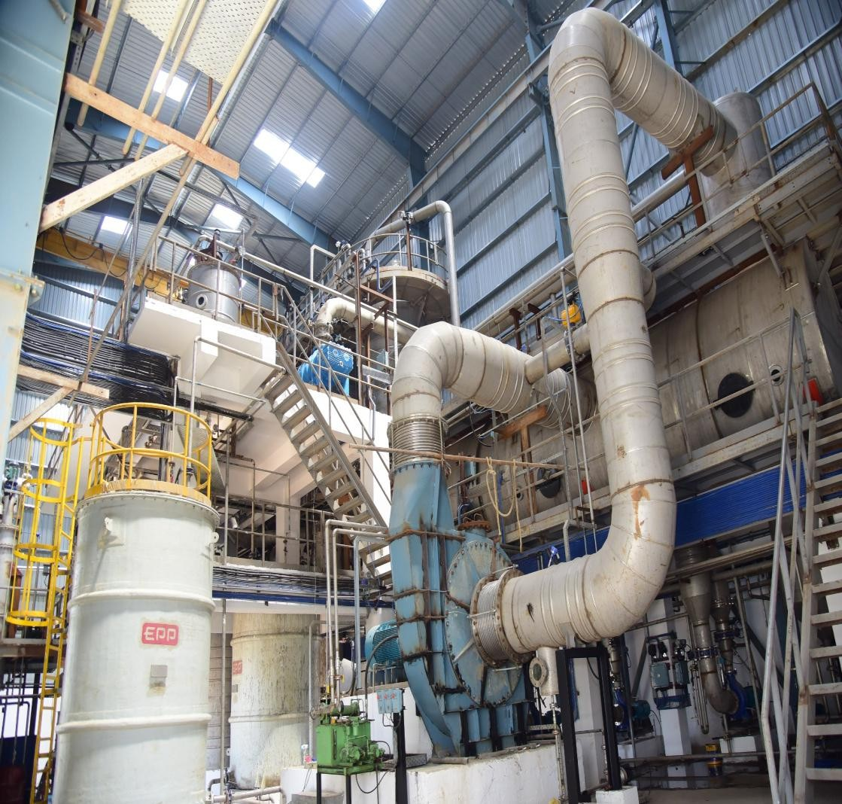
Mechanical Vapor Recompression (MVR)
MVR provides up to 90% energy savings compared to conventional evaporators by recycling latent heat, drastically cutting operating costs. It uses an electric compressor to raise vapor temperature/pressure, eliminating the need for large boilers. Key benefits include high water recovery (up to 95%), small footprints, and reduced CO2 emissions.
Benefits of MVR
Reuses vapour energy
Low steam consumption
Lower OPEX
Operational Flexibility
Environmentally sustainable
High product quality

Slide 18
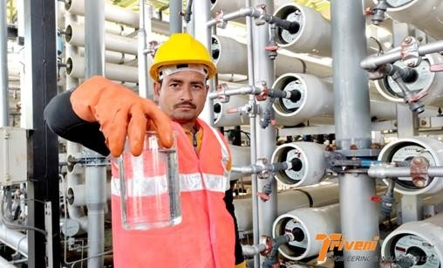
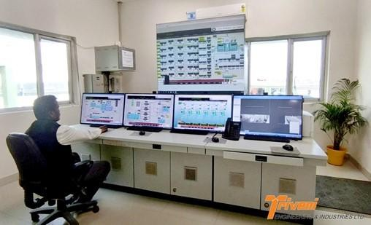
Triveni – ZLD Expertise
Complete EPC capability
Design, engineering, manufacturing, supply & commissioning
Automation & PLC/SCADA integration
Long-term O&M support
DBO/ PPP (HAM) formats

Slide 19
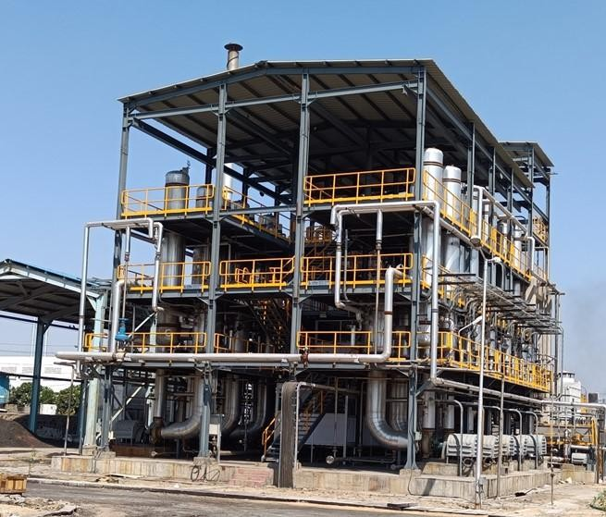
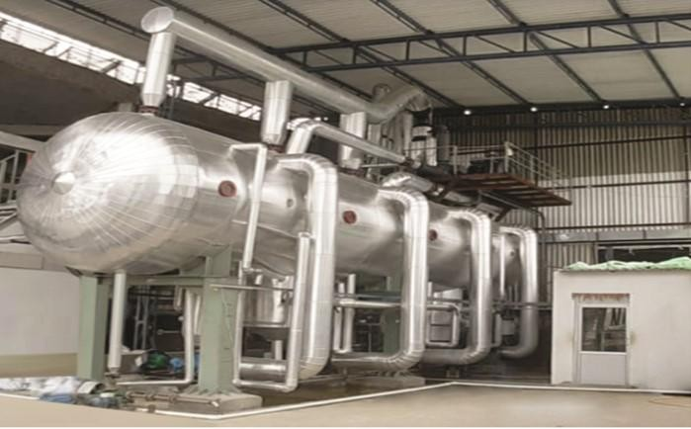
Wastewater Recycle, Reuse and ZLD Project Experience
5 MLD Recycling Plant at HPGCL- Hisar.
18 MLD Recycling Plant Package at APCPL, Jhajjar.
18 MLD ZLD Plant at Balotra with 1 MLD MEE.
6 MLD ZLD plant at RIICO with 0.36 MLD MVR.
7.2 MLD ZLD plant for RFCL

Slide 20

19

