Slide 1
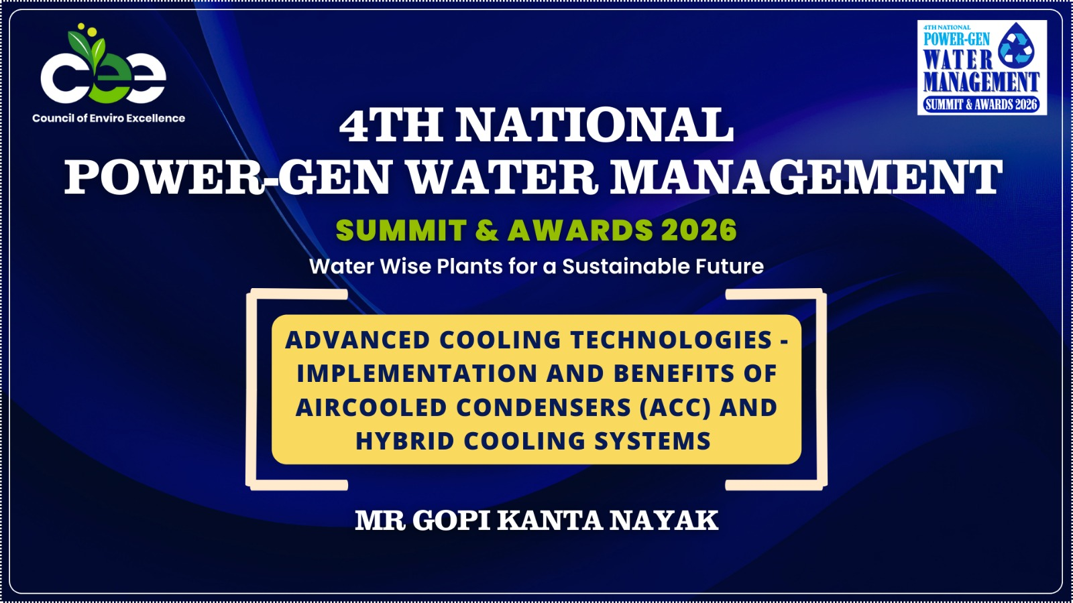

Slide 2
"Greening the Grid: Sustainable Pathways for Reliable Thermal Power"
"Principles, Technologies & Implementation Strategies for a Resilient and Water-Conscious Thermal Power Sector"
GK Nayak
Consultant
Ex-GM Chem-NTPC

Slide 3
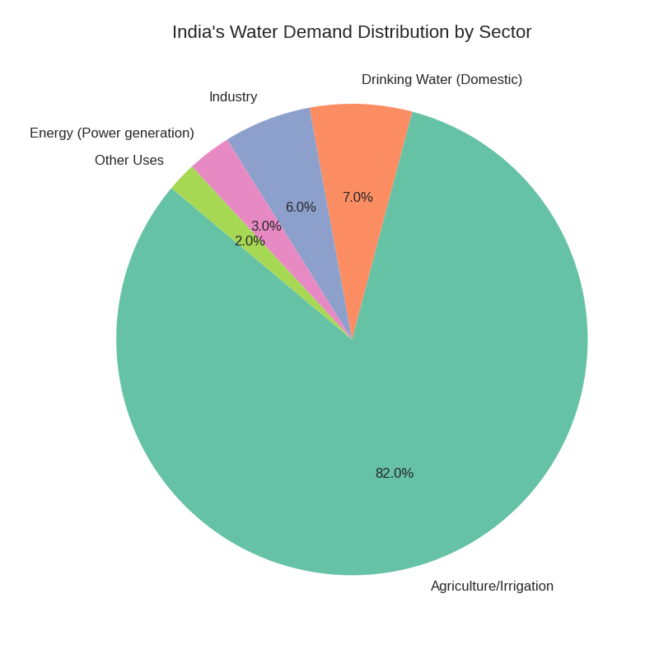

Slide 4
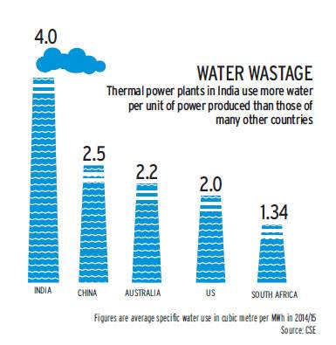
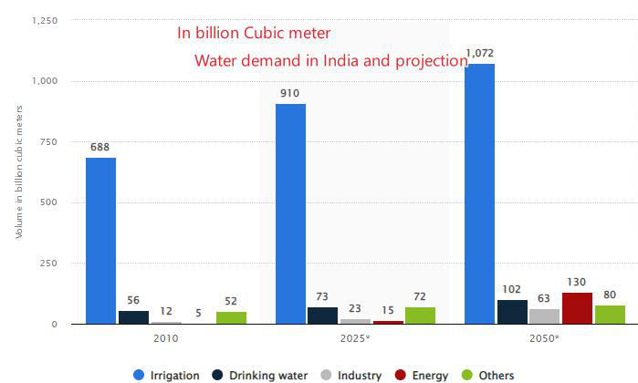
Water Use in India

Slide 6
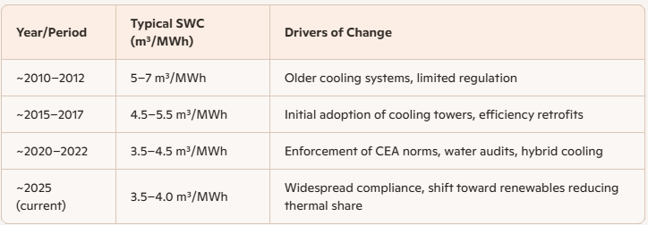
Trends in Specific Water Consumption (SWC) in India’s Power Sector

Slide 7
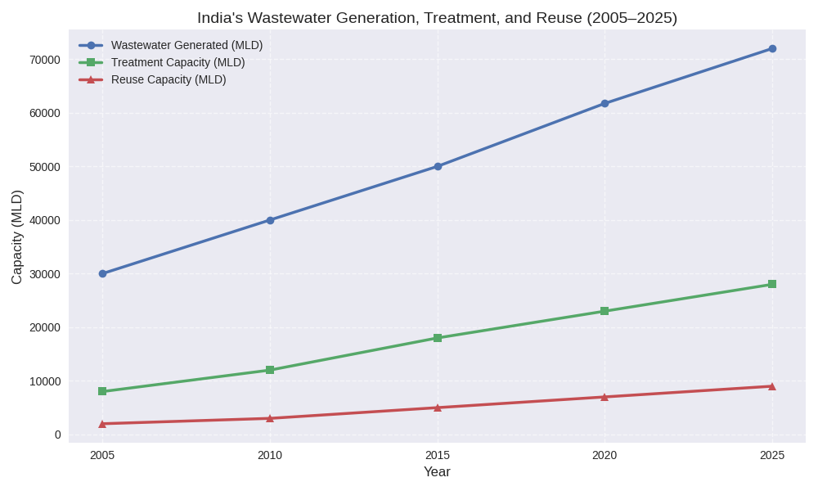

Slide 8
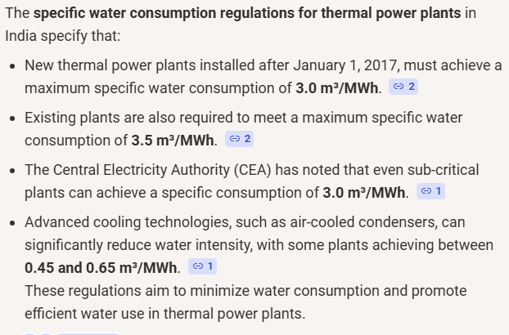

Slide 9
The Grand Trio
Sustainability
Reliability
Efficiency
We must understand even a single MW loss will complicate the water sp.cons index
Water
Energy
Cost effectiveness
Stakeholder’s satisfaction
Nation’s Goal

Slide 10
My Roles in the Nation wide water conservation efforts in thermal power plants
I initiated one thermal power plant water consumption study for one year in some chosen power plants
This project was supported by CEA designated EEC ( Efficiency Enhancement Centre). This becomes the base document for GOI to standardise the sp Water consumption which is now available.
In NTPC and some private plants, I educated people on CWT as it was normally an ignored area at the time.
Detail study of chemicals for useful CWT
Initiating a new area as CT microbiology and various projects on CT performance improvement in association with IIT-D.
Also got many opportunities to develop robust chemical cleaning protocols of various components in power plant.
Worked with EPRI for knowledge transfer of PPC in India and document development on this area across NTPC and sites.

Slide 12
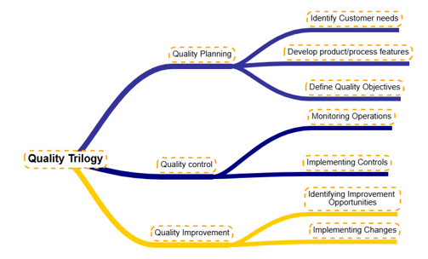

Slide 13
DMAIC
Define: what are customer expectations of the process?
Measure: what is the frequency of defects?
Analyse: why, when, and where do defects occur?
Improve: How can we fix the process?
Control: how can we make the process stay fixed?

Slide 14
Define
Step | Description | Focus tools | Deliverables
A | Identify project CTQ’s |  | Project CTQ
B | Develop team charter |  | Approved charter
C | Define process map |  | High level process map
This phase defines the project. It identifies customer CTQs and tied them to business needs. Further, it defines a project charter and the business is bounded by the project.

Slide 15
Measure
Step | Description | Focus tools | Deliverables
1 | Select CTQ characteristics | Customer, QFD, FMEA, | Project Y
2 | Define performance standards |  | Performance standard for project Y
3 | Measurement system analysis | Continuous gage R&R, test/retest, attribute R&R | Data collection plan & MSA data for project Y
This phase is concerned with selecting one or more product characteristics, mapping the process, making sure the measurement system is valid, making the necessary measurements, and recording the result.

Slide 16
Analyse
Step | Description | Focus tools | Deliverables
4 | Establish process capabilities | Capability indices | Process capability for project Y
5 | Define performance objectives | Team, benchmarking | Improvement goal for project Y
6 | Identify variation sources | Process analysis, graphical analysis, hypothesis tests | Prioritised list of all X’s
This phase entails estimating the short and long term process capability and benchmarking the key product performance metrics. Following this, a gap analysis is often undertaken to identify the common factors of successful performance, i.e., what factors explain best-in-class performance. In some cases, it is necessary to redesign the product and/or process.

Slide 17
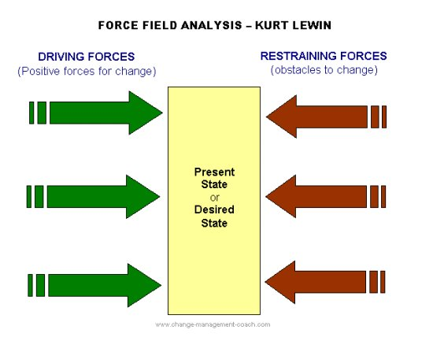

Slide 18
Managing Change
Drivers | Resistances
Nation Level Commitments | Innate nature of ours to maintain status quo
Availability of Technology | Lack of motivation
Technology validation | Lack of Team synergy
Resource availability | Non-availability of authentic data
Managing Team effectiveness | No scope of doing R&D
Clear benefits | Lack of Innovative culture

Slide 19
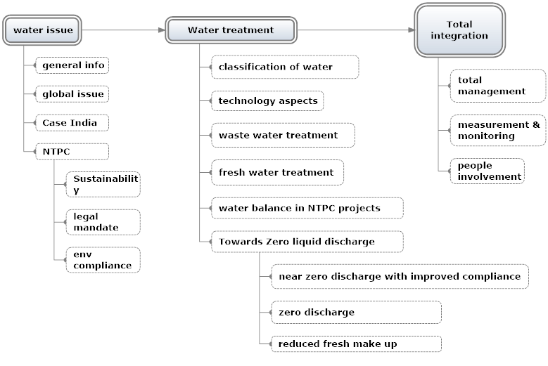

Slide 20
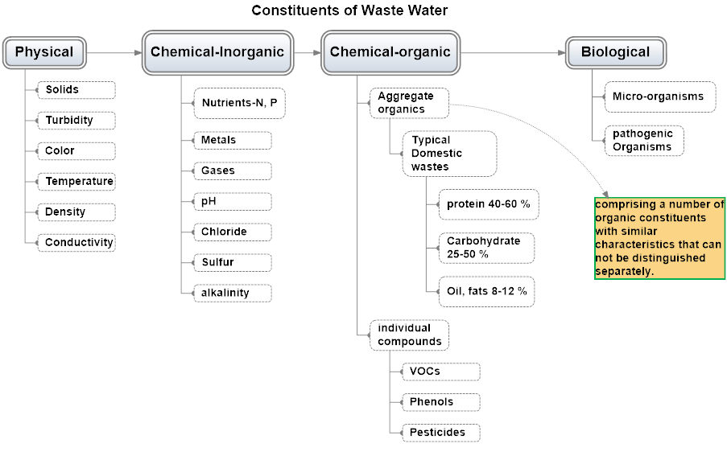

Slide 21
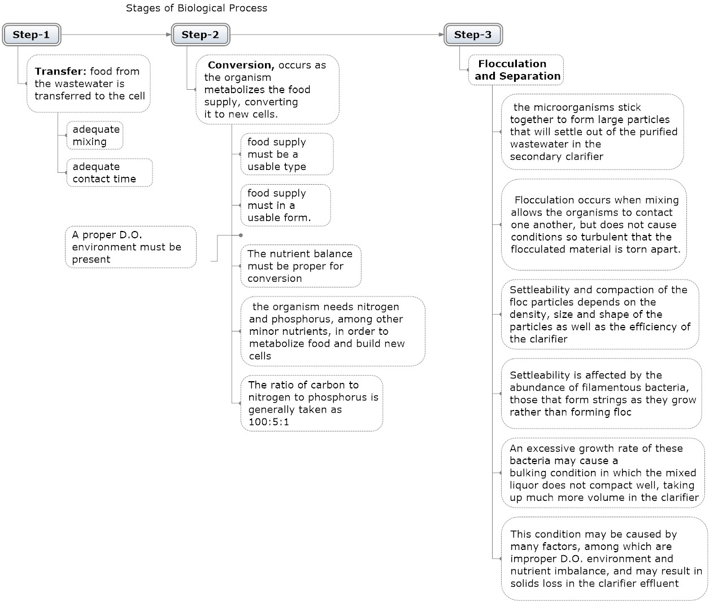
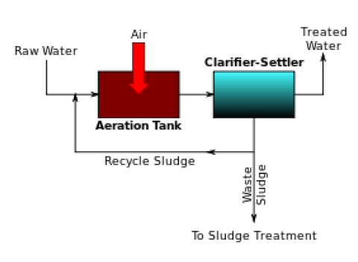
Activated Sludge Process

Slide 22
Activated Sludge Control Factors and Calculations
Control Factors Overview
Proper operation of an activated sludge plant will require knowledge of biological and physical factors that influence the efficiency of the process. These factors include:
• organic and hydraulic loading on the aeration tank
• dissolved oxygen in the aeration tank
• biosolids wasting rate
• return activated sludge rate
• clarifier loading
• solids settling and compaction characteristics

Slide 23
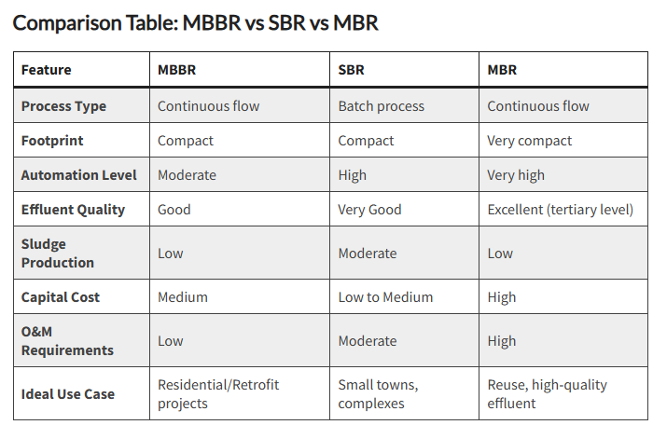

Slide 24
Project | Objectives | Associates | Status
ScaleBan | For deposit free condenser | Indian | Success and installed
CapDi | To reduce TDS in CW | Abroad | Success but not adopted
ATP monitoring | To test in situ bacteria population in CW | Indian, with IIT D | Success, not applied
CT fills | Low fouling fill, with better thermal efficiency | Indian | Success, not adopted
AFM technology | To reduce COD, BOD from STP O/L | Mix | Success, not adopted
UV disinfection in RO system | For efficient bio-control | Abroad | Installed
Colloidal silica mitigation | Water cons reduction, unit availability maintained | In-house research (patented) | Installed.
UPS resin | Water treatment, CPU | abroad | Installed
Chemical cleaning | With EPRI | mix | Installed
DGCC study | With EPRI | Mix | Installed across NTPC and other power plants

Slide 26



WBD
COC | 3 | 5 | 6 | 7 | 8 | 9 | 10
BD M3/Hr 500 MW | 480 | 225 | 174 | 140 | 116 | 97.5 | 83.3
9.8 %
Pump
Dust separation
Service water
Area wash
100 %
100 %
83 %
Horticulture
Reservoir
CW Forebay
8 %
CCF
Occasional sprinkling water requirement not considered
Online monitoring is highly advisable
AWRS
2 %
Potable Water
4 %
Fire Water Sump
DM Plant
63 %
Ash Slurry makeup / HP / LP pumps
Fire Water
CT
Hy
Spray
COC = 5
20 %
80
3 %
OWRP
Effluent
Sludge from Clarifier
LP
Ash Slurry Sump
B/D
HP
Cycle makeup
Units
Ash Slurry Pumps
Regn/Rinse
ZLD
Heaters
Notes:
The full form of OWRP in relation to water recirculation plant is "Owing to Recirculation Pump". This term refers to a type of pump used in wastewater treatment systems to move treated or partially treated wastewater back to an earlier stage of the process, enhancing treatment efficiency and improving mixing.

Slide 27
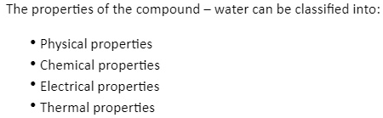
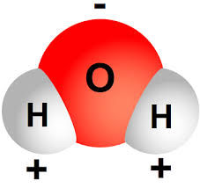
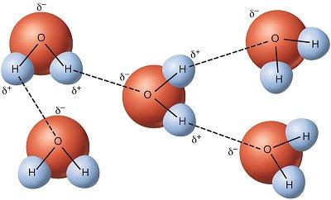
Structure of water and its impact on its properties

Slide 28
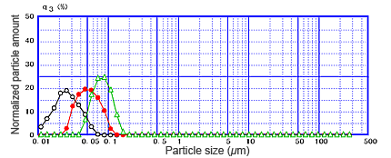
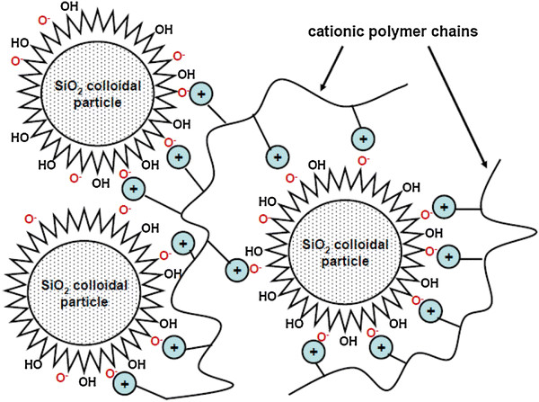
Emerging contaminants
Silica of different forms
  Reactive silica is detectable and exchangeable reversibly by SBA resin
    There is a limit to it for steam, boiler. Can deposit in turbine causing efficiency loss, and corrosion, it can also form scale in boiler requiring early acid cleaning.
  Colloidal silica is not detectable and cannot be exchanged reversibly. Removal process is subjective, difficult and prone to slippage thru the value chain.
    This blocks resin pores and causes loss of exchange capacity, and slippage of colloidal silica to boiler.
    For RO system it fouls membranes causing quality and capacity loss, requiring early membrane change.
Organics (NOM-Naturally Occurring Matter)
  Very complex to understand
  Many fragments are available
  Requires advanced technology to detect each fragments
  Removal requires customised approach

Slide 29
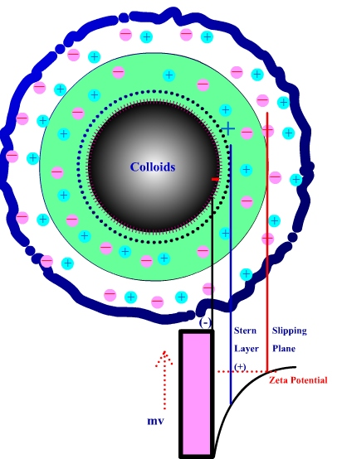
Colloids and layers
Electrical Double Layer
The development of a net charge at the particle surface affects the distribution of ions in the surrounding interfacial region, resulting in an increased concentration of counter ions, ions of opposite charge to that of the particle, close to the surface. Thus an electrical double layer exists round each particle.
Zeta Potential ….
The liquid layer surrounding the particle exists as two parts; an inner region (Stern layer) where the ions are strongly bound and an outer (diffuse) region where they are less firmly associated.
Within the diffuse layer there is a notional boundary inside which the ions and particles form a stable entity. When a particle moves (e.g. due to gravity), ions within the boundary move with it.
Those ions beyond the boundary stay with the bulk dispersant. The potential at this boundary (surface of hydrodynamic shear) is the zeta potential.

Slide 30
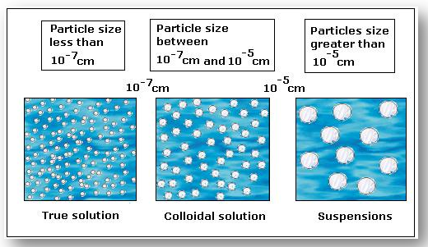
Water quality and removal of its contaminants
Removal technology:
TSS: Screening and settling.
Colloids: Coagulation and flocculation, Sand Filtration, Ultrafiltration.
TDS: Demineralisation, distillation, membrane based system, RO.

Slide 31
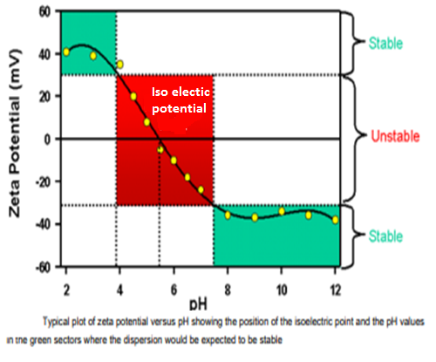
Factors affecting Zeta potential….: pH
In aqueous media, the pH of the sample is one of the most important factors that affects its zeta potential.
Imagine a particle in suspension with a negative zeta potential. If more alkali is added to this suspension then the particles tend to acquire more negative charge.
If acid is added to this suspension then a point will be reached where the charge will be neutralized.
Further addition of acid may cause a build up of positive charge if the ions are specifically adsorbed. In this case a zeta potential versus pH curve will be positive at low pH and lower or negative at high pH.
The point where the plot passes through zero zeta potential is called the isoelectric point and is very important from a practical consideration. It is normally the point where aggregation is most likely and hence the colloidal system is least stable

Slide 32
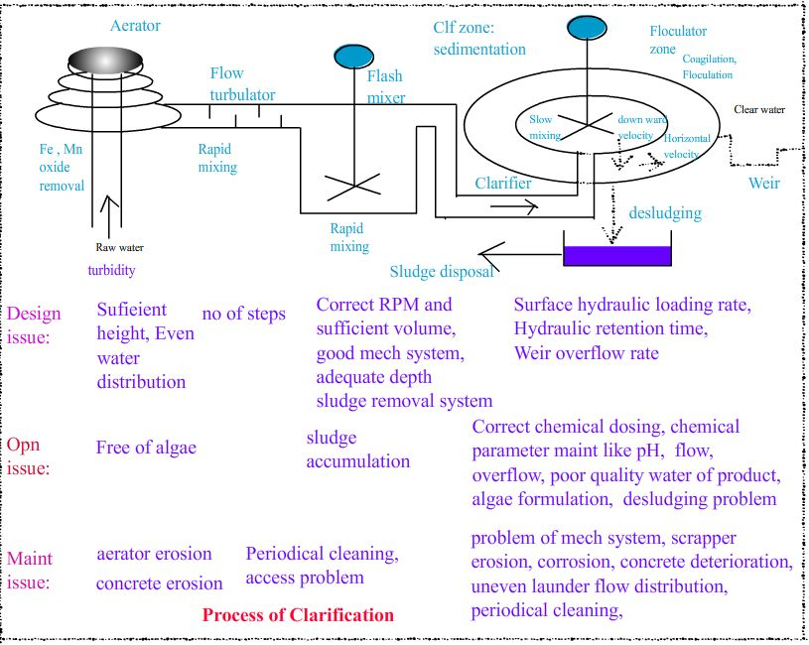
Clarification process: Design, operational and maintenance issue

Slide 34
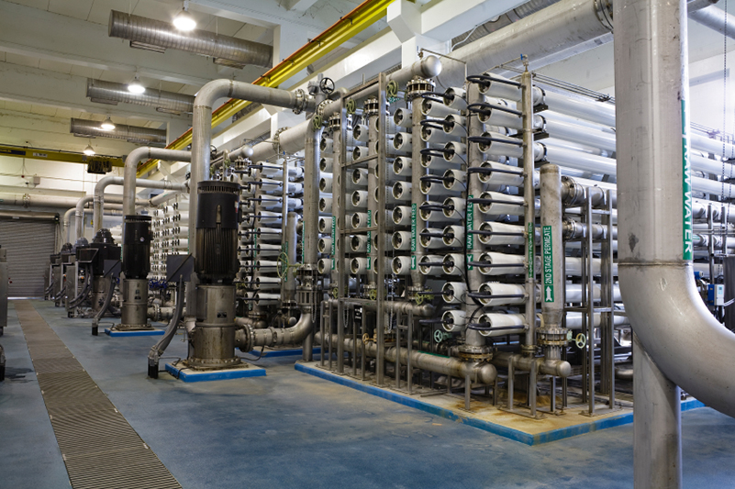
Reverse Osmosis

Slide 35
Use Of RO
Brackish water Desalination
Sea Water De-salination
Industrial and process water desalination
ZLD

Slide 36
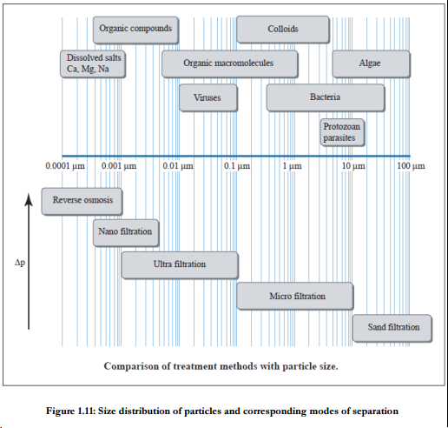

Slide 37
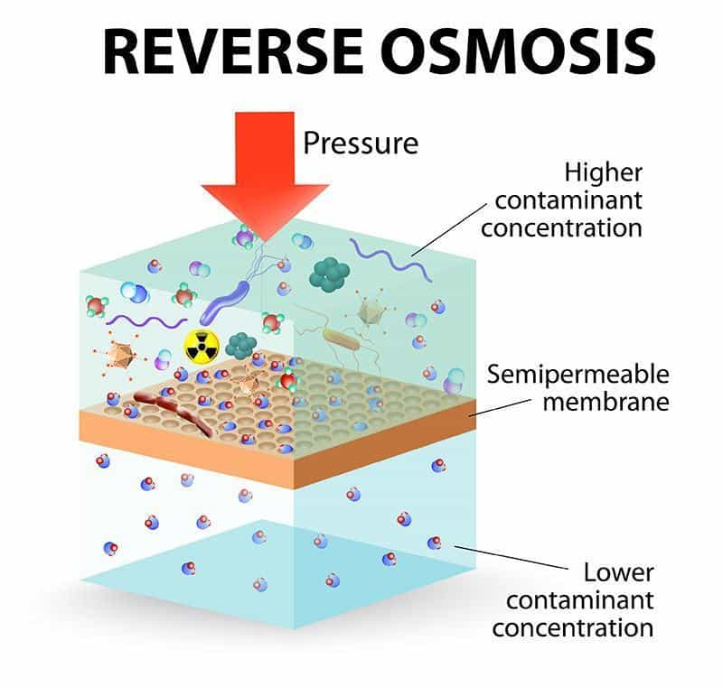

Slide 38
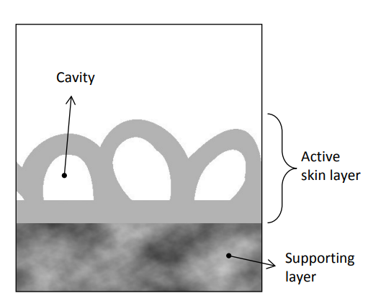
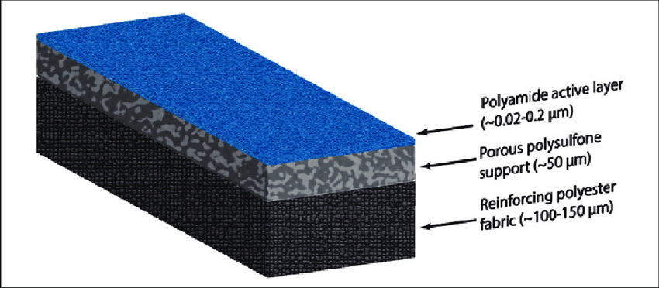
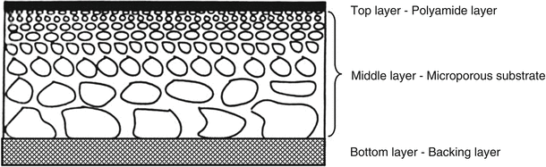
RO Membrane structure

Slide 39
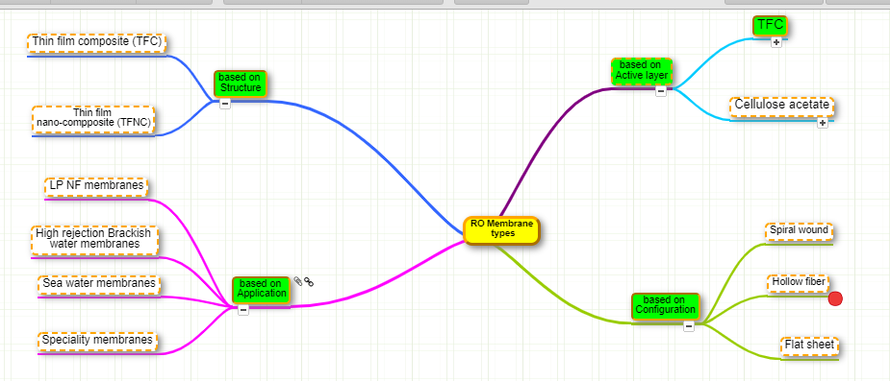
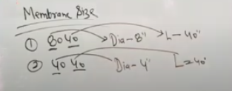

Slide 40
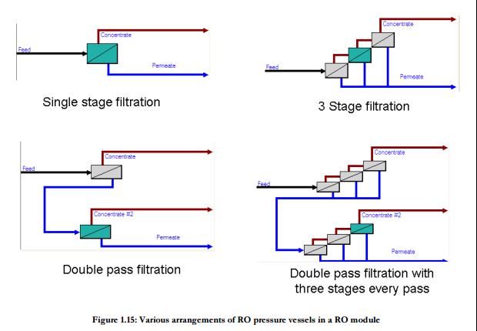
Stage and Pass

Slide 41
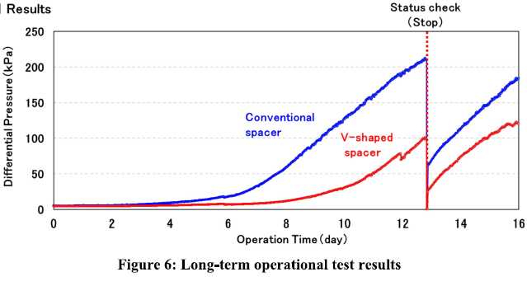

Slide 43
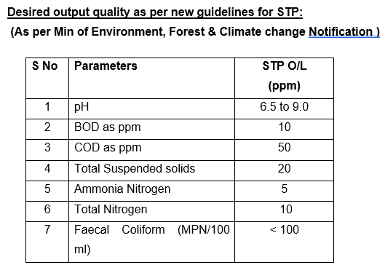
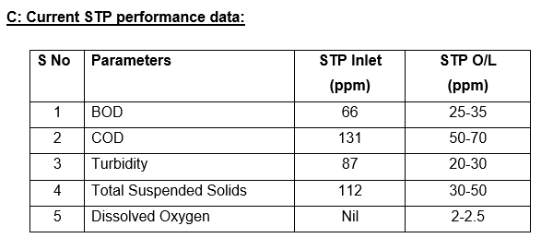
STP water reuse: new quality requirement

Slide 44
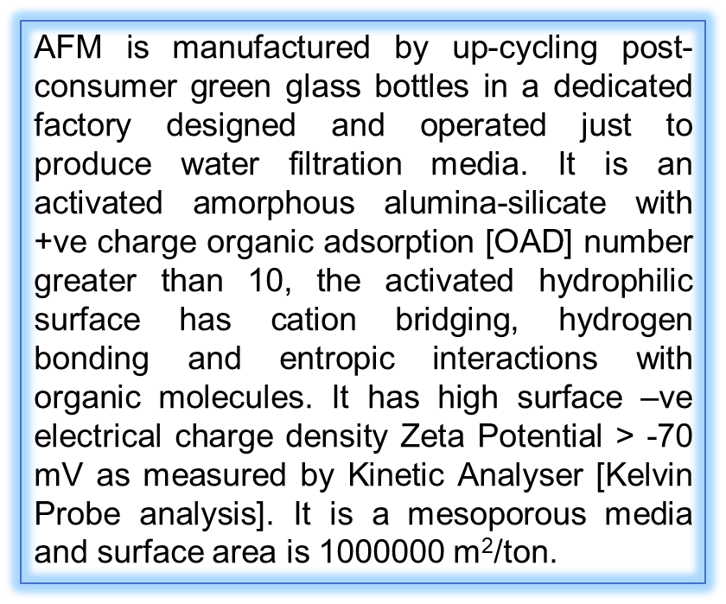
Recycling and Sewerage water remediation: Some advance process
1 Bio-Remediation: from UK, & USA
2 Soil Bio-Technology (SBT): a patent from IIT (Bombay), Mumbai
3 Activated Filter Media (AFM): Indigenous with the media imported.
The technologies at Sl no 1 & 2 are enlisted at Ministry of drinking water and sanitation. The Bio-remediation was in the process of trial, while SBT was under active consideration. The AFM technology is easy to implement and can be used at short notice as a retrofit to the existing plant where the STP’s performance needs further augmentation.

Slide 45
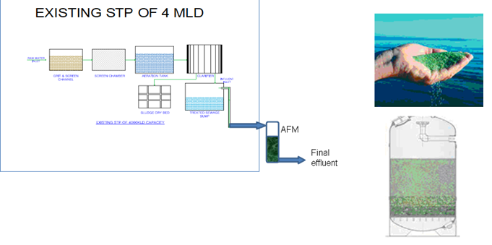

Slide 46
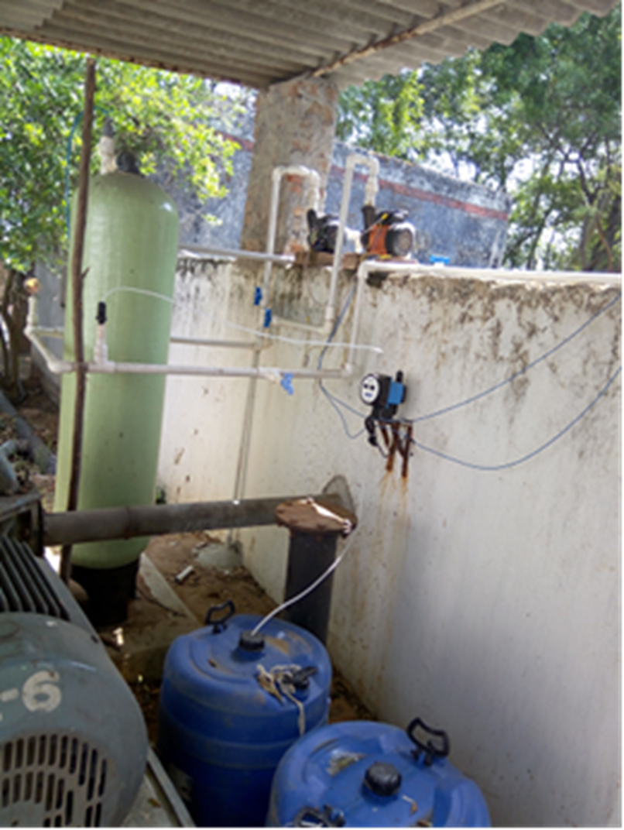
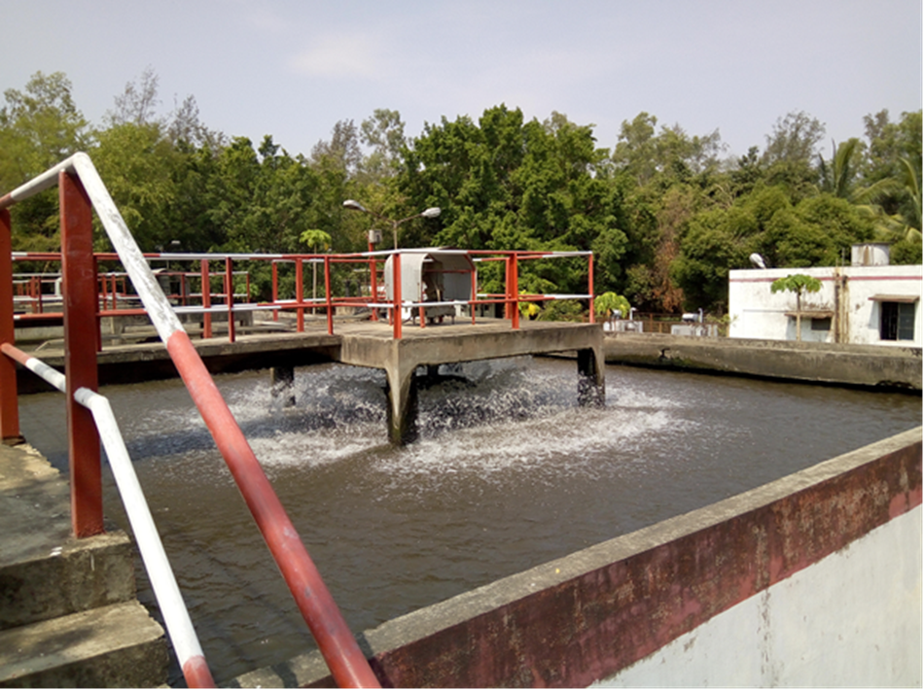
Augmented treatment Process
STP
AFM Trial

Slide 47


Slide 49
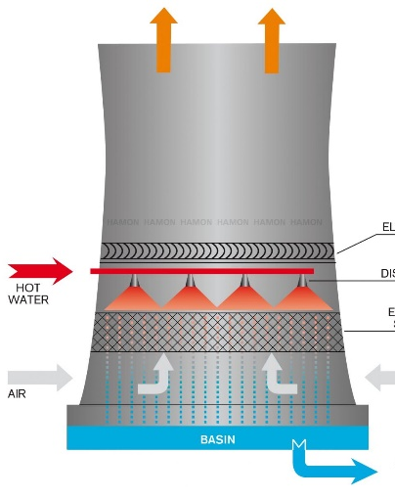
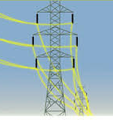
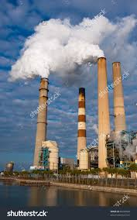
Energy flow in a typical thermal power station
0.48 MW
1 MW
Thermodynamic System
0.35 MW
0.16 MW

Slide 50
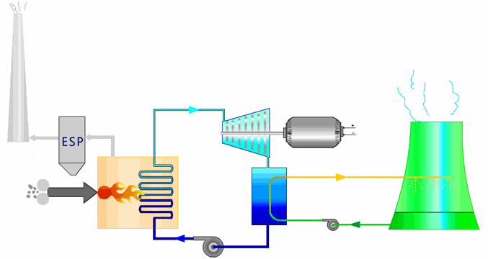
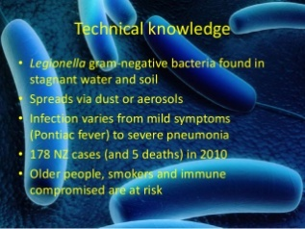
System contamination
corrosion
Correction:
Mechanical cleaning
Water jet cleaning
Chemical cleaning
Tube replacement
Fills replacement
Scaling/Fouling
MIC/Biofouling
Deposit
legionella
Fills weight gain
Vac Loss
Structural corrosion
White Rust
Cooling cap Loss
BTL
Deposit Build up

Slide 51
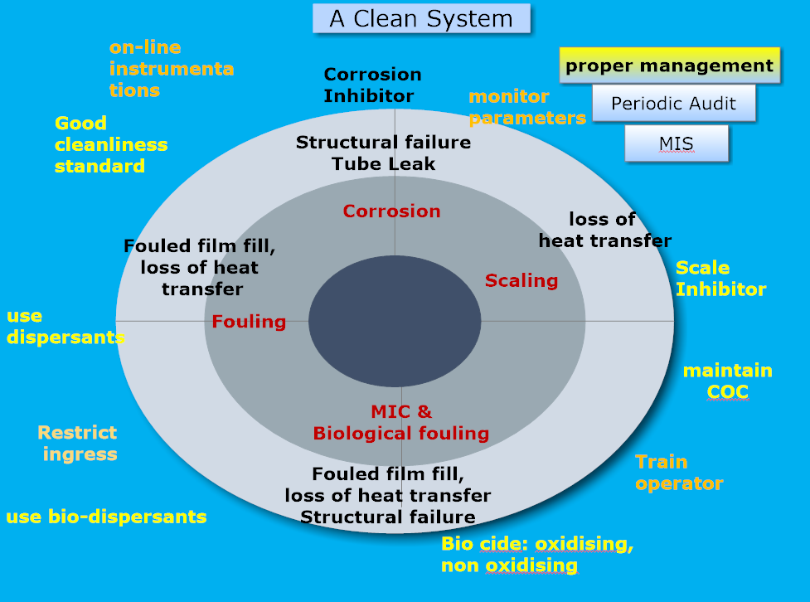


Slide 52
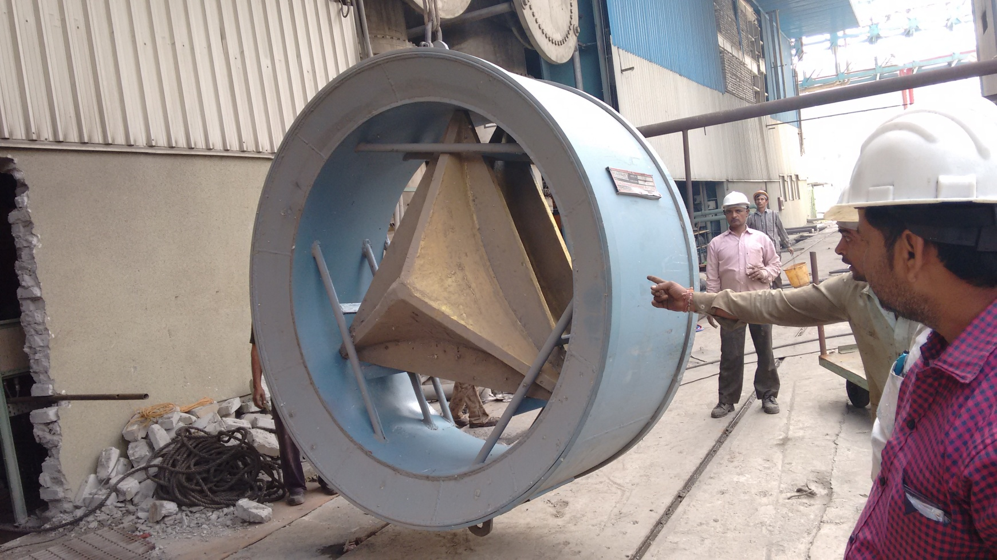
Scale ban for CW inlet Pipe
Metal Core

Slide 54

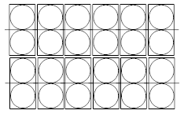
CT Types: Natural Draft Cooling Tower
Evaporation and drift
E
Air + water vapour
C
=
M
/
B
COC (C)= Cycle of Concentration
M
=
E
+
W
+
B
Basis: Silica, Cond, Mg etc.
M
=
E
x
C
/
(C-1)
Make up Mg = 80 ppm
CWS Mg =240 ppm
COC = 3
W
B
=
E
/
(C-1)
CT Fills
Air
Condenser
Air
Water
M
Blow Down
B
CW Make up
CT Basin
Circulating Pump
Notes:
E = (f * R * ΔT)/1000, where
E = Evaporation in gpm
R = Recirculation rate in gpm
ΔT = Temperature difference (range) between the warm
and cooled circulating water (°F)
f = A correction factor that helps to account for sensible heat
transfer, where
f (average) is often considered to be 0.75-0.80, but will rise
in summer and decline in winter
The factor of 1,000 is the approximate latent heat of water vaporization (Btu/lb). To check the general accuracy of this calculation, consider the previous problem we solved in detail. Evaporation was 3,159 gpm with a recirculation rate of 150,000 gpm and a range of 27°F. This gives a correction factor of 0.78, which falls directly in line with the rule-of-thumb value. Obviously, cooling tower location and daily/monthly climate changes will influence the correction factor.

Slide 55
x
While increasing concentration factor reduces water use, it also increases nutrients in the system water, encouraging growth of bacteria and slimes. Therefore, we normally run most cooling systems between 2 and 5
Water
B/D
x
COC | 3 | 5 | 6 | 7 | 8 | 9 | 10
BD M3/Hr 500 MW | 480 | 225 | 174 | 140 | 116 | 97.5 | 83.3
x
x
x
x
1 2 3 4 5 6
COC

Slide 56
Improving Cooling water system:
a case at NTPC

Slide 57
All total savings/yr at COC 5:
265186224 m3
(26.5 crore M³)
0.001% drift emissions per the CTI STD-140 test method.

Slide 58
COAL STATIONS
BADARPUR | --- | Once Through | --- | ---
BARH | 2X660 | Clarified Water | 3 | 2.0-3.0 | 7884000 | 9933840
DADRI | 4X210 | Soft water | 5 | 4.0-5.0
 | 2X490 | Clarified Water | 2.5 | 2.5-3.0 | 4257360 | 6149520
 | Gas (830 MW) | Soft water | 5 | 4.0-5.0
FARKKA | 1 | Once through | --- | ----
 | 2 | Once through | --- | ----
 | 1X500 | Clarified Water | 3 | 2.5-3.0 | 2128680 | 3074760
KAHALGAON | 4X210 | Clarified Water |  | 2.0-2.5 | 12772080 | 14664240
 | 3x500 | Clarified Water |  | 2.5-3.5 | 6386040 | 9224280
KORBA | 1 | Raw Water | ----
 | 2 | Raw Water | ----
 | 1x500 | Clarified Water | 3 | 3.0- 3.5 | 2128680 | 3074760
MOUDA | 2x500 | Clarified Water | 3 | 2.0-3.5 | 4257360 | 6149520
RAMAGUNDAM | --- |  | 2.0-2.8
 | 3x500 | Clarified Water | 2.5-3.7 |  | 6386040 | 9224280
 | 1X500 | Clarified Water | 2.5-3.7 |  | 2128680 | 3074760
RIHAND | ST I | Once Through | --- | ---
 | 2x500 | Clarified Water | 3 |  | 4257360 | 6149520
 | 2x500 | Clarified Water | 3 |  | 4257360 | 6149520

Slide 59
SIPAT | 3X660 | Clarified Water | 5 | 3.0-4.5 | 2365200 | 5439960
 | 2X500 | Clarified Water | 5 | 3.0-4.0 | 1419120 | 3311280
TALCHER K | 2X500 | Clarified Water | 2.5 | 2.0-3.0 | 7095600 | 8987760
 | 4X500 | Clarified Water | 2.5 | 2.0-3.0 | 14191200 | 17975520
TALCHER TH | 4X60 |  |  | 3.0-4.0 | 788400 | 1419120
 | 2X110 |  | 2.5 | 1.7-2.2 | 3547800 | 4052376
TANDA | 4X110 | Clarified Water | 3 | 2.5-3.0 | 2365200 | 3374352
UNCHAHAR | 1 |  | --- | ---
 | 2X210 | Clarified Water | 2 | 2.1 | 5597640 | 6543720
 | 3X210 | Clarified Water | 2 | 2.1 | 8396460 | 9815580
VINDHYACHAL | ST I |  | 2 | 2.3
 | ST II |  | 2.5 | 2.2
 | 2X500 |  | 2.5 | 2.1 | 11195280 | 13087440
 | 2X500 | Clarified Water | 4 | 2.2 | 9933840 | 11826000
 | 1X500 |  |  |  | 5597640 | 6543720
Jhajjar | 3X500 | Clarified Water | 4 | 4.8 | 331128 | 3169368
KANTI | 2X110 |  | 5.5 | 4.8 | 78840 | 583416
 | 2X195 |  | 5.5 | 4.8 | 110376 | 1024920
All total savings/yr at COC 5:
265186224 m3
(26.5 crore M³)

Slide 60
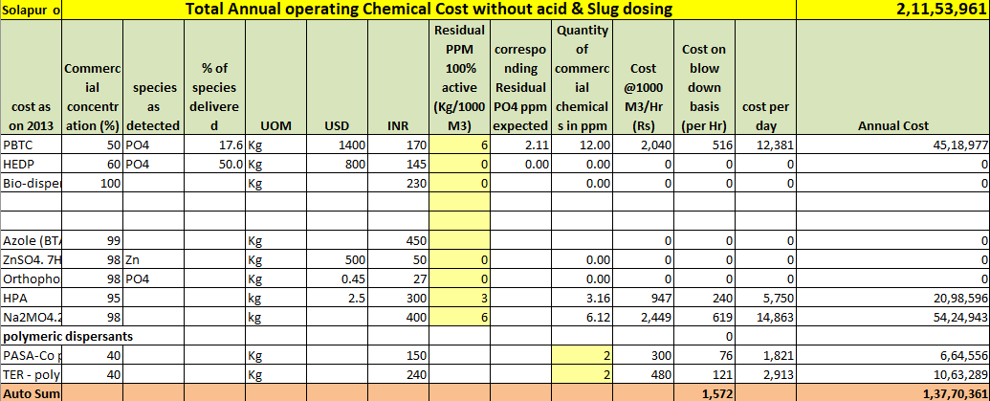

Slide 61
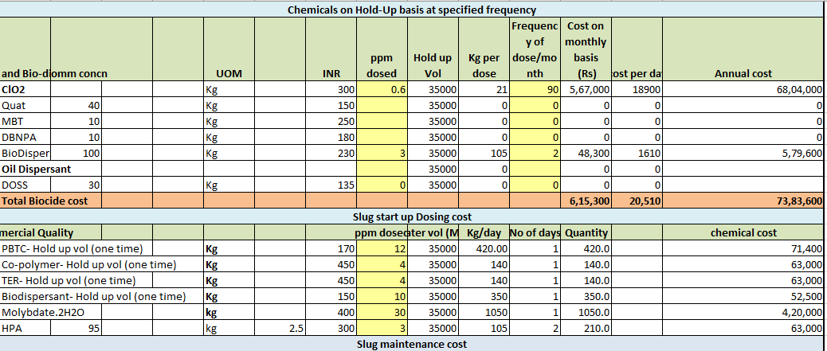

Slide 62
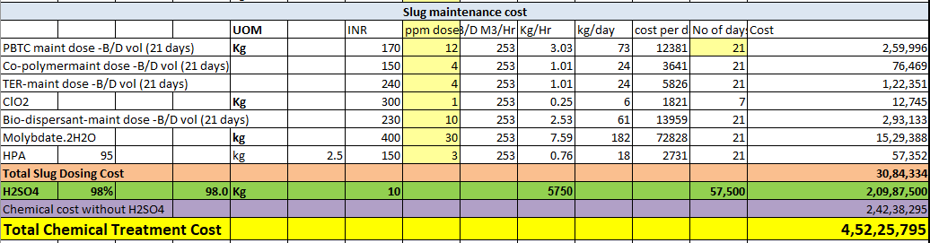


Slide 64


Slide 65


Slide 66


Slide 67


Slide 68

UPS RESIN

Slide 69


Slide 70


Slide 71
STP water-Issues
Quality of treated water
If not of consistent quality, treatment regime will be uncertain
Quantity of STP water
Adequate water is to be ensured or alternate water source to be identified.
Transportation
Maintenance of pipeline lines and other assets
Problem of hybrid water shall emerge
Cost responsibility
Leakages and other environmental concern

Slide 72
ATP measurement
ATP + O2 + luciferin
Mg++ / luciferase
AMP+ PPi + oxyluciferin + light
During the performance of this photon-producing reaction, light is measured by a luminometer and reported as Relative Light Units
(RLU). The amount of light produced is directly proportional to the amount of ATP present in
the sample.
ATP (Adenosine Triphosphate) is the main energy carrier for all living organisms. The measurement of ATP concentration in a sample provides an assessment of living biomass concentration: ATP is a biological Indicator within this technology.

Slide 73


BioFilms
Notes:
The mode of adsorption of some anion surfactants ((a) octyl sulphate sodium salt, (b) decyl
sulphate sadium salt, (c) dodecyl sulphate sodium salt, (d) hexadecyl sulphate sodium salt and (e)
dodecyl benzene sulfonate, respectively) is shown in Figure (10) [104]. The order of decreasing
inhibition efficiency of these anionic surfactants is (a) < (b) < (c) < (d) < (e). Higher molecular size
and high electron density on the adsorption centers may be responsible for high corrosion efficiency.

Slide 74




Slide 75


Slide 76


Slide 77


Slide 79
NETRA FOCUS AREAS
FOCUS AREAS
Climate Change & Environment
New and Renewable Energy
Efficiency & Availability Improvement
Advanced Scientific Services
Delivery Mechanism: Implementation in Plant
Technology Projects
Scientific Solutions

Slide 80
Critical Competencies in NETRA
  Metallurgy & NDT
  Water & Corrosion
  Process Technologies
  Computational Technologies
  By-Product Technologies

Slide 81
Sub Component of Critical Competencies in NETRA
Metallurgy & NDT | Water & Corrosion | Process Technologies | Computational Technologies | By-Product Technologies
NDT | Boiler Water | Combustion | AI Software | Bulk Ash Utilization
Mechanical Metallurgy | Cooling Water | Mechanical | Data and Image Analysis | Gypsum Product & utilization
Failure Analysis | DM Plant | Electrical | Weather Research & forecasting | CO2 capture and Utilization
RLA | STP Water | C&I | CFD Modelling
Condition Monitoring | Corrosion | Chemical

Slide 82
Professional competency development
Branch | Competency | Course structure |  |  | Training methodology
SWT | Level-1 | Module-1 | Module-2 | Module-3 | Developed for each module
SWT | Level-2 | Module-1 | Module-2 | Module-3
SWT | Level-3 | Module-1 | Module-2 | Module-3
Water Treatment
Boilers
CPU
CWT
RO

Slide 83
Knowledge Module for Sewerage Treatment Plant
Water plays a crucial role in ensuring smooth operations of a thermal power plant (TPP). It is typically used at a plant for cooling tower makeup, ash disposal, demineralizing (DM) water & boiler make-up, etc. As we all know that water is a very scarce resource and in the recent past, the availability of water has been a key concern for power developers. Competing uses, limited supplies as well as shortages in various parts of the country have resulted in a shortage of water for power generation.
In view of the criticality of the water demand and supply situation, NTPC has adopted systematic approach on water management measures to minimize consumption through judicious use and reuse of wastewater wherever possible.
One of the key policy measures for promoting water management at TPPs was the stringent norms on water consumption standards by the Ministry of Environment, Forest and Climate Change in December 2015. As per the revised norms, the existing plants are required to achieve a specific water consumption of 3.5 cubic meters per MWh by December 2017. Further, plants deploying the once-through cooling mechanism are required to install a cooling tower. Meanwhile, all plants being set up after January 2017 need to operate at a water consumption level of 3.0 cubic meters per MWh and achieve zero liquid discharge.

Slide 84
Another policy push for water management at TPPs was the mandate under the amended tariff policy of 2016 to use treated sewage water at plants located within a radius of 50 km from a sewage treatment plant (STP). In line with this decision we are initially working to utilize the secondary / tertiary treated water from the STP’s of their respective adjoining areas for our Dadri, Solpaur and Mouda plants. The main issues involved here are the assured supply of the needed quantity of water and its quality. (The acceptable quality of treated STP water for use in cooling or DM plant make is given in annexure-I).
To operate in such a changed scenario requires thorough understanding of the principles of operation, theoretical knowledge, and adequate practical and laboratory skills. In recent years there is development of a host of new technology and also many new concepts in the area of waste water treatment, like emerging contaminants have emerged. These require special technology to make the water re-usable.
To achieve this state of competency, NETRA wishes to position itself as a ‘Centre of Excellence’ on STP water treatment. This will require a systematic approach from course build up to development of training methodology. It is intended that training shall be given through a competent agency within India or Abroad to create world class professional.
As per the objectives stated, a comprehensive course structure is designed that will impart theoretical as well as practical training on the subject to the trainee who are MSc in background, and undergone one-year ET training.

Slide 85


Slide 86

SEWAGE TREATMENT PLANTS AND DISPOSAL (Module I,II &III-two weeks programme, Class room coaching, probable training agency: NEERI, Nagpur).

Slide 87


Slide 88


Slide 89
COURSE STRUCTURE for L-3
After gaining 5 years of experience at L-2 level and participation in conferences with minimum 2 paper presentations and 5 process improvement programs along with coaching in PMI or any other agency on STPs will transform the L-2 to L-3 level.

Slide 91

Message from Director Technical

Slide 92


Slide 93
Do not believe whatever is reported is true. Find yourself, it is the first job
Take influencers on your side
Believe in team spirit more than your individual caliber
Peg your motivation with a higher goal, thing will move a lot easier.
Deploy an attitude of continual learning.
Have patience

Slide 94


Slide 95



Slide 96


