Slide 1
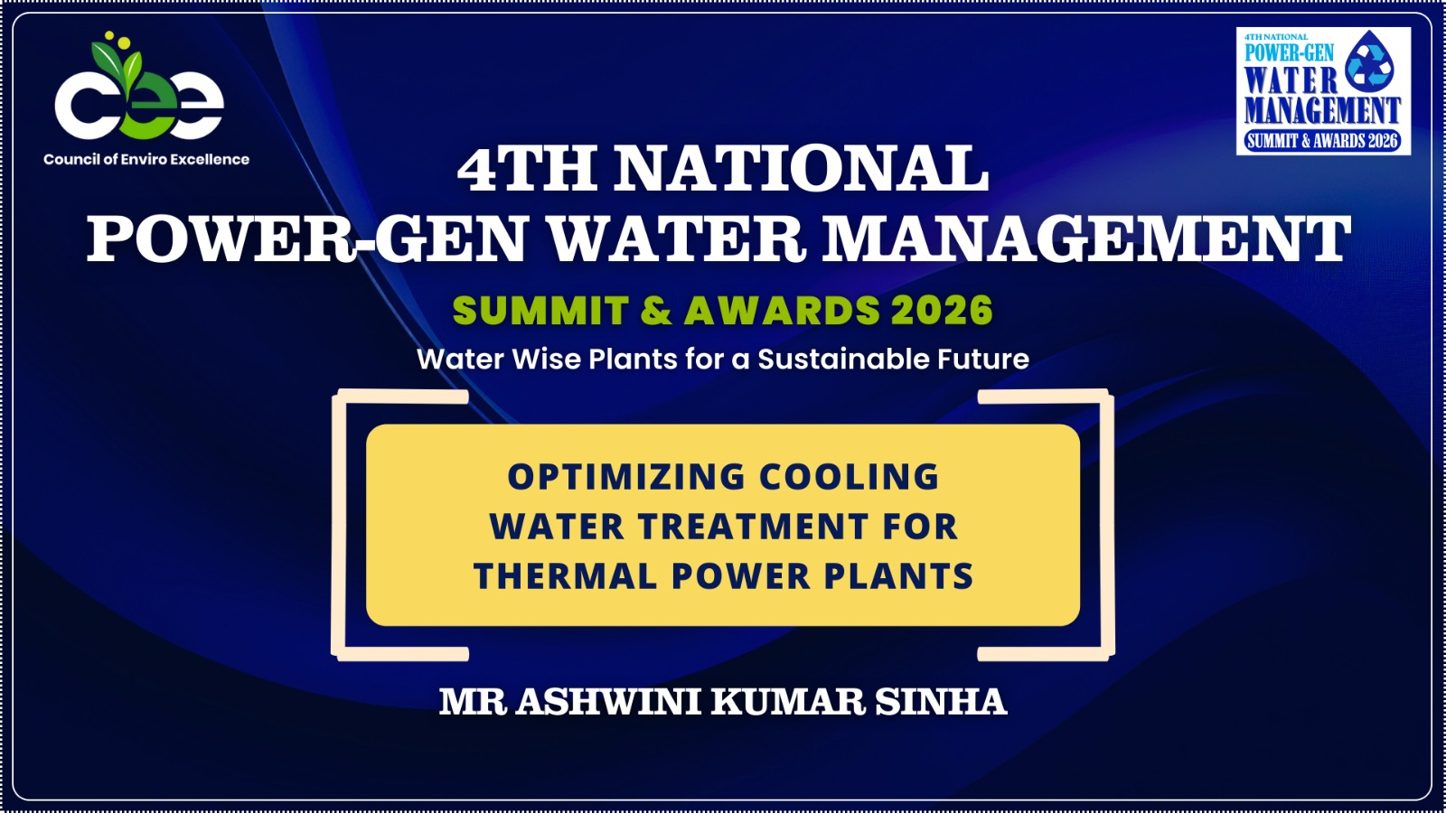

Slide 2
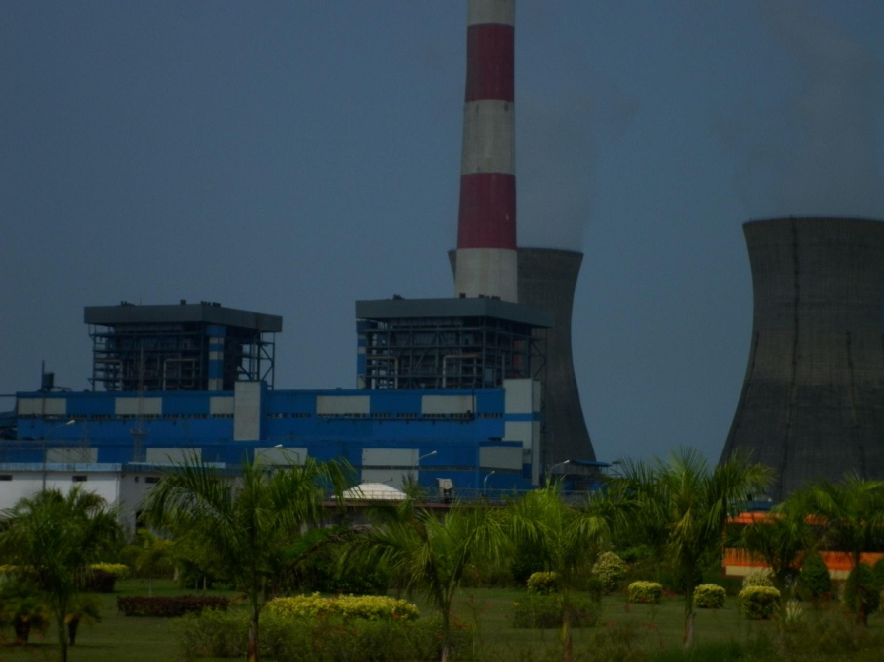



CWMC
1

Slide 3
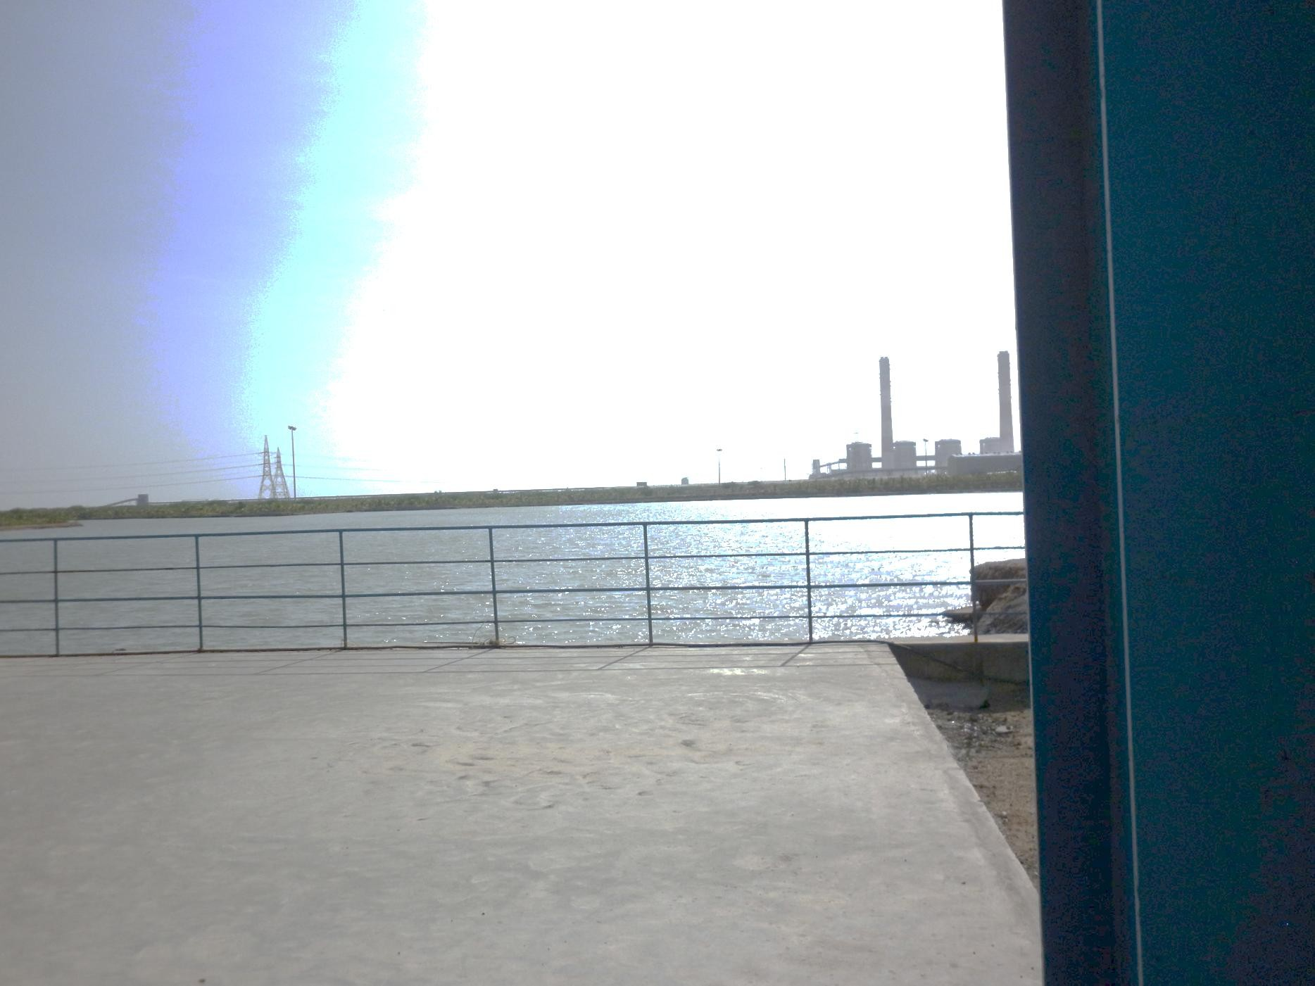
CWMC
2

Slide 4
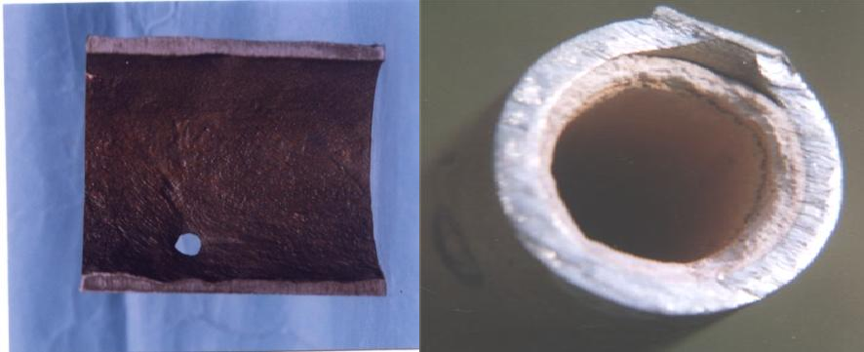
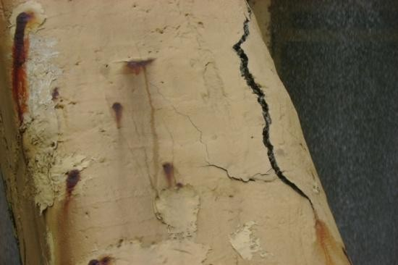
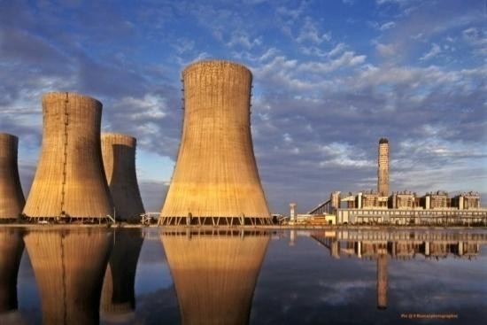
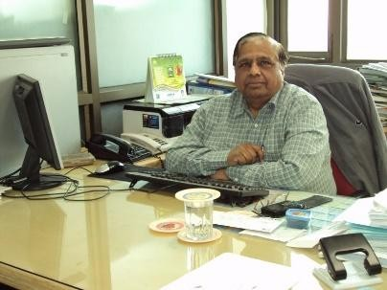
“Optimizing Cooling Water Treatment for Thermal Power Plants”
CWMC
Ashwini K Sinha
Principal Consultant, CWMC
(Ex-Additional General Manager (NETRA), NTPC)
Core Member, CII-Avantha Corrosion Management Committee,
Life Member AMPP (NACE International), Life Fellow Member SAEST ashwiniksinha@gmail.com ashwiniksinha@cwmcindia.com https://www.cwmcindia.com
CEE 4th National Power-Gen Water Management Summit and Awards 2026 - February 2, 2026. The Suryaa, New Friends Colony, New Delhi
Corrosion and Water Management Consultants
“Improving Plant Performance, Availability & Reliability by Chemical Interventions”

Slide 5
About Myself
CWMC
Name: Ashwini K. Sinha (Retired as Addl. GM (NETRA), NTPC in July 2012)
Qualifications: M.Sc (Electrochemistry)
P.G. Dip. In Corrosion Science & Technology, Univ. of Ferrara (Italy)
Affiliations: Life Member AMPP (NACE International), Life Fellow Member
SAEST, IAAPC, Core Member of CII - Corrosion Management Committee
Experience: 47+ years experience in Corrosion Analysis, Monitoring and Control in Power Plants. 5 Years BHEL (R&D), Hyderabad. 30 years with NTPC (R&D) (now “NTPC Energy Technology Research Alliance (NETRA). Free Lance Consultant in the areas of Corrosion & Water Management (since 2012).
Specialization: Corrosion Assessment, Failure Investigations, Corrosion Monitoring, Corrosion Audit, Design of Cathodic Protection Systems for Underground Pipelines; Condenser Water Boxes; RCC Structures such as Cooling
Towers; etc, Selection of Anticorrosive Coatings, Development &
&
Implementation of Cooling Water Treatments, Waste Water Recycling
Treatment, Chemical Cleaning of Condensers; Boilers; Pipelines; PVC Film Type Fill Packs of Cooling Towers; etc, Material Selection, Water Management, etc.
Research Studies on Extraction of Moisture from Flue Gases,
Ash Visit 4
Mineralization by Flue Gas, etc. (For details please https://www.cwmcindia.com)

Slide 6
About Myself
CWMC
Corrosion and Water Management - International,
Corrosion Assessment & Control of Plants under O&M by NOMAC –
  USC Plant (Coal & Gas Based, Seawater Cooled), Dubai. Desalination plants at Umm Al Quwain, IWP, Taweelah IWP, UAE. DEWA PV, Noor Energy 1 CSP, Shuaa Energy 1 PV (online), Dubai
  CCPP (Coastal, Air Cooled), Salalah, Oman;
  Tanger Wind Farms (Coastal), Morocco,
  Boujdour PV, Layuoune PV, NOOR 1 CSP, NOOR 4 PV; Morocco,
  Sohar3 CCPP (Seawater Cooled), IBRI CCPP (Air Cooled) & PV
(Online); Barka CCGT, & IWPP; Oman;
Vin Hao 6 PV (Coastal, Salt Pan), Vietnam (On site & Online),
Egypt Energy PV; Benban for Solar Energy PV; Nile Energy PV; Egypt,
Shuaibh IWPP (Seawater Cooled CCPP), Jeddah (online);
Sardarya CCGT, (Snow area), Riverside PV and BESS, Uzbekistan:
Al Dur 2, IWPP (Seawater Cooled CCPP), Bahrain (Online & On Site)
Bokpoort CSP, South Africa (Online)
Sembcorp IWPP (Seawater Cooled CCPP), Salalah, Oman
Failure of SS Tubes at Oman Food Products, Salalah, Oman
Condenser tubes and Boiler Tube Failures at CCPPs (3 No.), Iran
CW, ACW Pipelines Failure at NAVA Power, Zambia
5

Slide 7
About Myself
CWMC
Corrosion and Water Management - National
NTPC and NTPC Subsidiary Companies (Meja, Unchahar, Kudgi )
Adani Power- Mundra (Seawater), Tiroda, Kawai, Udupi (Seawater), Raipur,
Sembcorp (Seawater), Nellore
Rajasthan RVUNL - Kalisindh, Dholpur CCPP, Kota Thermal, Chhabra (TPP & SC), Suratgarh
Mahagenco – Chandrapur, Bhusawal, Koradi (SC) & Khaparkheda (STP Water)
CLP Jhajjar (SC) and Paguthan CCPP
Haldia Energy Limited, Haldia, Dhariwal Infrastructure Ltd., Chandrapur
Vedanta Limited, CPP & IPP, Jharsuguda, TSPL Bhatinda and Balco, Korba
GSECL Sikka TPS (Seawater), Jamnagar
Essar Sallaya Project (Seawater), Jamnagar
NABHA Power, Rajpura, Punjab
IOCL Refinery - Dibrugarh, Guwahati, Panipat
JSW – KSK Mahanadi, Jindal Raigarh,
HMEL Refinery, Bhatinda, Punjab
Reliance Power - Rosa Power, Shajahanpur, Sasan UMPP
Jindal Power, Raigarh; JSPL, Odisha, Jindal SimhaPuri, Nellore
Neyveli Lignite Corp. and NTPL, Neyveli, TN
Hindalco – Mahan, Sambalpur
Pipavav CCPP (Seawater), Gujarat
Tuticorin TPP (Seawater), Panipat Thermal Power Plant
6

Slide 8

Presentation Outline
CWMC
Introduction
Cooling Water System Problems
Scaling in Cooling Water Systems
Fouling/Biofouling in Cooling Water Systems
Corrosion in Cooling Water Systems
Cooling Water Treatment
Monitoring of Cooling Water Systems

Slide 9
Introduction
CWMC
8

Slide 10
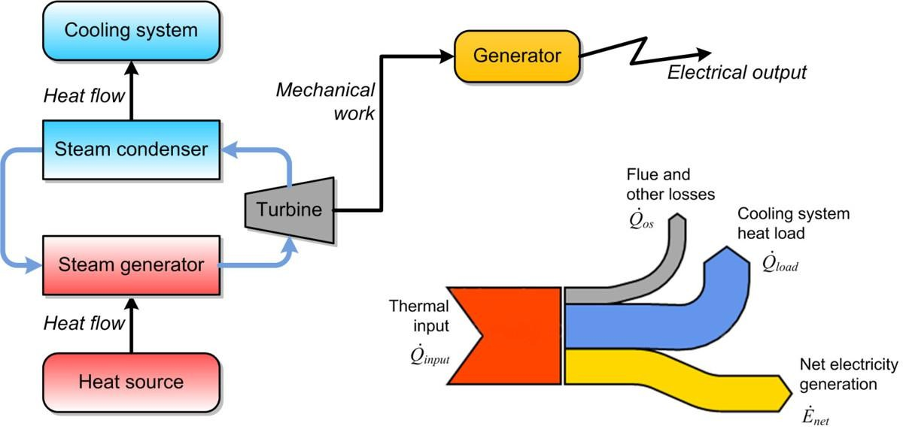
Energy Equilibrium in Power Generation
CWMC
9

Slide 11
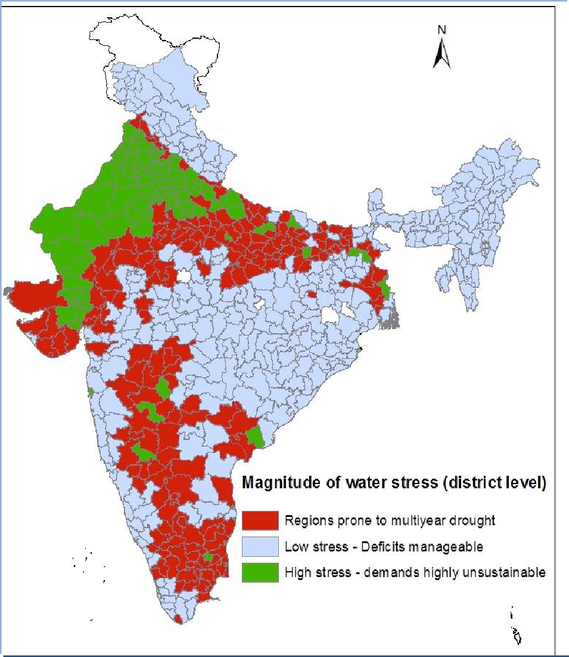
Water - INDIAN SCENERIO …
CWMC
Indian territory : 328 million
hectare
2.4 % of total earth’s land area
17 % of world’s population
18 % of world’s cattle
population
4 % of world’s water sources

Slide 12
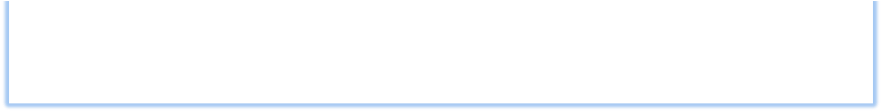
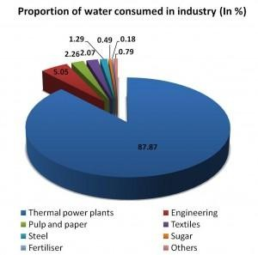
Water Availability & Utilization
CWMC

Slide 13
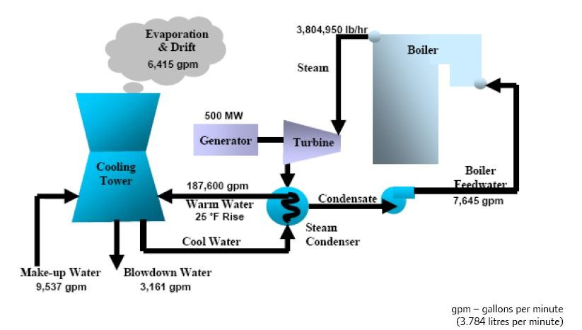
Process Flow Schematic for Wet Recirculating Cooling Water System
CWMC
12
1 GPM = 0.2271 M3/hour

Slide 14
Water Requirements
CWMC
Water Requirements for a 500 MW Unit
Flow rate
S.No. | Description | GPM | M3/Hr
1 | Boiler Feedwater | 7645 | 1736.18
2 | Circulating Water | 187600 | 42603.96
3 | Evaporation & Drift | 6415 | 1456.847
4 | Make up | 9537 | 2165.853
5 | Blowdown water | 3161 | 717.8631
13

Slide 15
STEPS INVOLVED IN COOLING WATER TREATMENT
CWMC
14

Slide 16
STEPS INVOLVED IN COOLING WATER TREATMENT
CWMC
Identify the source(s) and quantity of Cooling Waters for plant Cooling applications
Carryout complete chemical and Microbiological analysis (including seasonal changes) for all possible sources.
Identify the metals and environments in which cooling water
systems have to operate/installed.
Select possible treatments for the cooling water systems and type of protections to be applied along with monitorings required.
Select possible chemical treatments along with possible (and other
support systems) by Laboratory tests and Monitorings
Identify disposal methods of waste waters as per applicable norms.
Correlate the performance through plant system monitorings
15

Slide 17
Cooling Water
CWMC
16

Slide 18
COOLING WATER
CWMC
Water is used in Cooling Systems as a heat transfer medium and frequently also as the final
point to reject heat into the atmosphere by
of
evaporating inside cooling towers. Cooling
water is an essential process at power-generation and industrial plants.
The most important uses of
cooling exhaust
water steam,
includes condensing turbine cooling process fluids and
protecting high
pressure pump bearings.
Control of cooling water Chemistry is very critical in preventing corrosion, scale and fouling thereby
improving performance of the units.
17

Slide 19
Sources of water
CWMC
Ground water
- Wells, bore wells and springs
Surface water
- Lake, pond/reservoir, river, canal
Sea water
- Including Back sea water, Estuarine, Brackish water
Mine Water
Treated STP Water/Plant ETP Water/CW Blow Down
Harvested Rain Water
18

Slide 20
IMPURITIES IN WATER
CWMC
BACTERIA & VIRUSES
MICRO – ORGANISMS
TURBIDITY
COLOUR
MINERALIZATION
METALLIC
DISSOLVED GASES
AMMONIA
ORGANIC MATTER
POLLUTANTS

Slide 21
ORGANIC IMPURITIES IN WATERS
CWMC
Insoluble Organic Matter:
Debris of vegetable and animal origin
Micro-organisms
Oily material
Humic matter
Soluble Organic Matter:
Humic matter
Fatty acids
Nitrogenous matter (proteins, peptides, & Amino acids)
Saccharides & Sugars
Dissolved Organic gases (such as Methane)
Soluble extracts of Vegetable and animal matter
Synthetic Organic Compounds

Slide 22
Contaminants or impurities in water
CWMC
Physical Impurities:
Color, Tastes and odors, Suspended solids, Turbidity, Temperature
Chemical Impurities:
pH, Acidity, Alkalinity, Hardness, TDS, Fluorides, Chlorides, Sulphates, Nitrates Phosphates, Toxic chemicals- may be inorganic Like Zn,Cu,Pb,As, Cd, Cr(VI), Hg etc or various organic compounds Like pesticides, Carbon Tetra Chloride, Vinyl Chloride, Cyanide, Phenol, Chlorinated hydrocarbons etc. Dissolve Oxygen.(8- 10 mg/L) D.O makes the water taste good. Surface water contain more
D.O due to more surface contact. Depletion of D.O. indicated utilization by Organic or inorganic compounds I.e. contamination from domestic and industrial wastes.
Bacteriological Impurities:
Virus, Bacteria Protozoa, heliminthic worms.
21

Slide 23
Once Through System
CWMC
Heat Exchanger
River/Canal/Reservoir
Intake
CW
Pump
Discharge
Water makes one pass through the heat exchanger
equipment and discharged to waste.
Large quantity of water is needed.
Once-through system have advantage of not concentrating water during its passage through system, thus reducing scaling and corrosion potential of water.
Water is returned to source at higher temperature, thus cause thermal and chemical pollution of water bodies.
5. Highly prone to biological fouling.
22

Slide 24
Closed Re-circulating System
CWMC
Heat Exchanger
Air/Water
outlet
Recirculation
Pump
Chemical Dosing
Make up
Cooler
Air/Water Inlet
Water circulates in a closed cycle- water completely confined within the system pipes and heat exchangers.
Alternate cooling and heating without air contact.
Heat absorbed by the water in closed system is transferred to the
re-circulating water of an open re-circulating system from which the heat can be lost to atmosphere.
Example:- Automobile radiators & refrigeration units, electric
generators and chilled water systems, CCCW Systems, etc.
23

Slide 25
Closed Re-circulating System
CWMC
Generally such systems use deionized water or distilled water due to which hardness salts are not available so scale deposition is very low possibility. System is closed so not much losses or make-up water requirement is there. Normally these systems are prone to serious Corrosion and Microbiological issues such as Biofouling, Microbiologically Induced Corrosion, etc. Corrosion Inhibitors such as Nitrite, Molybdate, Silicates, Phosphates at higher dosage along with either oxidizing or non-oxidizing biocides are added to control the problems of Corrosion and Biofouling.
Closed Circuit Cooling Water Systems in power plants use DM water at higher pH in the main cooling water system and many times plate heat exchangers are used for heat transfer. Secondary cooling is provided by Raw or Clarified Water or Seawater (at stations using Seawater for cooling applications).

Slide 26
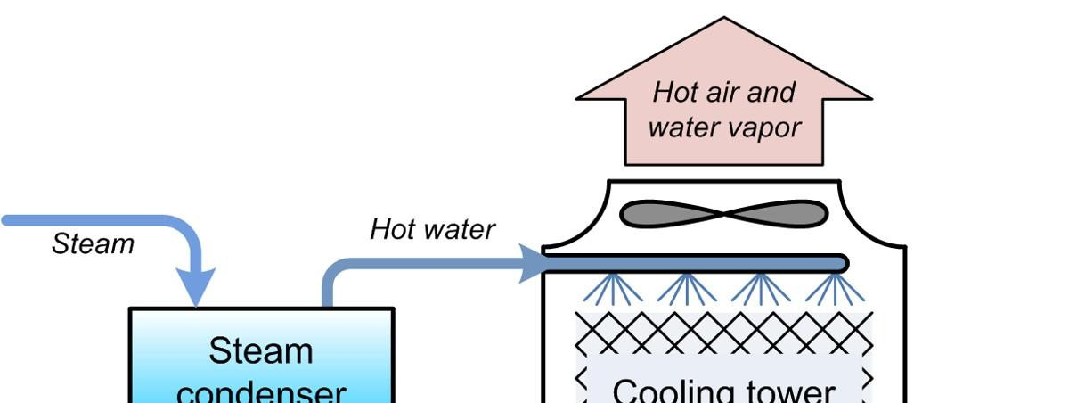
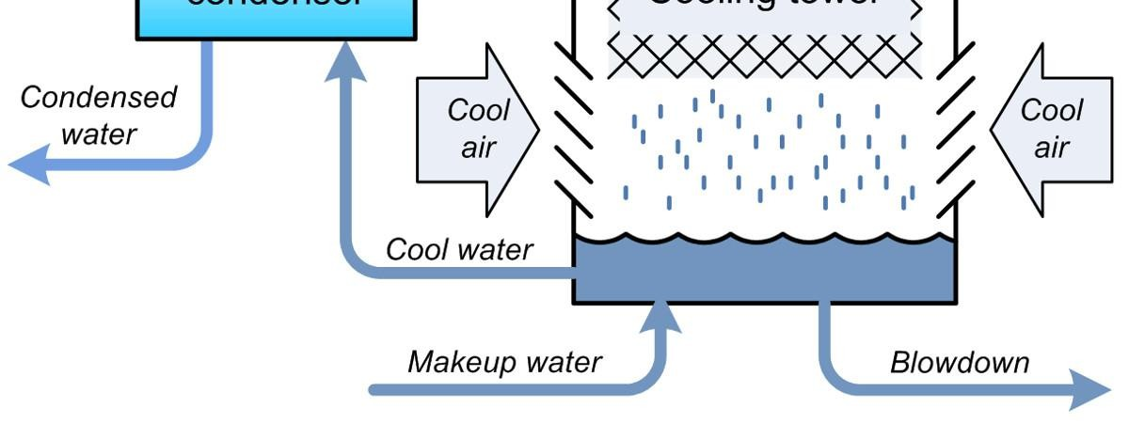
Open Recirculating ( Evaporative Cooling Towers)
CWMC

Slide 27
Open Recirculating ( Evaporative Cooling Towers)
CWMC
Drift
(B)
Warm Air
Blowdown
(B)
Condenser
Drift
Eliminators
Louver
Fills
Cool
Air
Make Up (M)
Circulating pump
Basin
Water circulates through the condenser or heat exchanger to a cooling tower and then returned to exchanger.
Same high volume flow rate as a once through system, but with less water discharge.
Cooling of water is by evaporation process, water loss by evaporation and
drift.
The evaporated water is very pure and the minerals are left behind to concentrate.
Used in power plants, chemical, petrochemical, petroleum refining, steel,
paper mills and all types of processing plants.
26

Slide 28
TERMS ASSOCIATED WITH COOLING TOWER
CWMC
Evaporation : Approx. amount of evaporation that occurs in a cooling tower can be calculated using the following formula.
E = (Cr X DT) / 1000
E = Evaporation rate
Cr = Recirculation rate of cooling tower
DT = Temp. diff. (ºF) between hot and cool circulating water
Drift ( D ) : Drift is a form of blow down that occurs due to entrainment of water droplets in the air leaving the cooling tower. Drift typically ranges from about 0.05% to 0.3% of the recirculation rate depending upon the type and efficiency of the cooling tower.
Make up ( MU ): Water added to Circulating water system to replace water lost from the system by evaporation, drift, blown down, and leakages.

Slide 29
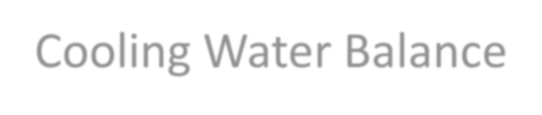
TERMS ASSOCIATED WITH CW SYSTEM
CWMC
Cycle of concentration ( COC ) :
Number of times the circulating is concentrated in cooling tower is known as Cycle of conc. The maximum (COC) depends upon the effectiveness of corrosion and scale inhibitor programs and on the quality of make up water.
Blow Down ( BD ):
Some water must be continually removed from cooling water system to prevent excessive build up of the dissolved solids. This is known as blow down.
Evaporation , Blow down, Drift and Make Up constitute the water balance around the cooling tower.
Cooling Water Balance
MU (flow) BD Cl⁻ or BD Mg⁺² Conc. Or BD Conductivity
C =
=
BD (flow)
MU Cl⁻ or MU Mg⁺² Conc. Or MU Conductivity
E
BD + D =
MU = E + BD + D
C -1

Slide 30
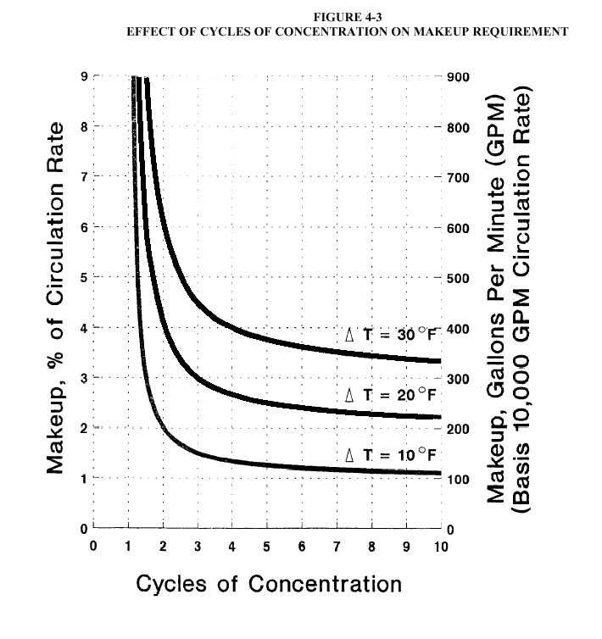
OPTIMIZED CYCLES OF CONCENTRATION
CWMC

Slide 31
COC Optimization
CWMC
S.N o | COC | Circulating Rate m3/hr | Drift M3/hr | Evaporati on M3/hr | Blow Down M3/hr | Make up M3/hr | Consumption of Inhibitors l/day |  | Cost of Inhibitors @ Rs. 33/litre Rs/day
 |  |  |  |  |  |  | 5 ppm | 10 ppm | 5 ppm | 10 ppm
1 | 1.5 | 32000 | 160 | 576 | 1152 | 1888 | 227 | 453 | 7476 | 14953
2 | 2.0 | 32000 | 160 | 576 | 576 | 1312 | 157 | 315 | 5196 | 10391
3 | 2.5 | 32000 | 160 | 576 | 384 | 1120 | 134 | 269 | 4435 | 8870
4 | 3.0 | 32000 | 160 | 576 | 288 | 1024 | 123 | 246 | 4055 | 8110
5 | 3.5 | 32000 | 160 | 576 | 230 | 966 | 116 | 232 | 3827 | 7654
6 | 4.0 | 32000 | 160 | 576 | 192 | 928 | 111 | 223 | 3675 | 7350
7 | 4.5 | 32000 | 160 | 576 | 165 | 901 | 108 | 216 | 3566 | 7133
8 | 5.0 | 32000 | 160 | 576 | 144 | 880 | 106 | 211 | 3485 | 6970

Slide 32
COC Optimization
CWMC
Expected Cooling water quality at different COC based on Clarified Water as make up to Cooling water
S.No | Parameter | Unit | Cycles of Concentration |  |  |  |  |  |  |  |  |  |  |  |  |  |  | Actual Data
 |  |  | 1 | 1.5 | 2 | 2.5 | 3 | 3.5 | 4 | 4.5 | 5 | 5.5 | 6 | 6.5 | 7 | 7.5 | 8 | CW | COC (3)
1 | pH |  | 7.61 | 7.68 | 7.91 | 8.08 | 8.22 | 8.34 | 8.45 | 8.54 | 8.62 | 8.70 | 8.77 | 8.83 | 8.89 | 8.94 | 8.99 | 7.92
2 | cond | µmhos/cm | 269 | 403.5 | 538 | 672.5 | 807 | 941.5 | 1076 | 1210.5 | 1345 | 1479.5 | 1614 | 1748.5 | 1883 | 2017.5 | 2152 | 1570 | 5.83643 12
3 | Total hardness | ppm as CaCO₃ | 116 | 174 | 232 | 290 | 348 | 406 | 464 | 522 | 580 | 638 | 696 | 754 | 812 | 870 | 928 | 580 | 5
4 | CaH | ppm as CaCO₃ | 74 | 111 | 148 | 185 | 222 | 259 | 296 | 333 | 370 | 407 | 444 | 481 | 518 | 555 | 592 | 380 | 5.13513 51
5 | MgH | ppm as CaCO₃ | 42 | 63 | 84 | 105 | 126 | 147 | 168 | 189 | 210 | 231 | 252 | 273 | 294 | 315 | 336 | 200 | 4.76190 48
6 | P alk. | ppm as CaCO₃ | 0 | 0 | 0 | 0 | 0 | 0 | 0 | 0 | 0 | 0 | 0 | 0 | 0 | 0 | 0 | 0 | #DIV/0!
7 | M alk. | ppm as CaCO₃ | 74 | 111 | 148 | 185 | 222 | 259 | 296 | 333 | 370 | 407 | 444 | 481 | 518 | 555 | 592 | 58 | 0.78378 38
8 | T. alk. | ppm as CaCO₃ | 74 | 111 | 148 | 185 | 222 | 259 | 296 | 333 | 370 | 407 | 444 | 481 | 518 | 555 | 592 | 58 | 0.78378 38
9 | Chloride | ppm as Cl | 36.06 | 54.09 | 72.12 | 90.15 | 108.1 8 | 126.2 1 | 144.2 4 | 162.27 | 180.3 | 198.33 | 216.3 6 | 234.39 | 252.42 | 270.45 | 288.48 | 338.1 | 9.37603 99
10 | Turbidity | NTU | 3.84 | 5.76 | 7.68 | 9.6 | 11.52 | 13.44 | 15.36 | 17.28 | 19.2 | 21.12 | 23.04 | 24.96 | 26.88 | 28.8 | 30.72 | 11.6 | 3.02083 33
11 | SiO2 | ppm as SiO₂ | 19 | 28.5 | 38 | 47.5 | 57 | 66.5 | 76 | 85.5 | 95 | 104.5 | 114 | 123.5 | 133 | 142.5 | 152 | 68 | 3.57894 74
12 | Sulphate | ppm as SO₄ | 20 | 30 | 40 | 50 | 60 | 70 | 80 | 90 | 100 | 110 | 120 | 130 | 140 | 150 | 160 |  | 0
13 | Iron | ppm as Fe | 0.078 2 | 0.117 3 | 0.156 4 | 0.195 5 | 0.234 6 | 0.273 7 | 0.312 8 | 0.3519 | 0.391 | 0.4301 | 0.469 2 | 0.5083 | 0.5474 | 0.5865 | 0.6256 | 0.22 | 2.81329 92
14 | Ca X SO₄ |  | 1480 | 3330 | 5920 | 9250 | 1332 0 | 18130 | 23680 | 29970 | 37000 | 44770 | 53280 | 62530 | 72520 | 83250 | 94720
15 | Mg X SiO₂ |  | 798 | 1795. 5 | 3192 | 4987. 5 | 7182 | 9775. 5 | 12768 | 16159. 5 | 19950 | 24139. 5 | 28728 | 33715. 5 | 39102 | 44887. 5 | 51072
 | PSI |  | 8.34 | 7.42 | 6.76 | 6.25 | 5.84 | 5.49 | 5.18 | 4.91 | 4.67 | 4.46 | 4.26 | 4.08 | 3.91 | 3.75 | 3.60
 | RSI |  | 7.98 | 7.24 | 6.54 | 6.00 | 5.56 | 5.18 | 4.86 | 4.57 | 4.32 | 4.08 | 3.87 | 3.68 | 3.50 | 3.33 | 3.17
 | LSI |  | -0.19 | 0.22 | 0.68 | 1.04 | 1.33 | 1.58 | 1.80 | 1.98 | 2.15 | 2.31 | 2.45 | 2.58 | 2.69 | 2.81 | 2.91

Slide 33
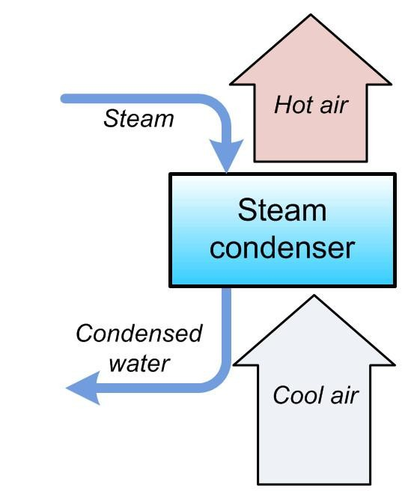
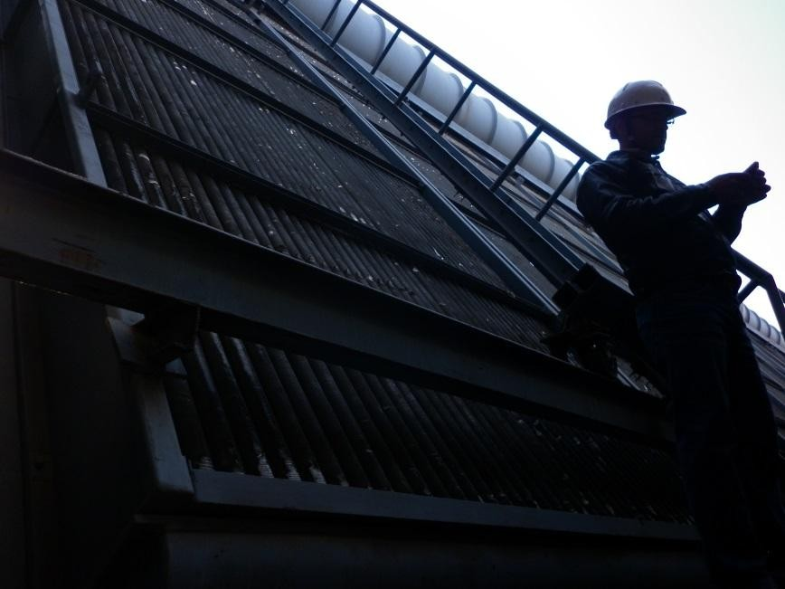
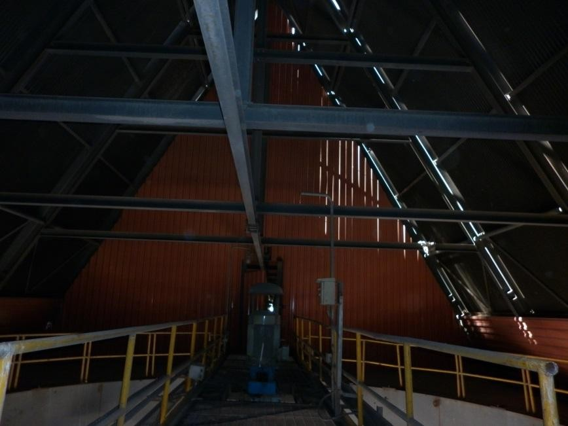
Air Cooled Condenser
CWMC
32

Slide 34
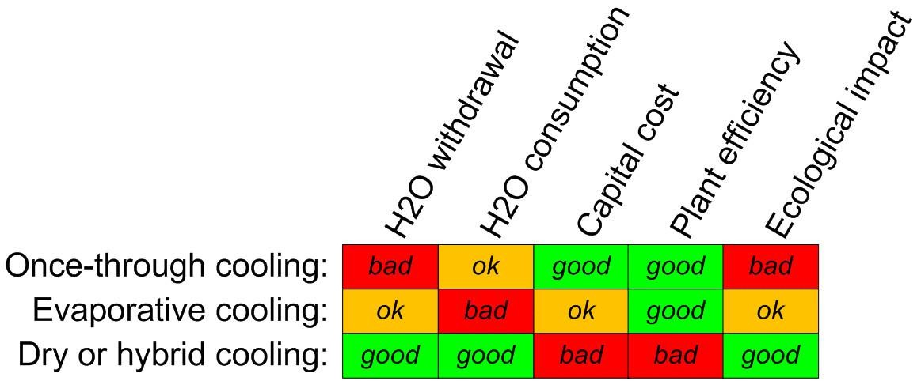
Overview of Cooling Technologies
CWMC

Slide 35
Cooling Water System Problems
CWMC

Slide 36
CWMC
Types of Make up Water for CW system
Raw Water
Clarified Water
Filtered Water
Soft Water
Seawater
Treated Waste Water or Recycled Water₃₅

Slide 37
Cooling Water Associated Problems
CWMC
Due to water’s ability to dissolve most substances to some extent, and its ability to support biological life every cooling water system is subjected to potential operational problems.
These are:
Deposit formation
Corrosion
Biological deposition and corrosion
36

Slide 38
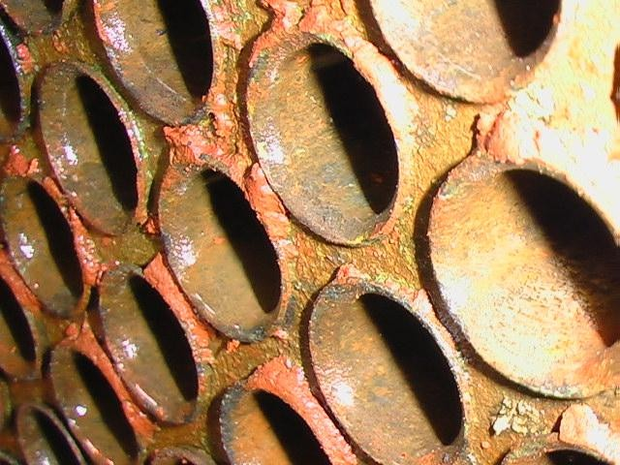
CASES OF CORROSION IN CONDENSER TUBES
CWMC
CORROSION OF CONDENSER WATER BOX & TUBE SHEET DUE TO SEA WATER (LEAKAGE AROUND TUBE/TUBEPLATE JOINTS)

Slide 39
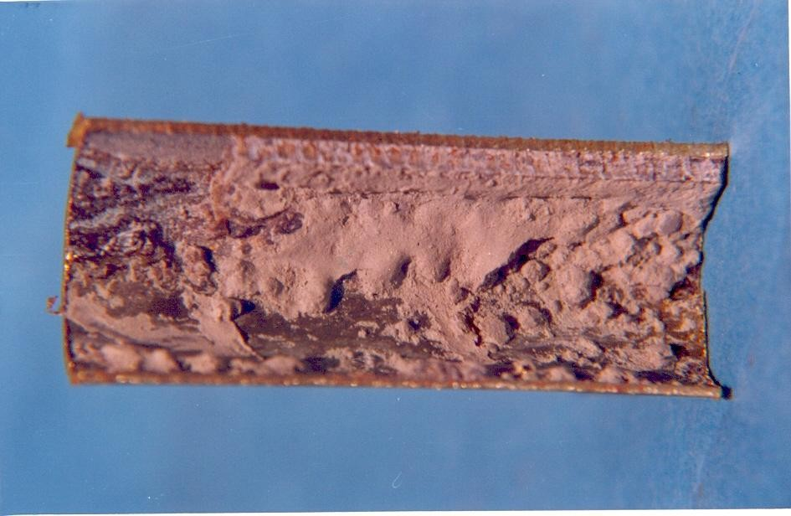
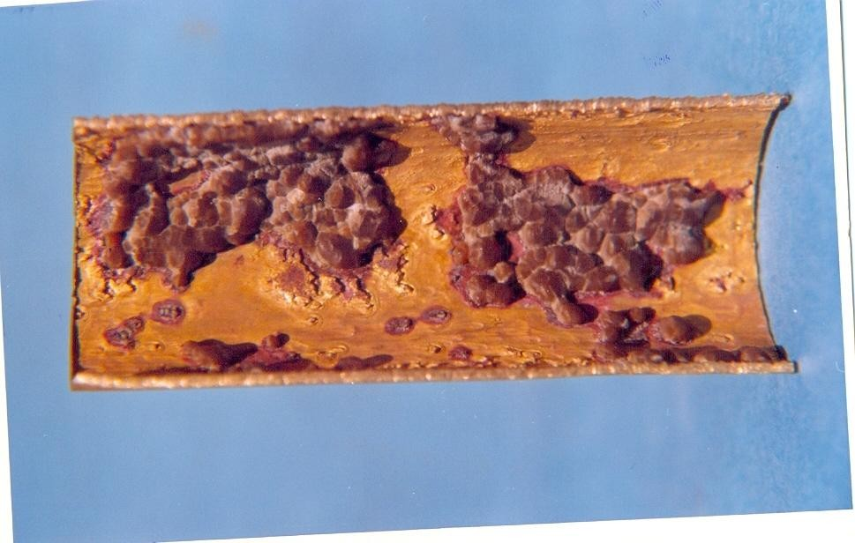
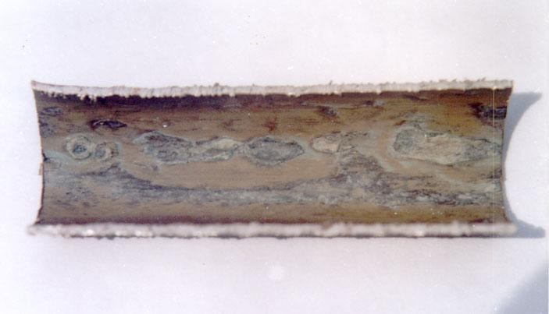
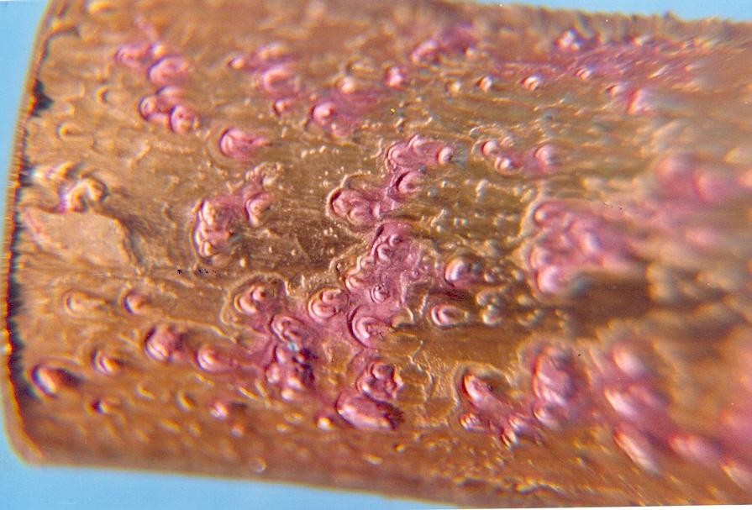
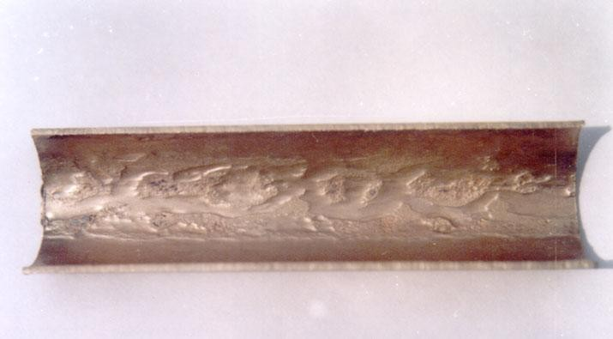
CASES OF CORROSION IN CONDENSER TUBES
CWMC
BIOFOULING OF ADM. BRASS CONDENSER TUBE
BIOFOULING OF ADM. BRASS CONDENSER TUBE
MIC OF ADM. BRASS CONDENSER TUBES

Slide 40
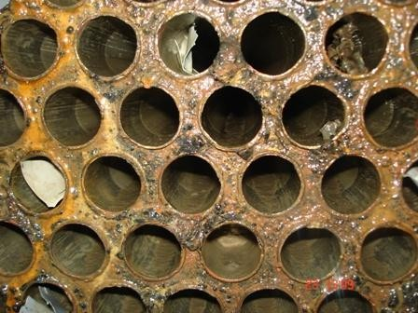
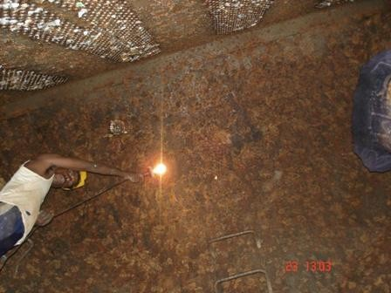
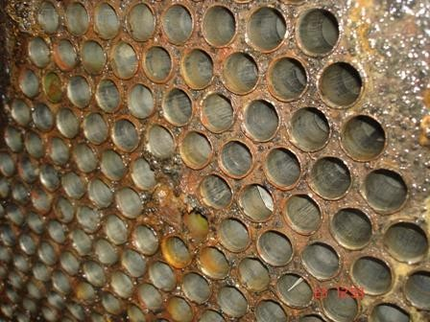
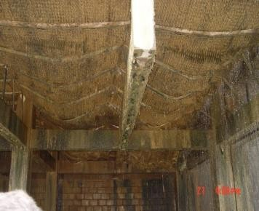
CASES OF CORROSION/FOULING IN CW SYSTEM
CWMC

Slide 41
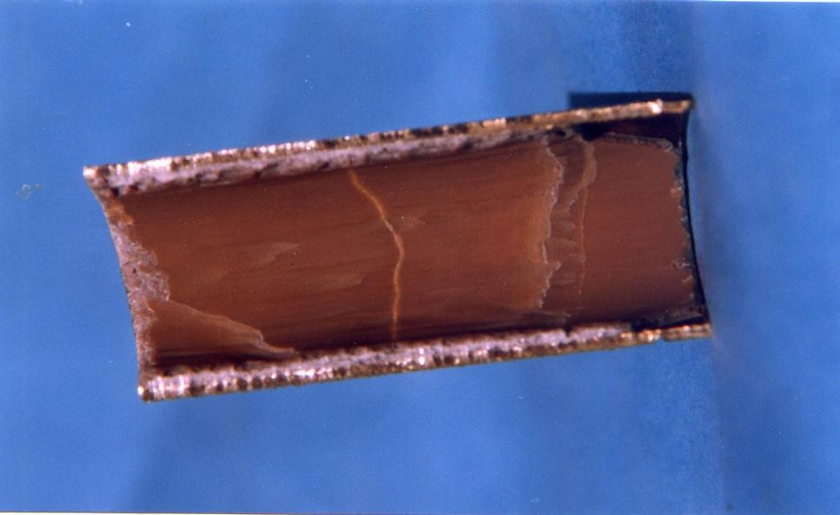
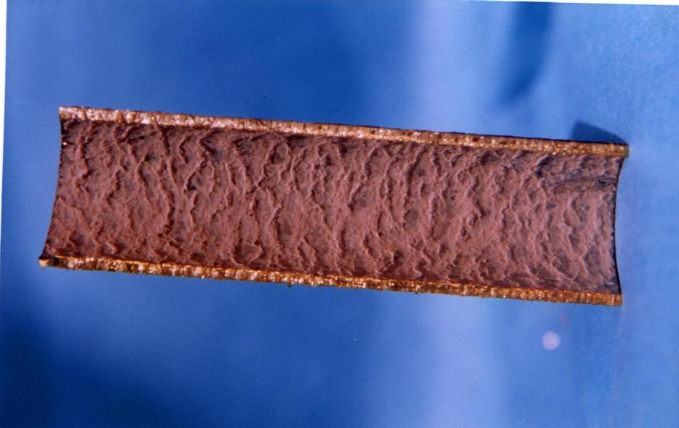
CWMC
CASES OF SCALE/CORROSION IN CONDENSER
TUBES
SCALING IN CONDENSER TUBE

Slide 42
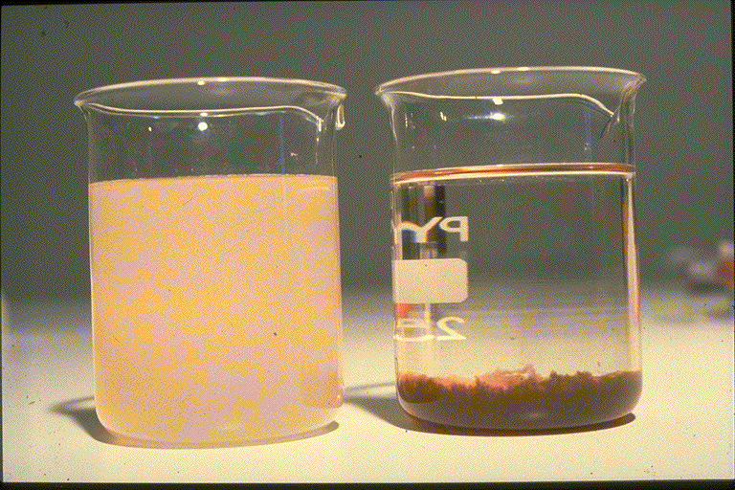

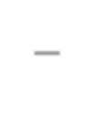
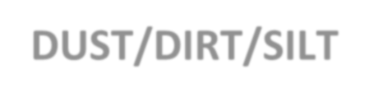
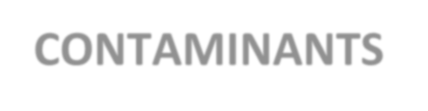
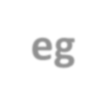
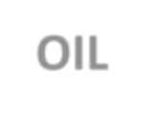
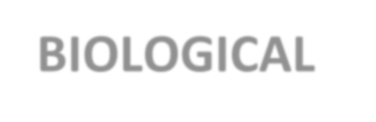
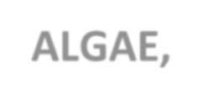
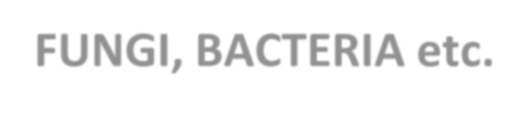
WHAT CAUSES CW PROBLEMS?
CWMC
DISSOLVED SOLIDS
e.g. CALCIUM
MAGNESIUM
SODIUM
CHLORIDE
BICARBONATE
SULPHATE
SILICA
IRON
DISSOLVED GASES
e.g. OXYGEN
CARBON DIOXIDE
NITROGEN
SULPHUR DIOXIDE
SUSPENDED MATTER
DUST/DIRT/SILT
CONTAMINANTS eg OIL
BIOLOGICAL eg ALGAE, FUNGI, BACTERIA etc.
41

Slide 43
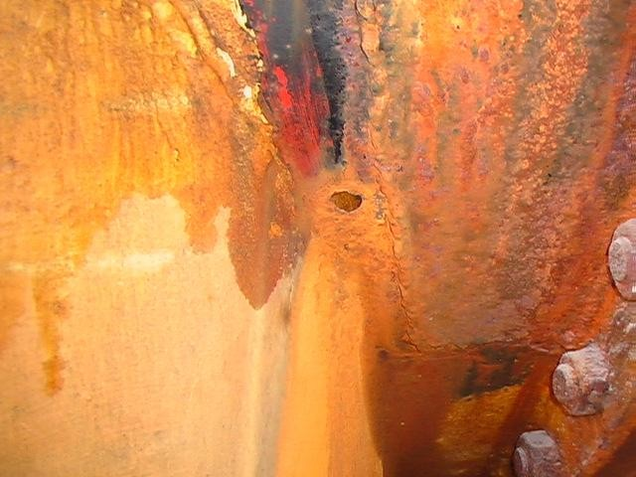

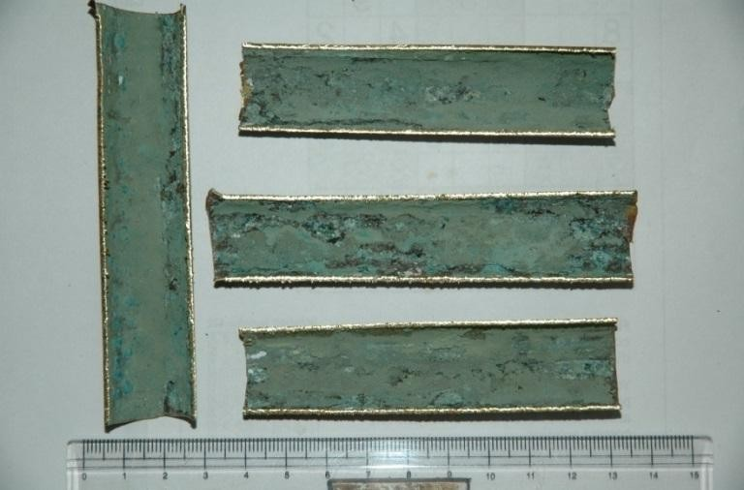
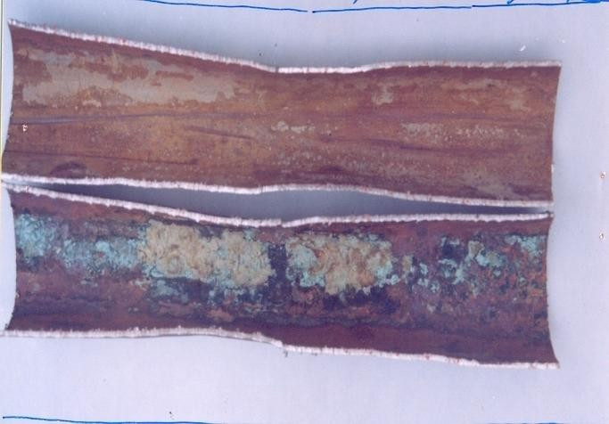
CW Problems
CWMC
Corrosion - Electrochemical
reactions involving O_{2,} H₂O
Scaling - Hard crystaline deposit of salts of Ca & Mg, with SiO₂, PO_{4,} CO₃
Fouling - Porous deposits Dirt Silts, Sand, Corrosion products
Biofouling/MIC – Algae, F4u2 ngi,
Bacteria

Slide 44








Biofilms
CWMC
Foulant | Thermal Conductivity
CaCO3 | 1.3-1.7
CaSO4 | 1.3
CaPO4 | 1.5
MgPO4 | 1.3
Fe Oxide | 1.7
Biofilm | 0.4
Common biofilms are 4 times more insulating than CaCO3 scale!
More insulating than
most common scales ⇨
Reduce heat transfer efficiency
Increase dP across heat exchangers & reduce flow
Health risks (legionella)
FLOW
P
P

Slide 45
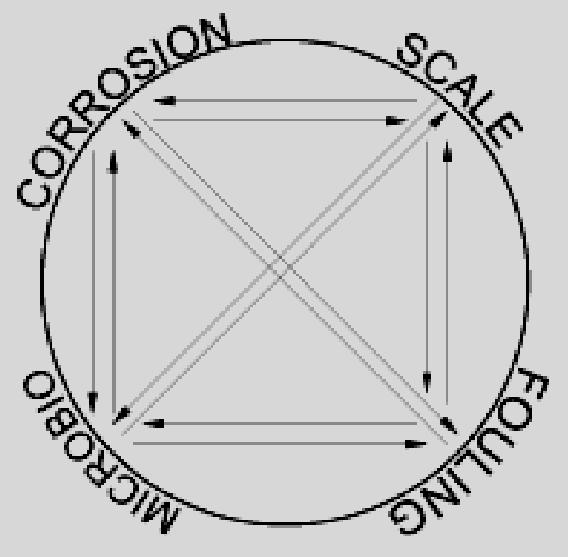
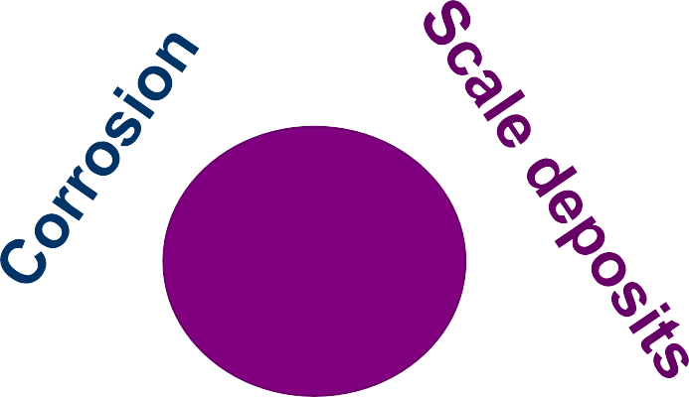
Virtuous Triangle
CWMC
Cooling Water Problems
Bio-fouling
These scaling/corrosion/fouling/microbiological problems of cooling water can be controlled by treating cooling waters with integrated chemical treatment program.

Slide 46
Deposit Problems
CWMC
Deposit problems are usually divided into two types
1.
2.
Fouling Scale
Fouling is the accumulation of water suspended materials on heat exchanger surfaces. It contributes to equipment deterioration.
Scale is a dense coating of predominantly inorganic materials and results from super-saturation of water soluble minerals.
Deposits of both types interferes with heat transfer in heat exchangers, thereby reducing their efficiency.

Slide 47
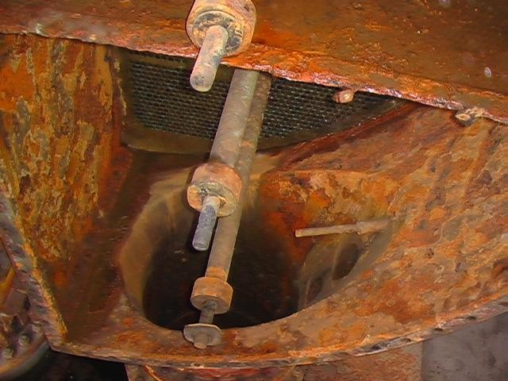
Corrosion
CWMC
Corrosion is an electrochemical process by which a metal such as mild steel returns to its natural state.
Deterioration and perforation of heat exchanger tubes can result in lost product, system contamination and inefficient operation. Such damage requires downtime for maintenance, equipment replacement etc all leading to increased production costs.

Slide 48
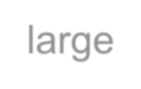
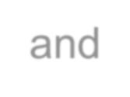

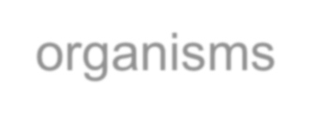


Biological Deposition and Corrosion
CWMC
Biological problems are created by both large and microscopic organisms. The former is the fouling that results from large plant and animal organisms, and usually affects steam condensing units. These are sargassum weeds, floating debris, mussels, oysters and large eels. While mechanical barriers are effective against the large organisms smaller water life remains a problem.
Microbiological problems are generally referred to as slime deposits. They result from the presence of microorganisms such as algae, fungi and bacteria. They can grow within a cooling system coating all pipe and heat exchanger surfaces. The gelatinous slimes produced by many micro organisms can trap sediments thus encouraging fouling and scale. Even corrosion can be caused by certain organisms that produce corrosive byproducts or environments. Corrosion by micro organism is called Microbiological Induced corrosion (MIC).

Slide 49
Scaling in Cooling Water Systems
CWMC

Slide 50


CWMC

Slide 51




SCALE
CWMC
As the water cycles in cooling system, the concentration of the dissolved ions increases until the solubility of one or more of the constituents is exceeded. When this happens, the material precipitates, or becomes a solid in water, and is available to become a deposit.
Scale in condenser Tubes
SCALING IN COOLER TUBE
50

Slide 52


Factors Affecting Scale formation
CWMC
pH
•
•
•
•
•
•
•
•
Water Temperature Alkalinity or Acidity
Concentration of scale forming materials in cooling water
Physical Fouling
Microbiological Characteristics of cooling water Flow rate of cooling Water
Operating Conditions of the Process
Holding Time Index
Scale Occurring in Cooling Water System
Most Common Calcium Carbonate Calcium Sulphate Calcium Phosphate Iron oxide
Silica
Less Frequent Magnesium Silicates Zinc Phosphate Calcium Flouride
Iron Carbonate
51

Slide 53
Scale Control
CWMC
There are three basic methods for preventing formation of calcium scale in cooling water system
Remove the calcium hardness or scaling minerals from the water prior to
use.
Keep scale-forming constituents in solution
Allow the impurity to precipitate as a removable sludge rather than as a hard deposit.
Based upon these basic methods scale control may be done in following manner
Limiting Cycle of Conc.
Softening of Make Up water
pH adjustment of cooling
water
Polyphosphate Dosing
Organo Phosphonates/ Various Organic Polymer Dosing
Scale Inhibitors
Control of Fouling
Control of Bio-fouling
Periodic Cleaning
  Mechanical Cleaning
  High Pressure water Jet Cleaning
52

Slide 54
Scale Control
CWMC
To predict corrosive or scale forming tendency of water following indices are used.
1. Langlier (or Saturation) Index
LSI = pH - pHs
pHs = (9.3 + A +B) - (C + D)
A -Total Dissolved Solid Factor
B - Temperature Factor
C - Calcium Hardness Factor
D - Alkalinity of Cooling Water
2. Ryzner ( or Stability) Index
RSI = 2pHs – pH
3. Puckorious ( or modified stability) index
PSI = 2pHs – pH_{e}
^{(pH}equilibrium ^{= 1.465log}(total alkalinity)⁾
LSI - +ve indicates Scaling tendency
LSI - - ve indicates Corrosive tendency RSI - > 6.0 indicates Corrosive tendency
RSI - < 6.0 indicates Scaling tendency PSI - > 6.0 indicates Corrosive tendency
PSI - < 6.0 indicates Scaling tendency
53

Slide 55
Scaling Severity keyed to index
CWMC
LSI
RSI/PSI Condition
3.0 | 3.0 | Extremely severe scaling
2.0 | 4.0 | Very severe
1.0 | 5.0 | Severe
0.5 | 5.5 | Moderate
0.2 | 5.8 | Slight
0.0 | 6.0 | Stable Water
-0.2 | 6.5 | No scaling very slight tendency to dissolve solids
-0.5 | 7.0 | No scaling slight tendency to dissolve solids
-1.0 | 8.0 | No scaling moderate tendency to dissolve solids
-2.0 | 9.0 | No scaling strong tendency to dissolve solids
-3.0 | 10.0 | No scaling very strong tendency to dissolve solids
54

Slide 56














Softening of Make Up Water
CWMC
Softening process removes Calcium and Magnesium either by
Lime soda softening
Ion-Exchange process
CaCO₃ + R-Na MgCO₃ + R-Na
= Na₂CO₃ + R₂-Ca
= Na₂CO₃ + R₂-Mg
Softened water of 0-5 ppm hardness as CaCO₃ is supplied as make up to the CW system. The chances of precipitation of scale is minimized provided alkalinity and TDS of CW do not become very high to affect the scaling index.
Lime softening is not preferred due to high pH of softened water.
(Acid dosing required for pH control)
In case of Ion exchange softening (base exchanger) discharge of waste regenerant (brine solution) is problematic.
55

Slide 57









Scale Control Program
CWMC
Acid Feed
Sulfuric acid addition reduce bicarbonate alkalinity as follows
H₂SO₄ + Ca(HCO₃)₂ CaSO₄ + CO2 + 2H₂O
Alkaline Treatment Method
Alkaline treatment programs are designed to either keep calcium in solution or to modify the crystalline structure of calcium carbonate, which precipitates as sludge like product, which can be removed by blow down.

Slide 58
Scale Control Program
CWMC
Scale stabilising chemical include
Polyphosphate, Polyacrylates Organo Phosphonates
(AMP – Amino tri(methylene) phosphonate
& HEDP- 1-hydroxyethylidine-1,1-disphophonic acid) PBTC – 2-phosphonobutane-1,2,4- tricarboxilic acid
Crystal Modifier are
Copolymers and Terpolymers
(Polymaleic acids and sulphonated polystyrenes)

Slide 59
PERIODIC CLEANINGS
CWMC
MECHANICAL CLEANINGS
On - Line Cleaning (COLTS)
Cleaning by Bullets
Brushings
High Pressure water Jetting
Debris Filters
Travelling Water Screen
Backwashing
CHEMICAL CLEANING
ACID - HCl, SULFAMIC, ORGANIC ACIDS
CHELANTS
PROPRIETARY CLEANING SOLVENTS

Slide 60


Chemical cleaning of severely scaled condensers
CWMC
Heat Rate Improvement = 183 Kcal/kwh
Annual Gain = Rs. 15 Crores
Full Load operation against 80% before cleaning
5599

Slide 61


Case Study of Chemical Cleaning of Condensers
CWMC
Scale deposition in seawater cooled Condensers with Titanium Tubes
Chemically Cleaned seawater cooled Condensers with Titanium Tubes
Specific work: Development of Chemical Cleaning Procedure for Titanium Tubes using Inhibited Sulphamic Acid and Titanium corrosion Inhibitor.
Benefit:
Improvement in Vacuum = 18.77 mm of Hg or 21.77 Kcal/KWH in Heat rate

Slide 62



Case Study of Chemical Cleaning of Condensers
CWMC

Slide 63

Water Requirement for Power
CWMC
For seawater or saline water Sp. Heat is 3.93 which implies a circulation rate of around 62000 m3/hr
Source: CEA

Slide 64
Remedial Measures
CWMC
The typical allowable chloride levels for stainless steels are as indicated below:
Chloride Level ppm | Stainless Steel Grade
<200ppm | 304L, 316L
200-1000ppm | 316L,duplex alloy 2205
1000-3,600 ppm | Duplex alloy 2205 6% Mo super-austenitic, super-duplex
>3,600ppm | 6% Mo super-austenitic, super-duplex
15,000 – 26,000 ppm (seawater) | 6% Mo super-austenitic, super-duplex
Copper Nickel alloys can tolerate upto 70000 ppm of chloride but are highly
susceptible to sulphide induced corrosion.
63

Slide 65
Remedial Measures
CWMC
Supportive corrosion control measures such as anticorrosive coatings, cathodic protection, suitable passivating agents, etc are required especially if lower grade of materials are used in contact with seawater.
Detailed assessment is required to identify suitable treatment of cooling waters taking into account the heat transfer conditions prevalent so that scaling, fouling, corrosion & biofoulig in the cooling water systems.
4. All RCC
structures in contact with seawater or chloride laden
atmosphere should be properly protected with high performance coatings such as 100% solids polyurethane, polyuria, 100% solids epoxy. All surfaces of structures in contact with seawater or water vapour should be fully coated not partially coated. Application of cathodic prevention (at low levels of protective current) can help in prolonging the life of the RCC structures at competitive prices. Structures which have been damaged by corrosion of reinforcement bars should be subjected to detailed condition monitoring. In case the chloride ingress is detected beyond acceptable levels, then routine patch repair will not be sufficient and application of cathodic protec₆t₄ion should be considered.

Slide 66
Guidelines for operation of recirculating seawater
CWMC
Typical Operating Conditions: Seawater Cooling Towers
Parameter | Value | Remarks
Cycles of Concentration | 1.2 – 1.6/1.7 (preferably < 1.3) | Operation at > 1.5 requires advanced scale control
Alkalinity | 200 – 225 max (Preferably < 140) | Depends on makeup alkalinity, cycles, acid feed
Skin temperature | 65 oC (Normal < 50 oC) | Higher temperature require specific treatment to control potential precipitation of Mg(OH)₂ and/or CaSO₄
Flow velocity | 1 – 2.5 m/s | Depending on erosion resistance of the metallurgy
Reynolds number | 30000 - 60000 | Low values promote the deposition of suspended solids
Suspended solids | < 8 mg/l or < 15 mg/l | For film fill and splash fill respectively
RSI | > 6.2 is preferable | Based on interpretation of RSI
Pre-treatment for removal of suspended matter (filters, grits) and organic matter is necessary (continuous chlorination to maintain FRC of 0.2 – 0.5 ppm or shock dosing of Chlorine dioxide if pH is more than 8.2. Online tube cleaning system is beneficial. Online monitoring of fouling, scaling, biofouling & Corrosion65 is recommended. Alkalinity control to < 140 ppm by acid can be effective.

Slide 67
Fouling/Biofouling in CW Systems
CWMC

Slide 68

FOULING
CWMC
Fouling is deposition of suspended solids or buildup of microbiological organisms within heat exchanger and cooling tower fills.
Warm water, aeration nutrients and sunlight transform a cooling tower into an efficient bio-reactor.
Types of fouling
General Fouling
Fouling by corrosion products
Microbiological Fouling

Slide 69
Types of Fouling
CWMC
There are several types of fouling, each forming depending on the type of fluid and conditions. The following are some of the more common fouling mechanisms;
Crystallization is one of the most common type of fouling. Certain salts commonly present in natural waters have a lower solubility in warm water than cold. Therefore, when cooling water is heated during the cooling process (particularly at the tube wall) these dissolved salts will crystallize on the surface in the form of scale. [Common Solution: reducing the temperature of the heat transfer surface often softens the deposits]
Sedimentation, the depositing of dirt, sand, rust, and other small matter is also common when fresh water is used. This can be controlled to a degree by the heat exchanger design. [Common Solution: velocity control]
Biological Organic growth material occurs from chemical reactions, and can cause considerable damage when built up. [Common Solution: material selection]
Chemical Reaction Coking appears where hydrocarbon deposits in a high
temperature
application.
[Common
Solution: reducing
the
temperature
between the fluid and the heat transfer surface]

Slide 70
Types of Fouling
CWMC
Corrosion can destroy surface areas of the heat exchangers, creating costly damage. Fouling will slow down heat transfer and damage equipment unless it is dealt with accordingly. [Common Solution: material selection]
Freezing Fouling results from overcooling at the heat transfer surface causing solidification of some of the fluid stream components. [Common Solution: reducing the temperature gradient between the fluid and the heat transfer surface.]
Fouling factor
The most common way to account for the effects of fouling in a tubular heat exchanger is the application of a fouling factor. The fouling factor is a predetermined number that represents the amount of fouling a particular heat exchanger transferring a particular fluid will sustain. In the heat transfer equation the fouling factor is added to the other thermal resistances to calculate the Total Thermal Resistance which is the
reciprocal of U
clean.

Slide 71




Cooling Tower Fill Fouling
CWMC
SEVERE BIOFOULING OF COOLING TOWER
Fouling by corrosion products
BIOFOULING OF ADM. BRASS CONDENSER TUBES

Slide 72
THE BIOFOULING PROCESS
CWMC
Bacteria prefer to colonise surfaces
– enables production of biofilm which acts to protect and entrap food sources
Planktonic bacteria
  free swimming in bulk water
Sessile bacteria
  attached to surfaces
71

Slide 73
BIOFILM FORMATION
CWMC
What is a Biofilm?
A biofilm consists of microbial cells (algal, fungal, or bacterial) and the extracellular biopolymer they produce. Generally, it is bacterial biofilms that are of most concern in industrial water systems, since they are generally responsible for the fouling of heat transfer equipment. When dealing with cooling towers and spray ponds, algal biofilms are also a concern. Not only will algal biofilms foul distribution decks and tower fill, but algae will also provide nutrient (organic carbon) that will help support the growth of bacteria and fungi. Algae do not require organic carbon for growth but instead utilize CO₂ and the energy provided by the sun to manufacture carbohydrate. So, a cooling water system with little organic carbon can generate its own through the growth and dispersal of algal cells.

Slide 74




BIOFILM FORMATION
CWMC
Fig.1 - Attachment of bacteria to surfaces
Initial Development
Maturation
Accumulation of debris

Slide 75

BIOFILM FORMATION
CWMC

Slide 76










CWMC
Biofilms
More insulating than most common scales ⇨
Reduce heat transfer efficiency
Increase dP across heat exchangers & reduce flow
Health risks (legionella)
Foulant | Thermal Conductivity
CaCO3 | 1.3-1.7
CaSO4 | 1.3
CaPO4 | 1.5
MgPO4 | 1.3
Fe Oxide | 1.7
Biofilm | 0.4
Common biofilms are 4 times more insulating than CaCO3 scale!
FLOW
P
P

Slide 77


Losses in Pipelines due to Friction Head & consequent Energy Losses
CWMC

Slide 78


Losses in Pipelines due to Friction Head & consequent Energy Losses
CWMC
Pump designed for 630 m3/hr was delivering 450 m3/hr due to Severe fouling. Corrosion products

Slide 79

Losses in Pipelines due to Friction Head & consequent Energy Losses
CWMC

Slide 80

CWMC
CASES OF CORROSION IN
CONDENSER TUBES
MICROBIOLOGICAL CORROSION OF CONDENSER TUBE

Slide 81

CWMC
CASES OF CORROSION IN
CONDENSER TUBES
CORROSION & FOULING IN CW MAKEUP WATER PIPES

Slide 82

CWMC
CASES OF CORROSION IN
CONDENSER TUBES
CORROSION & BIOFOULING OF RAW WATER PIPELINE

Slide 83

CWMC
CASES OF CORROSION IN
CONDENSER TUBES
Tuberculation in Pipes

Slide 84




Fouling of PVC Film Type Fills of CT
CWMC
Loss of around Rs. 1.2 Crore per 500 MW unit per year
8833

Slide 85
Fouling of PVC Film Type Fills of CT
CWMC
Need based Biocleaning to be Adopted using Strong Oxidizing Biocide such as Chlorine Dioxide along with suitable dispersant and surfactant will reduce organic fouling.
8844

Slide 86
FACTORS CONTRIBUTING TO MICROBIAL GROWTH
CWMC
Rate of incoming contamination from make up water & air
Amount of nutrient present
pH
Temperature
Sunlight
Availability of oxygen/carbon dioxide
Water velocities

Slide 87
Fouling Control
CWMC
Filtration
Cleaning
  On – load Cleaning
  Off - load Cleaning
Blow Down
Control By chemicals
  Dispersants
  Sludge fluidisers – High molecular weight polymers
  Surfactants
  Biocides

Slide 88
Fouling Control
CWMC
Biocides are used to control microbiological fouling and organic fouling in cooling water.
Types of Biocides
Oxidising Biocides
- Have the ability to oxidise organic matter eg. protein groups
Non-oxidising Biocides
Prevent normal cell metabolism in any of the following ways :
  Alter permeability of cell wall
  Destroy protein groups
  Precipitate protein
  Block metabolic enzyme reactions
Biodispersants (nonionic surfactants) are used to enhance the effectiveness of biocides

Slide 89
Oxidising Biocides
CWMC
Various Oxidising Biocides used in cooling water system for microbial control are as follows:-
Chlorine and its various products
Bromine
Chlorine dioxide
Ozone
Hydrogen Peroxide
Halogen Donors / Halogen Releasingcompounds
Oxidising biocides are capable of undergoing oxidative reactions with organic molecules. They kill microorganisms on contact and dissipate to form harmless, non-toxic products. However their activity is short and require frequent and continuous dosing. Also high dosages cause delignification of timbre and metallic corrosion.

Slide 90
Oxidising Biocides
CWMC
Rapid kill
Cost effective
Tolerant of contamination
e.g. Bromine, Chlorine Dioxide
Minimal environmental impact
e.g. Bromine, Ozone, Peroxide, Chlorine Dioxide
Ineffective against SRB’s
Low residual toxicity
Counts approaching potable water standards possible

Slide 91
EFFECTIVENESS OF CHLORINE AS A BIOCIDE
CWMC
EFFECT OF pH ON THE DISSOCIATION OF HYPOCHLOROUS ACID
pH | HClO⁻
4 | 100
5 | 99.7
6 | 96.8
7 | 75.2
8 | 20.0
9 | Negligible

Slide 92
EFFECTIVENESS OF CHLORINE AS A BIOCIDE
CWMC
EFFICIENCY OF CHLORINE AT DIFFERENT pH IN COOLING WATER SYSTEM
Percent un-ionized form (HOCI ⁻ or HOBr⁻)
100
0
HOBr
Percent ionized from (OCl ⁻ or OBr⁻)
80
20
60
20°C
40
O°C
40
60
HOCI
20
80
4
5 6 7 8 9 10 11
pH
Cl₂ + H₂O
HOCl + OH–
HOCl + H⁺ + Cl–
(Hypocblorous acid)
H⁺ + ClO–
(Hypocblorite ion)
H₂O + ClO–
HOCl + OH–

Slide 93

EFFECTIVENESS OF CHLORINE AS A BIOCIDE
CWMC

Slide 94

EFFECTIVENESS OF CHLORINE DIOXIDE AS A BIOCIDE
CWMC
Chlorine dioxide (ClO₂) is a synthetic yellowish-green gas with chlorine like odor. ClO₂ is unstable as a gas and will undergo decomposition into chlorine gas (Cl₂), oxygen gas (O₂) and heat. However, ClO₂ is stable and soluble in an aqueous solution. For example, solutions of approximately 1% ClO₂ (10 g/L) may safely be stored if the solution is protected from light and kept chilled. In solution, ClO₂ exists as a true gas. The instability of ClO₂ has an important consequence. It negates the possibility of creating and transporting cylinders or rail cars of the gas. Instead ClO₂ must be produced and used at the same location.

Slide 95
Comparison of Biocides
CWMC
For clean systems:
pH 6.8‐8.0
Cl₂ < NaOCl < HOCl + NaBr < ClO₂ < Ozone
pH 8.0 ‐ 9.3
HOCl + NaBr < ClO₂ < Cl₂ < NaOCl < Ozone For systems with high organic loading: pH 6.8 ‐ 9.3
ClO₂ < HOCl + NaBr < Cl₂ < NaOCl < Ozone For systems with ammonia contamination: pH 6.8 ‐ 9.3
ClO₂ < HOCl + NaBr < Cl₂ < NaOCl < Ozone

Slide 96

Economic Comparison
CWMC

Slide 97
Non Oxidising Biocides
CWMC
Methylene bis-thiocyanate (MBT)
Organo tin compound
Quaternary ammonium salts
Organo sulphur
Copper salts
DBNPA (2,2-dibromo-3-nitrilopropionamide)

Slide 98
Non Oxidising Biocides
CWMC
Screen water
Select alternating biocide to prevent resistant strains from developing
Effective against SRB’s
Can protect system long after dosing.
Contain biodispersant
Higher dosage for kill possible
Environmentally some have rapid breakdown e.g. DBNPA

Slide 99
BIODISPERSANTS
CWMC
Improves penetration of biocide within bacterial slime
Disperse released bacteria and biofilm into bulk water for removal by blow down
Reduces ability for bacteria to attach to system surface
Improves performance of both non oxidising and particularly oxidising biocides

Slide 100
Physical Methods
CWMC
Ultra Violet and Ultra Filtration
  Only Effective At Point Of Use
  Cannot Kill Sessile Organisms
  Offer No Protection To Isolated Parts Of System (Static Areas)
  Environmentally Acceptable.

Slide 101
CONTROL OF FOULING IN CT FILLS
CWMC
Mechanical Methods –
Filters for Make up water – To remove suspended matter from Make up water
Side Stream Filters – To remove suspended matter from CT
basin
CT Air Filters – To prevent ingress of suspended matter/ bacteria from air
Note: Chemical treatment along with use of Filters will reduce
treatment cost.

Slide 102


CONTROL OF FOULING IN CT FILLS
CWMC
Side steam Filter

Slide 103
FOULING INHIBITORS
CWMC
POLYMERS, CO-POLYMERS, TER-POLYMERS,
HOMO-POLYMERS OF POLYACRYLIC ACID, POLYMAELIC ACID,
POLYSULPHONIC ACID,
PBTC, HEDP
ARE USED IN DIFFERENT COMBINATIONS AND/OR BLENDED WITH OTHER ANTISCALANT, CORROSION INHIBITORS, DISPERSANTS, ETC

Slide 104
Corrosion in CW Systems
CWMC
103

Slide 105

WHAT IS CORROSION
CWMC
IRON OXIDE
REFINING
MILLING
STEEL
CORROSION
IRON OXIDE

Slide 106



CORROSION
CWMC
Corrosion is a natural process and is a result of the inherent tendency of metals to revert to their more stable compounds, usually oxides. Most metals are found in nature in the form of various chemical
compounds called ores. In the
General Corrosion
Pitting Corrosion
refining process, energy is added to the ore, to produce the metal. It is this same energy that provides the driving force causing the metal to revert back to the more stable compound.
Under deposit Corrosion

Slide 107


CWMC
WHAT IS CORROSION
CORROSION IS A NATURAL PROCESS BY VIRTUE OF WHICH THE METALS TEND TO ACHIEVE THE LEAST ENERGY STATE – I.E. COMBINED STATE
M M²⁺ + 2e⁻
ANODIC REACTION
N ²⁻ + 2e N
MIC
CATHODIC REACTION
Dezincification

Slide 108


CWMC
CORROSION
Corrosion is an natural process by virtue of which the metals tend to achieve the least energy state i.e. combined state
M M²⁺ + 2e⁻ N ²⁺ + 2e⁻ N
^{ANODIC REACTION} CATHODIC REACTION
Anode
Fe → Fe²⁺ + 2e⁻
Fe²⁺ + 2OH⁻ → Fe (OH)₂
Fe (OH)₂ + H₂O + 1/2 O₂ → Fe (OH)₃ Fe (OH)₃ → Fe₂O₃ . H₂O + 2H₂O
Cathode
2 H⁺ + 2e⁻ → H₂
4H⁺ + O₂ + 4e⁻ → 4 OH⁻ O₂ + 2H₂O + 4e⁻ → 4 OH⁻

Slide 109

MECHANISM OF CORROSION
CWMC
Na⁺ _{Ca}++
Cl⁻
OH⁻
_{SO} – -
O₂
_{Fe}++
4
O
2
_{H}+
H₂
_{H}+
Water
Fe(OH)
2
OH–
_{H}+ _{H}+
Fe(OH)
Fe⁺
_{Fe}++
Fe⁺
2
Fe⁺
Fe⁺
Electrons
Anode
Steel
Cathode
Corrosion Cell

Slide 110


UNDER DEPOSIT CORROSION
CWMC
O₂
O₂
Available to the Metal Surface
OH– O₂ - 2H₂O - 4e → 4OH–
Deposit
OH–
Corrosion Products - M
(OH)₂
Oxygen Depleted Zone
_{M}+ +
_{e}–
_{e}–
Base Metal
(M)
Cathode |  | Anode
Cathode
Differential aeration cell under a deposit

Slide 111


Corrosion in CW System
CWMC
110

Slide 112


Condition of RCC Structures of Cooling Towers
CWMC

Slide 113
TYPES OF CORROSION
CWMC
Corrosion falls into three basic categories
GENERAL CORROSION
LOCALISED (PITTING, SCC, Dealloying) CORROSION
GALVANIC CORROSION
General corrosion takes place over the entire metal surface while localised pitting takes place at a small anode and because of smaller area is typically more severe.
Galvanic corrosion occurs when one metal sacrifices itself to protect another. This would occur when two dissimilar metals are in contact.
112

Slide 114
CORROSION IN CW SYSTEM
CWMC
PIPELINES
CONDENSER WATER BOXES
TUBE PLATES
TUBE - TUBE PLATE JOINTS
CONDENSER TUBES - INTERNALS
CONDENSER TUBES - EXTERNALS
INLET END OF CONDENSER TUBES
PUMPS
BOILER TUBES (CARRY OVER)
AUXILLIARY COOLING WATER SYSTEM
HEAT EXCHANGERS
PLATE HEAT EXCHANGERS
Cooling Towers, basin, channels

Slide 115
Effects of Condenser Tube Leaks and Damage
CWMC
NOTE:
Chloride & Sulphate ions are Corrosive in nature
Hardness salts will have tendency of deposition
Silica can travel to turbine and cause deposition
Corrosion Products & Deposits reduce heat transfer
Deposits also promote under deposit corrosion
Deposits, Corrosion products in CW system Promote Fouling

Slide 116
Causes of Corrosion
CWMC
Dissolved Oxygen
Dissolved and suspended solids
Acidity – Alkalinity
Water velocity
Temperature
Microbiological Growth
Presence of CO, NH₃, H₂S and Chlorine
High Chloride /sulphate
Galvanic Action
Pollutants
Fouling/ Under deposit corrosion
The pH or alkalinity of the water is extremely important as it affects
corrosion significantly.
As a general rule corrosion potential decreases when pH increases, but as the pH increase so does the potential for scale.

Slide 117
CORROSION CONTROL
CWMC
pH adjustment
Effective aeration
Effective Chlorination
Balancing the chloride and hardness
Polyphosphate dosing
Ferrous sulphate dosing
Cathodic Protection
Corrosion inhibitors
Correct design
Corrosion resistant materials
Anti corrosive coating
Avoid galvanic coupling
Keeping the system clean

Slide 118
Corrosion Control
CWMC
Corrosion inhibitors are used to control the corrosion in CW system, which are
Phosphates -When added to the system in presence of calcium
hardness will form a cathodic inhibitor.
Chromates : Anodic inhibitor
Zinc : Cathodic inhibitor, which provides excellent pitting corrosion protection.
Triazoles : An anodic inhibitor that specifically protects system yellow metals.
Phosphonates : Cathodic inhibitor which that lays down
monomolecular film on metal surfaces.
Molybdates : A non toxic heavy metal that is excellent anodic
inhibitor
117

Slide 119
Corrosion Monitoring
CWMC
System corrosion rates can be measured with the use of:
Corrosion Coupons
Corrater Readings
Water chemistry tests

Slide 120
Cooling Water Treatment
CWMC

Slide 121

Schematic of a recirculating cooling water system in a coal-fired power plant
CWMC

Slide 122
Objectives of Cooling Water Treatment
CWMC
MINIMISE SCALE
MINIMISE CORROSION
MINIMISE FOULING
MINIMISE BIOFOULING
MAXIMUM SAFETY
MAXIMUM EFFICIENCY
NON-POLLUTING
WATER CONSERVATION

Slide 123
Integrated Cooling water treatment
CWMC
Key elements of cooling water treatment
1. Scale control- Ca, Mg Compounds & Silicates
Use of threshold inhibitors- phosphonate or/and polymeric compounds
•
2. Corrosion Control
Use of cathodic, anodic & adsorption based inhibitors
•
3. Fouling Control – metal oxides, silt & suspended impurities Use of Homopolymers , multifunctional Co-polymers & Ter- polymers/quadpolymers
•
4. Microbiological control – Biofouling & microbiological induced corrosion Use of oxidising & non-oxidising biocides & Biodispersants
•

Slide 124


Attributes of an efficient treatment
CWMC
Knowledge of the System & Variation taking place
Threshold inhibition – Effectiveness over saturation level of various scalants.
  Ca ion Tolerance
  Crystal modification ability
  Stability wrt oxidising biocides
  Effectiveness in presence of metal oxides
Corrosion Inhibition- Selecting inhibitors:
-Cathodic Anodic or complexing type
  Passivating inhibitors demonstrate better flexibility over - Precipitating type
  Effectiveness of inhibitor stabilisers/dispersants
  Effectiveness of dispersants in presence of metal ions

Slide 125
Attributes of an efficient treatment
CWMC
Antifoulants
Building synergy with antiscalants for threshold stabilization & Ca ion tolerance
Dispersing effectiveness
Metal ion/oxide tolerance
Biodispersants
Ability to detach sessile bacteria
Dispersing ability
Penetrating ability
Ionocity
Oxidizing Biocides
Stability over operational conditions
Effectiveness over wide range of pH
Oxidizing potential
Corrosivity

Slide 126
Attributes of an efficient treatment
CWMC
Nonoxidizing Biocides
Selection w.r.t effectiveness over different microbial species:- algae, fungus & various Bacteria
Tolerance w.r.t hardness, Zn, metal oxide, oil, hydrocarbons
Compatibility with oxidising biocides
Retention time
inhibitory consideration
Biodegradability
Health, Safety & Environmental considerations
Acceptable discharge level
Biodegradability
Handling Issues
Legionella Effectiveness

Slide 127
Typical CW Treatment Formulation
CWMC
Cooling Water Treatment program may include
Phosphate (Tri, hexa, ortho) TSP, SHMP
Organo phosphonates: AMP, HEDP, PBTC
Zinc Sulphtate/molybdate
Triazole: Benzo triazole, TTA
Dispersants mono, co or ter polymers of acrylates, sulphonates, maleic acid etc
Bio-dispersant
Biocides

Slide 128
Scale Inhibitor dosage
CWMC
If PSI or RSI is | ppm of active Phosphonate (HEDP) | ppm of Polyacrylate (1000 mol. Wt.)p
6.0 or above | -0- | -0-
6.0 to 5.5 | 0.2 to 0.5 | 0.5 to 1.0
5.5 to 5.0 | 0.5 to 1.2 | 1.0 to 3.0
5.0 to 4.5 | 1.2 to 2.2 | 3.0 to 5.0
4.5 to 4.0 | 2.2 to 3.2 | Can’t be controlled with Polyacrylate
Below 4.0 | Can’t be controlled with phosphonate

Slide 129
Dosages & Residuals
CWMC
The formulation is dosed in a manner so that the following residual concentrations of scale & corrosion inhibitors, dispersants, biocides is maintained in the system
Chemical
Inorganic phosphate as PO₄
Organic phosphate as PO₄
Residuals 2-3 ppm
1.5-2.0 ppm
0.5-1.0 ppm
0.5-1.0 ppm
1.0-2.0 ppm
0.2-0.5 ppm
0.05-0.1 ppm
0.2 – 0.5 ppm
Zinc as Zn
Molybdate as MoO₄
Dispersant as polymer
Biocides Chlorine
ClO₂ (continuous) once daily

Slide 130
Sulphuric acid required (kg/day)
CWMC
= {0.026 X (Circulating Water Alkalinity – 300) X Blow Down
(m3/hour)}
(Where 0.026 is a factor applied for calculations)

Slide 131

Corrosion criteria for commonly used metal alloys in cooling tower systems
CWMC

Slide 132
Monitoring of Cooling Water Systems
CWMC
131

Slide 133
EPRI Guidelines for Cooling Waters
CWMC
Water Quality |  | EPRI Guidelin es | Remarks
Paramet er | Units
Ca | Mg/l CaCO3 | 900 (max)
Ca X SO₄ | (Mg/l)² | 500000
M Alkalinity | Mg/l CaCO3 | 30 – 50 220 - 250 | Without Scale Inhibitor With Scale Inhibitor
Mg X SiO₂ | Mg/l CaCO3 ^{X} Mg/l SiO2 | 35000
SO₄ | Mg/l
SiO₂ | Mg/l | 150
PO₄ | Mg/l
Fe (Total) | Mg/l | < 0.5
Mn | Mg/l | < 0.5
Cu | Mg/l |  | < 0.1
Al | Mg/l |  | < 1
S | Mg/l |  | 5 | < 0.25 ppm for Copper Alloys
NH₃ | Mg/l |  | < 2 | For copper based alloys present in the system
pH |  |  | 6.0 – 7.2 7.8 – 8.4 | Without Scale Inhibitor With Scale Inhibitor (Higher operating pH is possible with new alkaline treatments)
TDS | Mg/l |  | 70000
TSS | Mg/l |  | < 100 < 300 | For Film type Fill Splash type Fill
BOD | Mg/l
COD | Mg/l
LSI |  | < 0
RSI |  | > 6
PSI |  | > 6
Desirable: BOD < 5 ppm, Turbidity < 2 NTU, Sulphide < 0.1 ppm (for Cu based systems), Chloride < 200 ppm for SS 304 (upto 500 ppm short duration & < 500 ppm for SS 316 (3000 ppm short duration)

Slide 134

EPRI Guidelines for Cooling Waters
CWMC

Slide 135
Microbiological Parameters for Cooling Waters
CWMC
PARAMETERS | LIMITS | UNIT | PROTOCOL
Total Bacterial Count | <1 x10⁴ * <2 x10³ ** | CFU/mL | Standard Method for Examination of water and waste water 20th Edition, Part 9215-B IS 5402 (latest edition)
Total Fungal Count | <10 | CFU/ mL | Standard Method for Examination of water and waste water 20th Edition, Part 9610-B IS 5403 (latest edition)
Sulphate Reducing Bacteria | <100 | MPN/ 100 mL | ASTM Standard, 1990. D 4412 - 84 (latest edition)
Sulfur Oxidising Bacteria: a. Thiobacillus thiooxidans b. Thiobacillus thioparus | <2 | “ | Standard Method for Examination of water and waste water 20th Edition, Part 9240-D IS 1622 (CL 3.8) Latest edition
Acid Producing Bacteria | <100 | “ | NACE Standard TM0194-194
Gas Producing Bacteria | <100 | “ | NACE Standard TM0194-194
Nitrifying Bacteria | Not desirable | “ | Microbiology of Cooling Water, James W Mccoy
Ammonia Producers | N.S. | “ | Microbiological Methods-Collins and Lyne’s, 7th Edition
Slime Formers: a. Pseudomonas aeruginosa b. Enterococcus Sp. | N.S. | “ | Standard Method for Examination of water and waste water 20th Edition, Part 9213-F IS 13428 (Annexure 1 CL 6.1.5
Iron Bacteria | <2 | P/A | Standard Method for Examination of water and waste water 20th Edition, Part 9240-B IS 1622 (CL 3.6)
Manganese Bacteria | <2 | P/A | Standard Method for Examination of water and waste water 20th Edition, Part 9240-D

Slide 136
Screening Tests
CWMC
Laboratory Screening Tests for Evaluating Deposit Control Polymers
1. Threshold inhibition
a. Calcium carbonate
Static moderate conditions
Stirred severe conditions
Calcium sulfate
Barium sulfate
Calcium phosphate
Calcium phosphonate
Silica polymerization
2. Dispersancy
Iron oxide
Hydroxyapatite
Kaolin clay
Metal ion stabilization
  Iron
  Zinc

Slide 137
Screening Tests
CWMC
Laboratory Screening Tests for Evaluating Deposit Control Polymers
Deposit control
  Calcium carbonate
  Calcium sulfate
Product use considerations
  Calcium ion tolerance
  Chlorine compatibility
  Hydrolytic stability
  Thermal stability
  Total solids

Slide 138
Dosage Rates – as per RSI for CaCO3 Prevention
CWMC
Scaling | LSI | RSI/PSI | HEDP | PBTC | Polyacrylate
 |  |  | (100% Active Basis)
None | 0.0 | > 5.8 | 0.0 | 0.0 | 0.0
Slight | 0.2 | 5.6 – 5.7 | 0.2 | 0.1 | 0.5
Moderate | 0.5 | 5.3 – 5.5 | 0.5 | 0.3 | 1.0
Strong | 1.0 | 4.7 – 5.2 | 1.0 | 0.5 | 2.2
Very Strong | 1.5 | 4.3 – 4.6 | 2.0 | 1.2 | 4.0
Severe | 2.0 | 4.1 – 4.2 | 3.0 | 1.8 | X
Very Severe | 2.5 | 3.9 – 4.0 | X | 2.4 | X
Highly Stressed | > 2.7 | < 3.9 | X | X | X
Activity of Commercial Product |  |  | 60 | 50 | 50
% PO4 in Commercial Product |  |  | 55.3 | 17.6 | X
% P |  |  | 18.1 | 5.7 | X

Slide 139
Acceptable Performance Criteria for Cooling Water Systems
CWMC
Cumulative corrosion rate of Mild Steel: < 2.0 mpy with no pitting.
General corrosion rate of Stainless Steel: < 0.10 mpy. (No visible sign of localized corrosion should be on SS tubes).
Corrosion rate of Cu-Ni: < 0.10 mpy with no pitting.
Scale deposition rate: <15 mg/dm²/year.
Total Viable Count (TVC): Not to exceed 10000 counts/ml in cooling
water. Complete Microbiological analysis – once in 3 months.
Sulphate Reducing Bacteria (SRB): Not to exceed 100 organisms/100 ml in cooling water.
Heat Transfer not to vary more than 5 % from the time of starting the
treatment program
The system should be free from deposits & fouling.
The system should be free from Algae & Fungi growth on towers, basins, sumps etc.
Scaling: Hard scales should not be there only scaling in traces & loose in nature, which can be cleaned by water jet on deposit monitor, can be there.
Magnesium Cycle - To be consistent with cycle of concentration.
12.Silica Cycle - To be more than or equal to Magnesium cycle.
138

Slide 140
CWMC
Monitoring and Evaluation of Treatment Programme
Monitoring Continuous
pH
Water Level in sump
Blow Down Rate
Make up water rate
Temperature
Every shift
Residual Chlorine
Langelier index Ryzner Index (RSI)

Slide 141
Monitoring and Evaluation of Treatment Programme
CWMC
Complete Analysis
Make water and Circulating water (Daily)
pH
Alkalinity
Conductivity
Turbidity
Calcium and Magnesium Hardness
Chlorides
Silica
Iron
Ammonia and Nitrites
Treatment Chemicals

Slide 142
Evaluation
CWMC
Corrosion Control
Corrosion Coupons
On-line corrosion/ Instant Corrosion meter
  Scale and Fouling control
Scale and fouling monitor
Heat transfer data
Periodic inspection
  Microbiological control
Regular microbiological analysis
On-line bio-fouling monitor
ORP monitor

Slide 143


ONLINE BIOFOULING MONITORING
CWMC

Slide 144



ONLINE BIOFOULING MONITORING
CWMC

Slide 145

CWMC
ONLINE CORROSION/FOULING
MONITORING

Slide 146


ONLINE MONITORING OF CHEMICALS
CWMC

Slide 147

CWMC
LABORATOTRY CELL FOR ELECTROCHEMICAL STUDIES

Slide 148


CWMC
CORROSION RATE MONITORS FOR FIELD

Slide 149


CWMC
INPLANT CORROSION MONITORING OF CW SYSTEM THROUGH WEIGHT LOSS COUPONS

Slide 150




CWMC
CORROSION TEST RACK WITH TEST COUPONS FOR
MONITORING OF CORROSION & SCALING IN CW SYSTEM

Slide 151
CORROSION RATE BY WEIGHT LOSS
CWMC
22.3 x W
D x A x T
C.R. (mpy) =
MPY | = |  | Mils Per Year
W | = |  | Weight Loss (mg)
D | = |  | Specific Gravity (gm /cm²)
A | = |  | Exposed Area (inch²)
T | = |  | Time (Days)
1 MM | = | 40 Mils
1 MIL | = | 25 Microns

Slide 152

CWMC
INPLANT BIOFOULING MONITORING OF CW SYSTEM

Slide 153

DISSOLVED OXYGEN ANALYZER
CWMC

Slide 154
Guidelines for assessing Corrosion
CWMC
Model | Corrosion rate (mpy) | Comments
Carbon Steel | 0-2 | Excellent corrosion resistance
 | 2-3 | Generally acceptable for all systems
 | 3-5 | Fair Corrosion resistance acceptable with Iron fouling control program
 | 5-10 | Unacceptable corrosion resistance
Admiralty Brass | 0-0.2 | Generally safe for heat exchanger tubing & Ms equipments
 | 0.2-0.5 | High corrosion rate may enhance corrosion of mild steel
 | >0.5 | Unacceptable high rate for long term; significantly affects MS corrosion
Stainless steel | 0-0.1 | Acceptable
 | > 0.1 | Unacceptable corrosion resistance

Slide 155
Significance of Observed Biological count
CWMC
Count Range | Inference
0 -10000 | Essentially sterile
10000-500000 | System under control
500000 - 1million | System may be under control but should be monitored
1 million – 10 million | System out of control- requires biocide
Over 10 million | Serious fouling problems may be occurring immediate biocide additive required

Slide 156
CONCLUSIONS
CWMC
STEPS INVOLVED IN OPTIMIZING COOLING WATER TREATMENT
Identify the Sources of make-up water for CW System.
Identify the components where the cooling water will be distributed. Carry out detailed Chemical & microbiological analysis over 1 year. Carry out COC Optimization by theoretical analysis of Cooling Water
Carry out laboratory treatment chemicals by chemical tests as indicated.
Carryout regular chemical analysis of cooling waters, blow down waters
Carry out regular chemical and instrumental monitorings of Scaling, Fouling, Biofouling and Condenser performance

Slide 157
CONCLUSIONS
CWMC
MONITOR ALL PARAMETERS AT THE INLET AND OUTLET REGULARLY
USE ONLINE MONITORING EQUIPMENT REGULARLY
USE PROPER CHEMICAL TREATMENT WITH CONTINUOUS ANALYSIS
USE & OPTIMIZE BIOCIDES AND OTHER CHEMICALS
WHEREEVER FEASIBLE OPERATE AT HIGHER COC WITH TREATMENT
WATER QUALITY IS NOT GOING TO IMPROVE IN FUTURE
PRE-TREAT THE WATER FOLLOWED BY TREATMENT FOR
CONTROLLING SCALING, FOULING, CORROSION & BIOFOULING
MAINTAIN CLEANLINESS ARROUND COOLING WATER SYSTEM

Slide 158




CWMC
157

