Slide 1
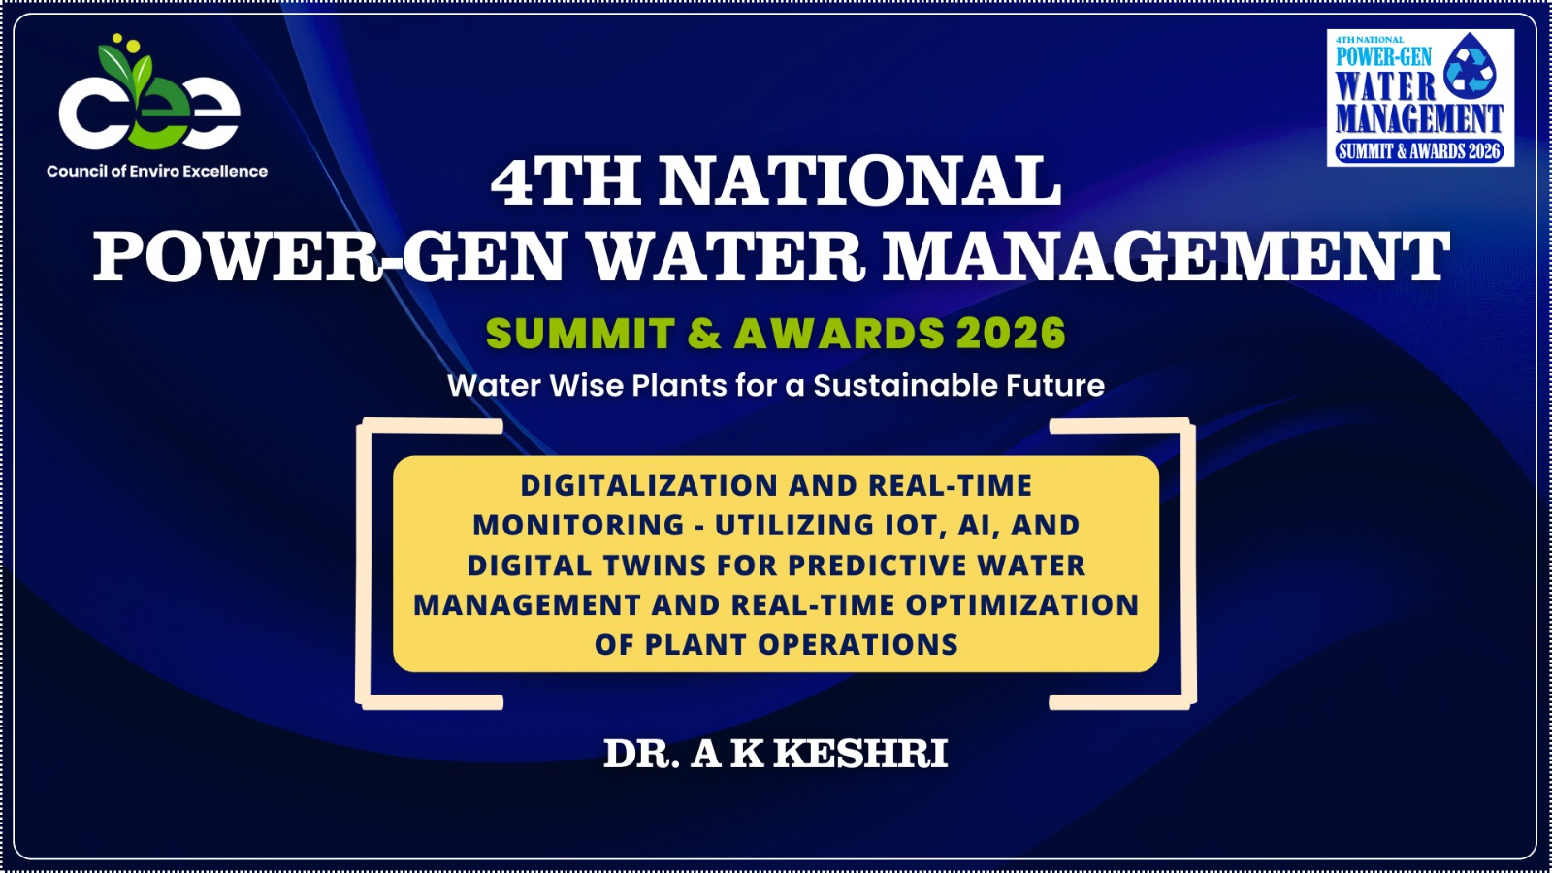

Slide 2


DIGITALIZATION AND REAL TIME MONITORING: UTILIZING IoT, AI
© Prof. (Dr.) Ashok K. Keshari/Dept. of Civil and Environmental Engg./IIT Delhi
AND DIGITAL TWINS FOR PREDICTIVE WATER MANAGEMENT AND REAL TIME OPTIMIZATION OF PLANT OPERATIONS
Prof. (Dr.) A. K. Keshari
Professor
Department of Civil Engineering
Indian Institute of Technology Delhi, Hauz Khas, New Delhi 110016, India Phone: +91 26591236, Fax: +91 26581117, Cell: +91 8860025845
E-mail: akeshari@civil.iitd.ac.in, keshariak19@gmail.com

Slide 3
Rational: Challenges Ahead
© Prof. (Dr.) Ashok K. Keshari/Dept. of Civil and Environmental Engg./IIT Delhi
Water sustainability is becoming a challenging problem worldwide as several sectors are facing water scarcity and it drives economic, industrial, agricultural, and socioeconomic growth of the region besides being the lifeline for the sustenance of life and ecosystems.
Wastewater generation is increasing manifold and managing wastewater is becoming a major challenge as waste disposal is no longer an easy task for industries and municipal corporations.
There has been increasing concerns regarding water pollution resulting from municipal sewage and industrial effluents.
Water is linked with almost all Sustainable Development Goals
(SDGs) (WB 2023).
Climate change is one of the most critical challenges to water resources.

Slide 4
Leveraging Technologies for DigitaIization, Real-
© Prof. (Dr.) Ashok K. Keshari/Dept. of Civil and Environmental Engg./IIT Delhi
Time Monitoring, Prediction & Performance:
Geospatial Technologies:
  GIS
  Remote Sensing
  Drone, LiDAR
Digital Twin
Artificial Intelligence/Machine Learning
Decision Science: Optimization Techniques
Smart Water and Wastewater Infrastructure
Smart Metering and Digital Transformation
Hydrological & Environmental Modelling
Environmental Impact Assessment (EIA) & Social Impact Assessment (SIA)
Vulnerability, Hazard & Risk Assessment

Slide 5
Digital Twin
© Prof. (Dr.) Ashok K. Keshari/Dept. of Civil and Environmental Engg./IIT Delhi
Virtual Digital Replica of Real-World System – Object or component, Process or System, that uses real-time data to reflect/simulate behavior/traits/response, monitor conditions, performance and predict future outcomes
Dynamic
Enables continuous monitoring, simulation, analysis and real- time prediction, maintenance and management
Helps in improving efficiency, visualization, enhanced oversight, informed decisions, and scalability
Data Sources: Sensors, IoT, Satellite Remote Sensing, Drone, LiDAR
Analytics Engine: Artificial Intelligence/Machine Learning
GeoAI, Generative AI, DTaaS (digital twin as a service)

Slide 6
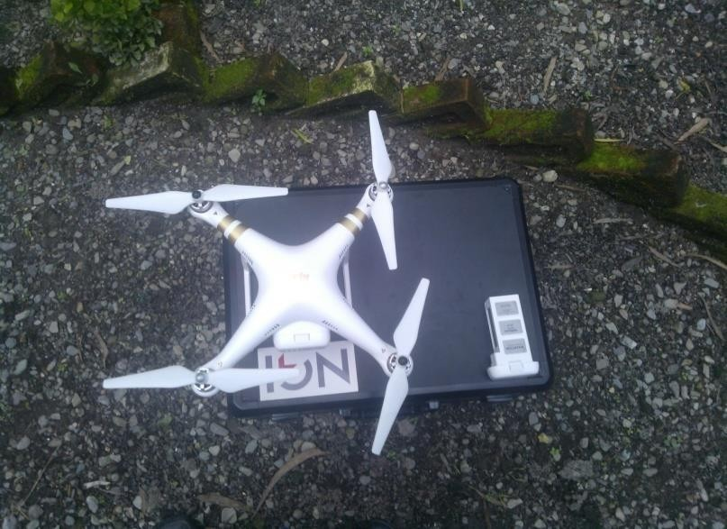
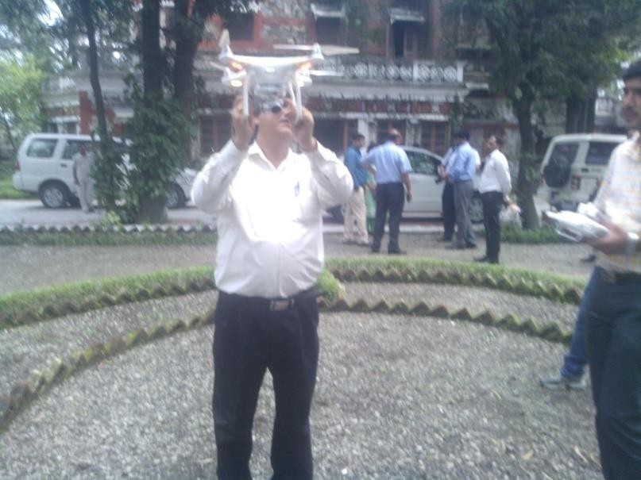
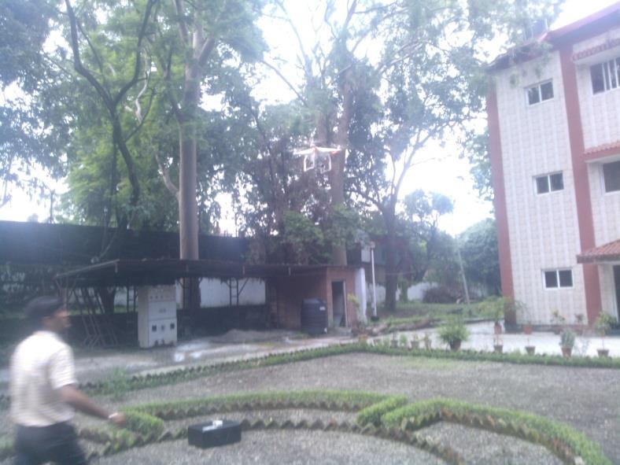
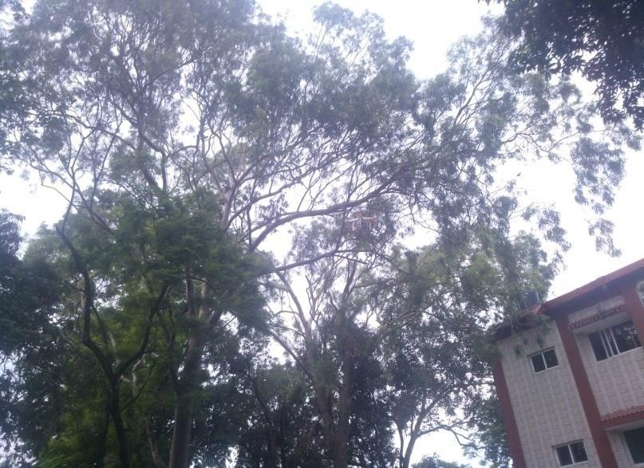
Satellite Remote Sensing & Drone Technology: Data Acquisition using Drone
© Prof. (Dr.) Ashok K. Keshari/Dept. of Civil and Environmental Engg./IIT Delhi

Slide 7

IMPROVING WUE & HER IN INDUSTRIES
© Prof. (Dr.) Ashok K. Keshari/Dept. of Civil and Environmental Engg./IIT Delhi
Process Intervention
Technology Intervention
Operational Management
Utility Intervention
Specific Water Consumption
Water Footprint
EIA & SIA
Hydrological Regime & Groundwater Quality Impact Assessment
4th National Power-Gen Water Management Summit & Awards, Feb. 2, 2026, New Delhi, India, organized by Council of Enviro Excellence

Slide 8
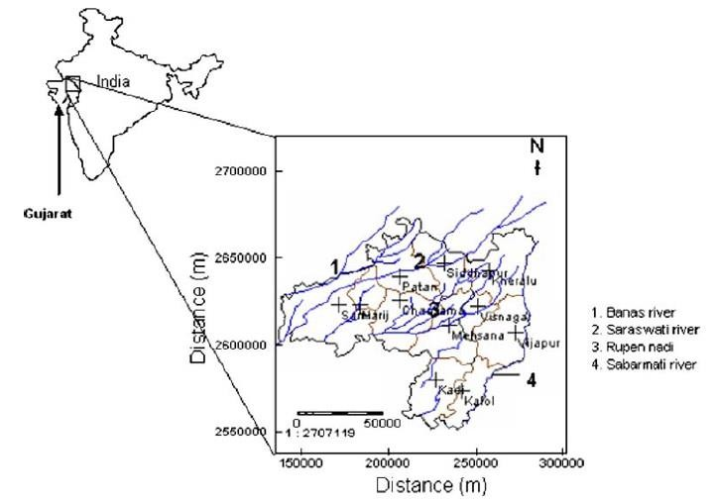
Application to Mehsana Aquifer System
© Prof. (Dr.) Ashok K. Keshari/Dept. of Civil and Environmental Engg./IIT Delhi
Groundwater Simulations
Unconfined aquifer
K = 11.17 - 39 m/day
Specific yield = 10 - 15%
Effective porosity = 25%
Specified head boundary condition
Recharge due to rainfall
Well abstraction
Model Calibration - 1980 -1983
Model Validation - 1983- 1986

Slide 9
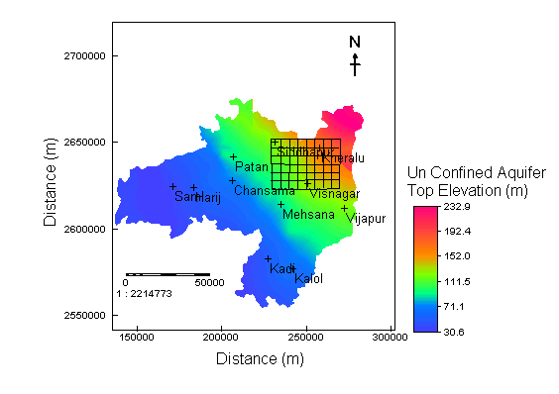
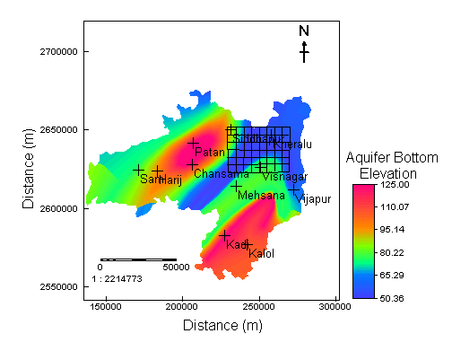
Modeled area
© Prof. (Dr.) Ashok K. Keshari/Dept. of Civil and Environmental Engg./IIT Delhi
-40 km x 30 km
-Grid size 5 km x
5km
Aquifer Top Elevation with Groundwater Modeling Grid
Aquifer Bottom Elevation (amsl, m)

Slide 10
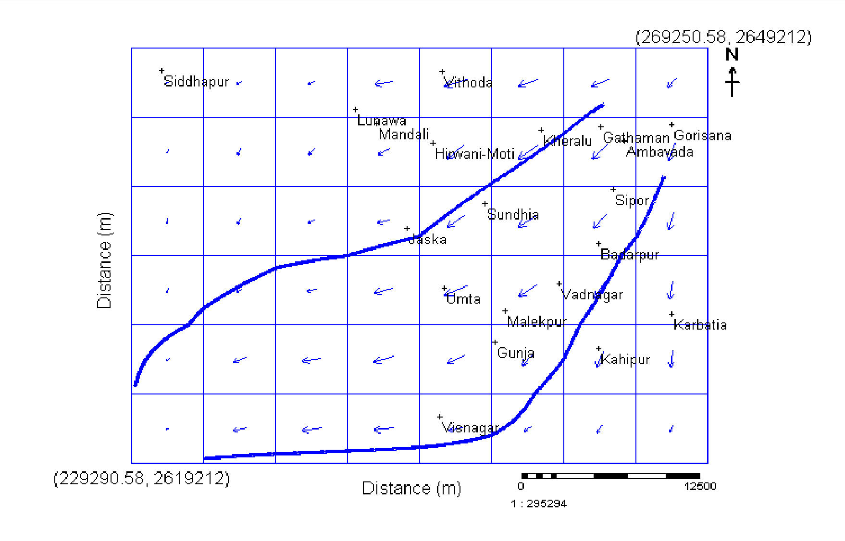
Velocity Vector Map and the Flow lines (Processing MODFLOW AND PMPATH)
© Prof. (Dr.) Ashok K. Keshari/Dept. of Civil and Environmental Engg./IIT Delhi

Slide 11
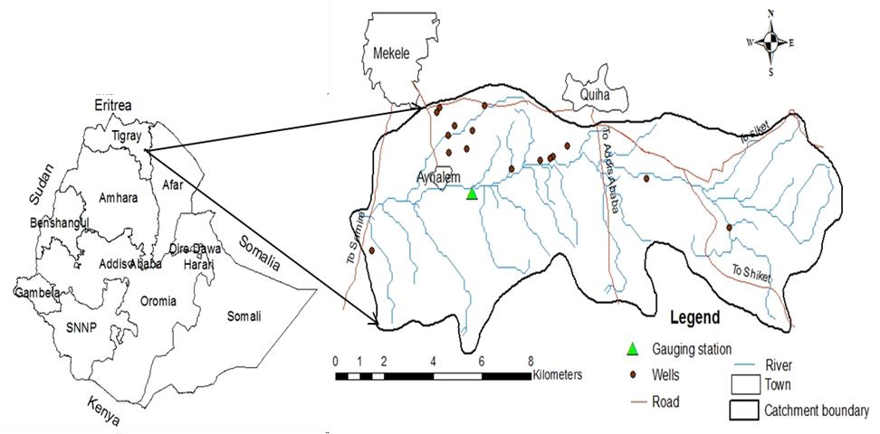
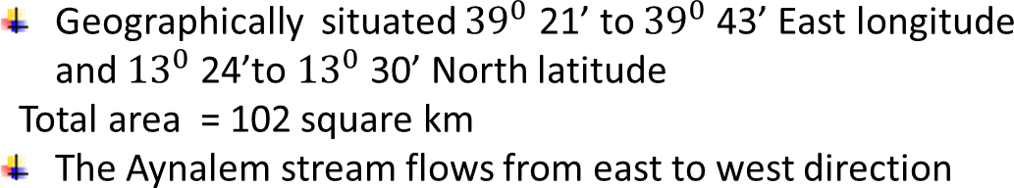
Simulation-Optimization Model for Conjunctive Water
© Prof. (Dr.) Ashok K. Keshari/Dept. of Civil and Environmental Engg./IIT Delhi
Use Management & Eco-system Services:
The Aynalem well field is the main water supply source of Mekelle city
(Capital of Tigray Region)
It is located 770 km North of Addis Ababa , capital of Ethiopia.
Total population =272,519
The model area is discretized into 200/200 columns/ rows with a grid size of 104.965 m by 37.135 m
The aquifer is discretized vertically in one layer depending on the hydrogeological stratification of the aquifer.
Fig. Map of study area

Slide 12
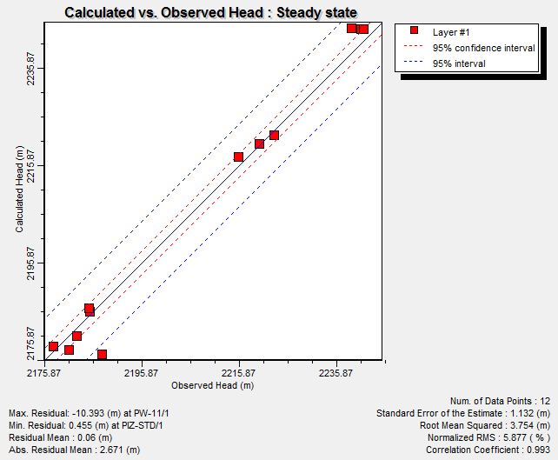
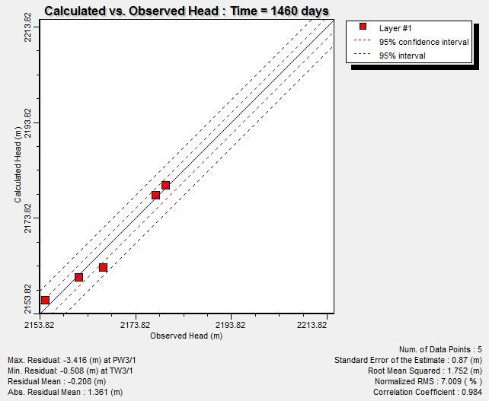
Model Calibration: Aynalem well field
© Prof. (Dr.) Ashok K. Keshari/Dept. of Civil and Environmental Engg./IIT Delhi
Mean error (ME), mean absolute error (MAE) and root mean square error (RMSE) are 1.31 m,
2.02 m and 2.34 m respectively
It is evident from the figure that calculated and observed values are in good agreement.
Simulation runs were taken for transient conditions for a planning horizon of four year from 2003-2006 with 90-days stress period.
(r²) and (RMSE) values of validation model at end of simulation period are 0.984 and
Fig. Comparison of calculated versus observed
hydraulic head: (a) steady state, (b) transient state^{1.752, respectively.}

Slide 13
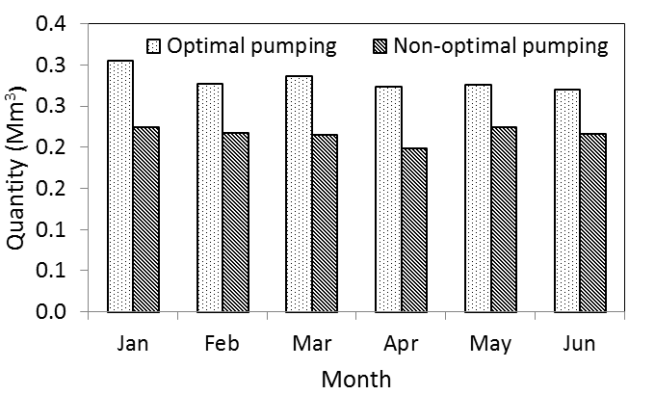
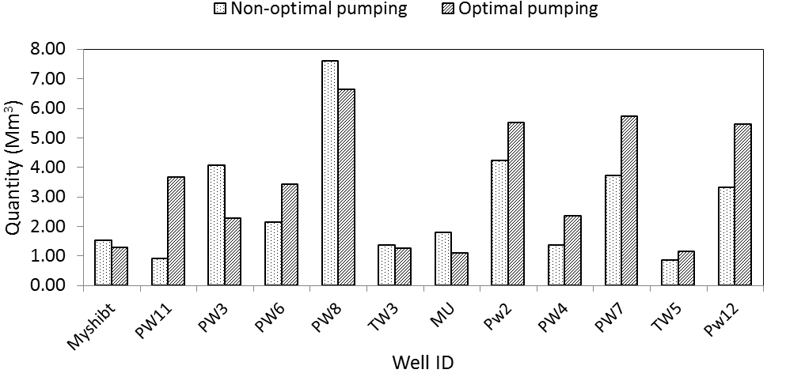
Optimal Water Management: Aynalem Watershed
© Prof. (Dr.) Ashok K. Keshari/Dept. of Civil and Environmental Engg./IIT Delhi
Fig. Comparison of average monthly optimal and non-optimal pumping during dry periods
Fig. Comparison of total annual optimal and non-optimal pumping of each well
Feb. 2, 2026
4th National Power-Gen Water Management Summit & Awards, Feb. 2, 2026, New Delhi,
India, organized by Council of Enviro Excellence
12/30

Slide 14
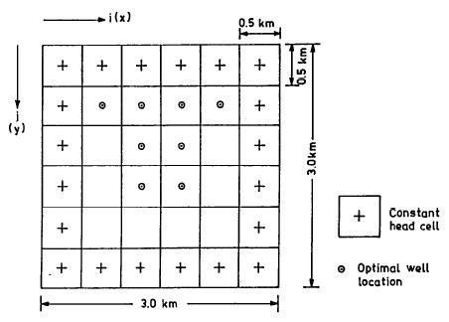
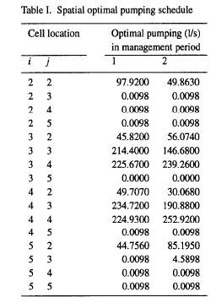
OPTIMAL WELL LOCATION & OPTIMAL PUMPING SCHEDULE
© Prof. (Dr.) Ashok K. Keshari/Dept. of Civil and Environmental Engg./IIT Delhi
Feb. 2, 2026
4th National Power-Gen Water Management Summit & Awards, Feb. 2, 2026, New Delhi, India, organized by Council of Enviro Excellence
13/30

Slide 15
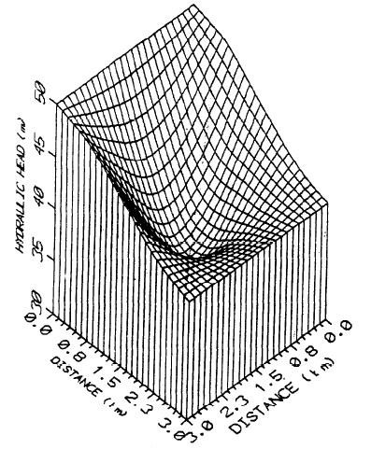
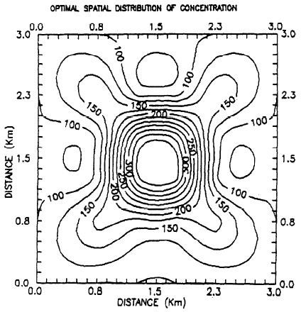
OPTIMAL SPATIAL DISTRIBUTION OF CHLORIDE CONCENTRATION:
© Prof. (Dr.) Ashok K. Keshari/Dept. of Civil and Environmental Engg./IIT Delhi
OPTIMAL HYDRAULIC HEAD DISTRIBUTION: 2nd YEAR
2nd YEAR
Feb. 2, 2026
4th National Power-Gen Water Management Summit & Awards, Feb. 2, 2026, New Delhi, India, organized by Council of Enviro Excellence
14/30

Slide 16
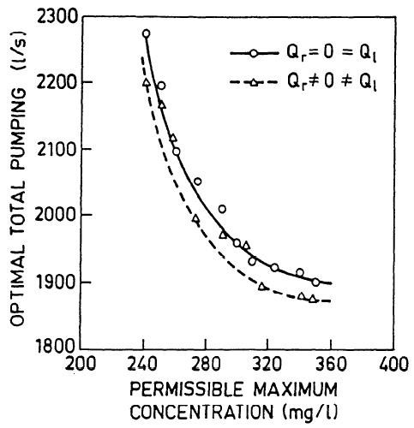
PARETO OPTIMAL SOLUTIONS: TRADEOFF BETWEEN
© Prof. (Dr.) Ashok K. Keshari/Dept. of Civil and Environmental Engg./IIT Delhi
CONFLICTING OBJECTIVES
Level
1 2 3 4 5 6
7
8
9
10
λ12
8.1 9.7 3.0 2.87 5.0 2.8 0.2 0.73 1.6 1.6
W12
+10 +9 +6 +
2
+1 -1 -3 -5 -6
Optimal total pumping (l/s)
2400
2200
2000
1945 l/s
305 mg/l
1800
200 250 300 350 400
Maximum concentration (mg/l)
OPTIMUM LEVEL OF AQUIFR RESTORATION
15/30

Slide 17
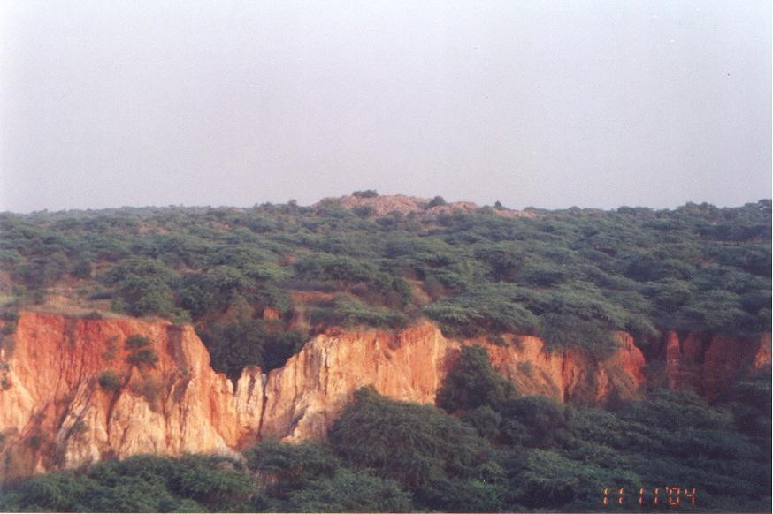
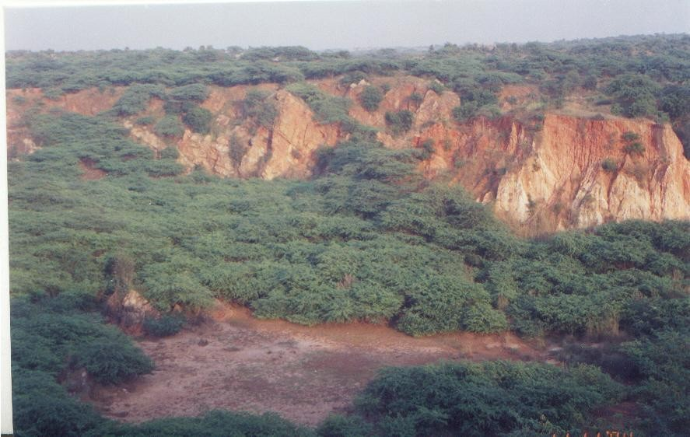
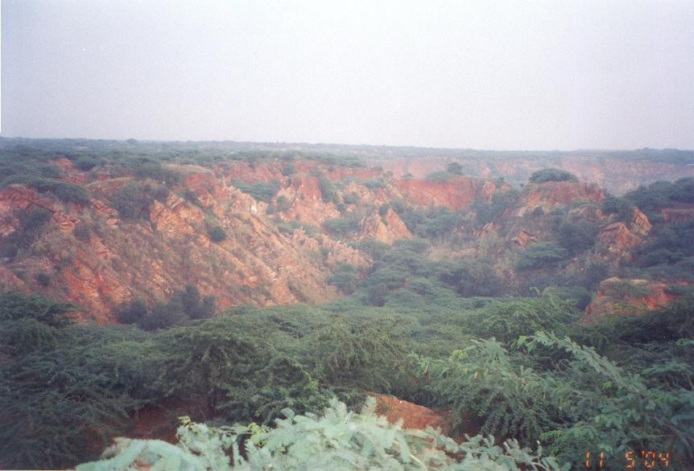
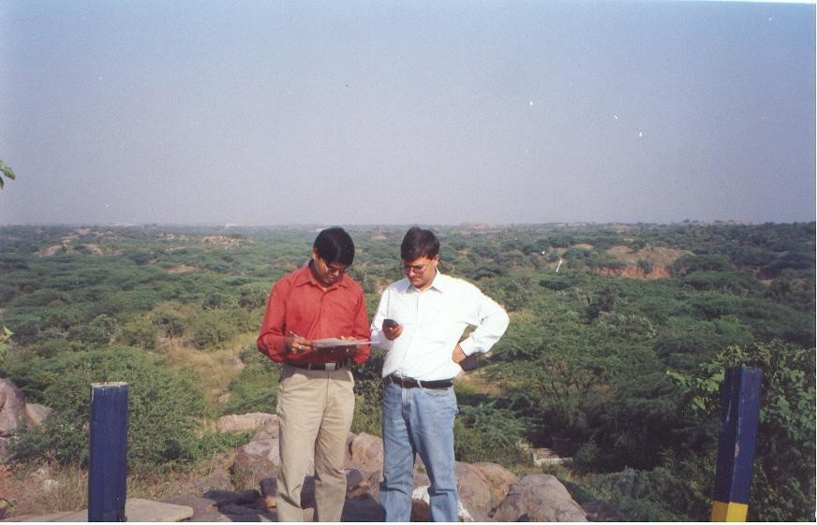
Fractured and weathered quartzite aquifer system
© Prof. (Dr.) Ashok K. Keshari/Dept. of Civil and Environmental Engg./IIT Delhi
Reconnaissance Survey for Baseline Scenario
GPS Survey for
DEM generation

Slide 18
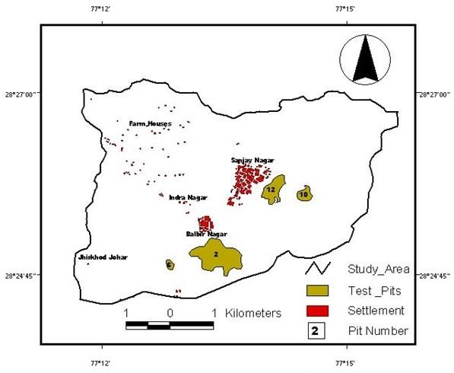
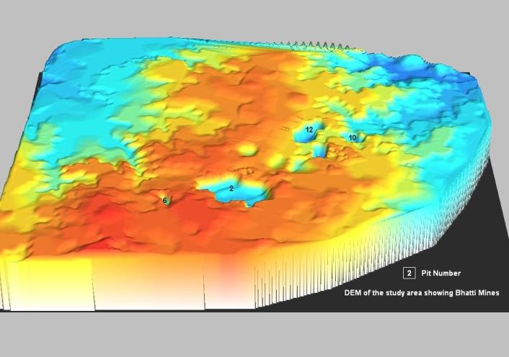
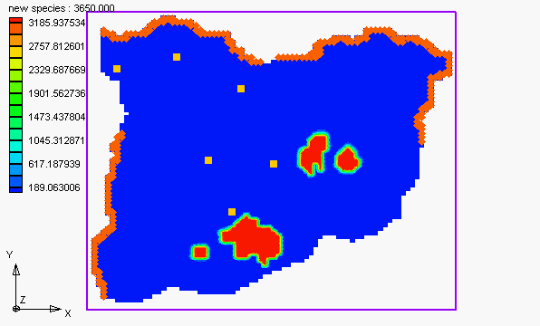
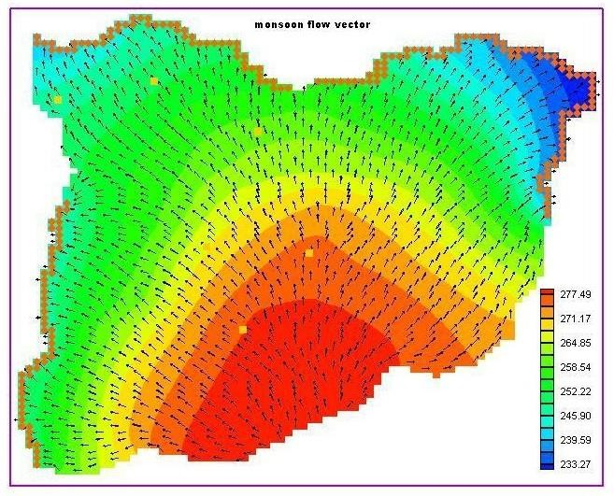
Groundwater Flow Vectors & Contaminant Plumes in Monsoon
© Prof. (Dr.) Ashok K. Keshari/Dept. of Civil and Environmental Engg./IIT Delhi

Slide 19
Migration of contaminant plume
© Prof. (Dr.) Ashok K. Keshari/Dept. of Civil and Environmental Engg./IIT Delhi
Contaminant plume migration

Slide 20
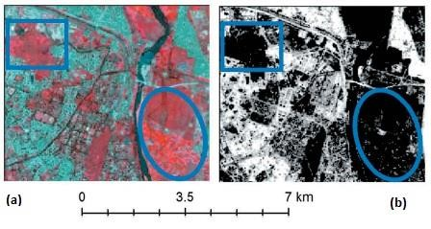
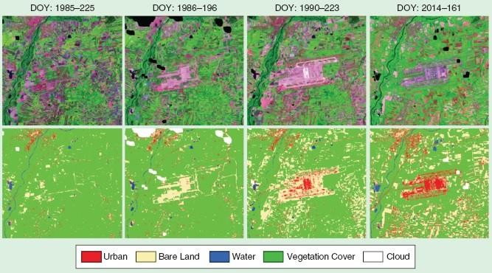
Artificial Intelligence/Machine Learning Algorithms
© Prof. (Dr.) Ashok K. Keshari/Dept. of Civil and Environmental Engg./IIT Delhi
FCC and impervious surface obtained for a part of New Delhi city derived from Landsat image using the rule based spectral unmixing algorithm (modified after Patidar and Keshari 2020)
Land cover changes because of the construction activity as derived using recurrent neural network (RNN) based deep learning from satellite image sequences (modified after Lyu et al. 2017)
4th National Power-Gen Water Management Summit & Awards, Feb. 2, 2026, New Delhi, India, organized by Council of Enviro Excellence

Slide 21
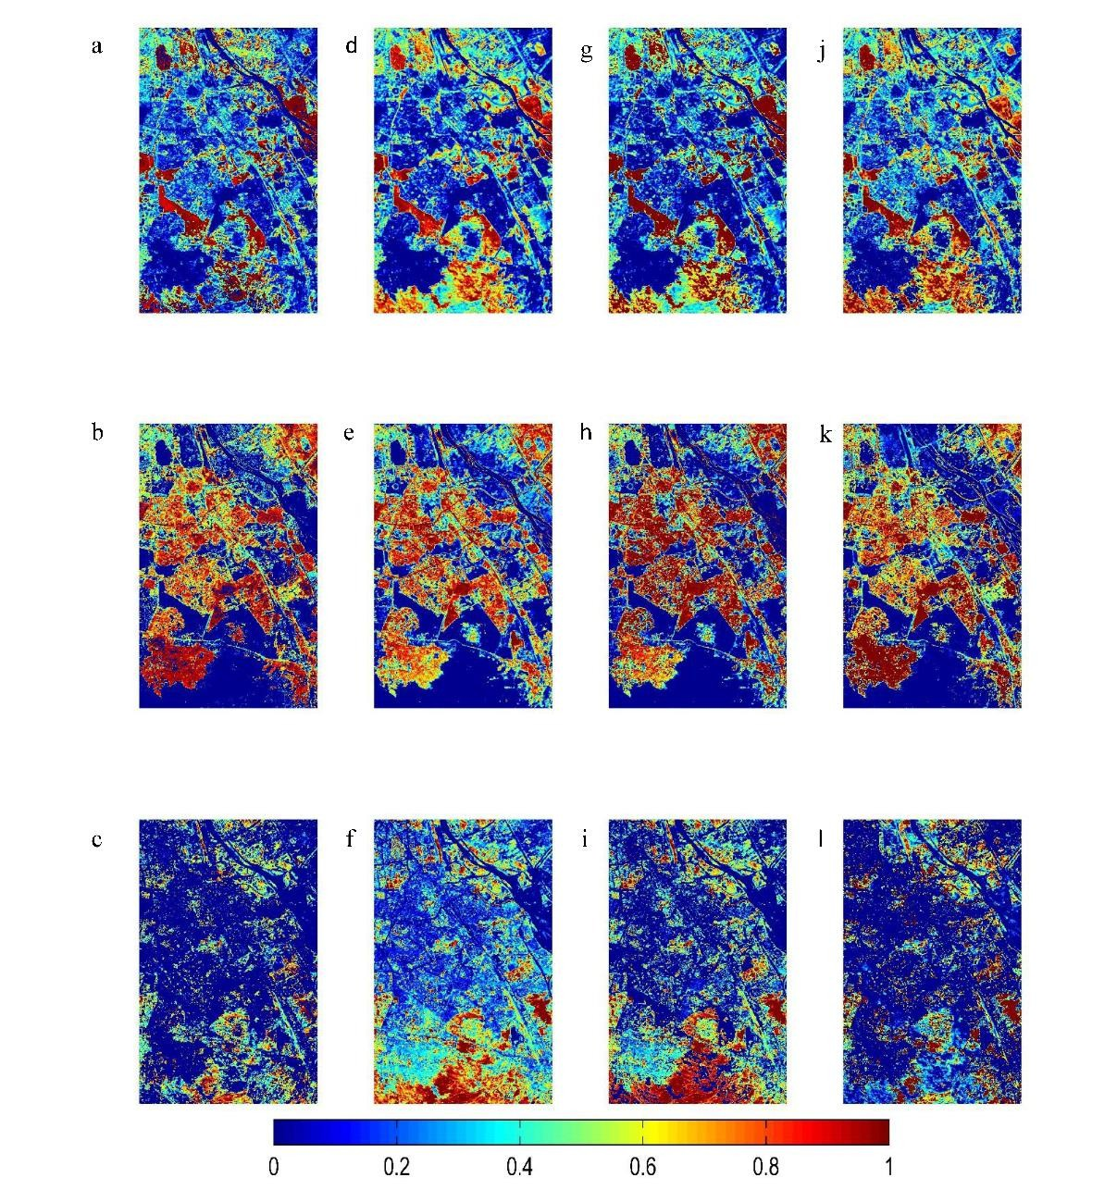
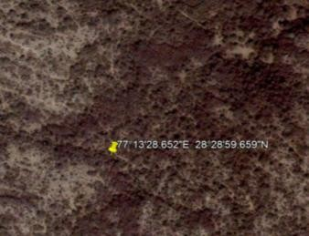
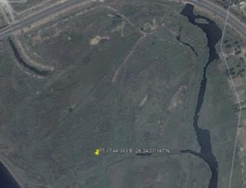
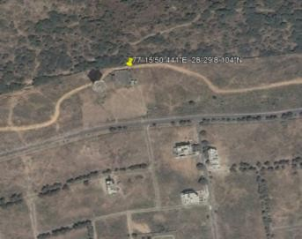
Land Cover Fraction Maps: Sub-pixel Land Cover Estimation using various Spectral Mixture Analysis & Multiple Endmember
© Prof. (Dr.) Ashok K. Keshari/Dept. of Civil and Environmental Engg./IIT Delhi
PNMESMA
MESMA NSMA SASMA
MESMA: Multiple Endmember Spectral Mixture Analysis
NSMA: Normalized Spectral Mixture Analysis PNMESMA: Pre-
screened and Normalized Multiple Endmember Spectral Analysis SASMA: Spatially Adaptive Spectral Mixture Analysis
(Source: Patidar & Keshari, 2018)
Vegetation
IS
Soil
Google Earth images, Oct 2006
4th National Power-Gen Water Management Summit & Awards, Feb. 2, 2026, New Delhi, India, organized by Council of Enviro Excellence

Slide 22
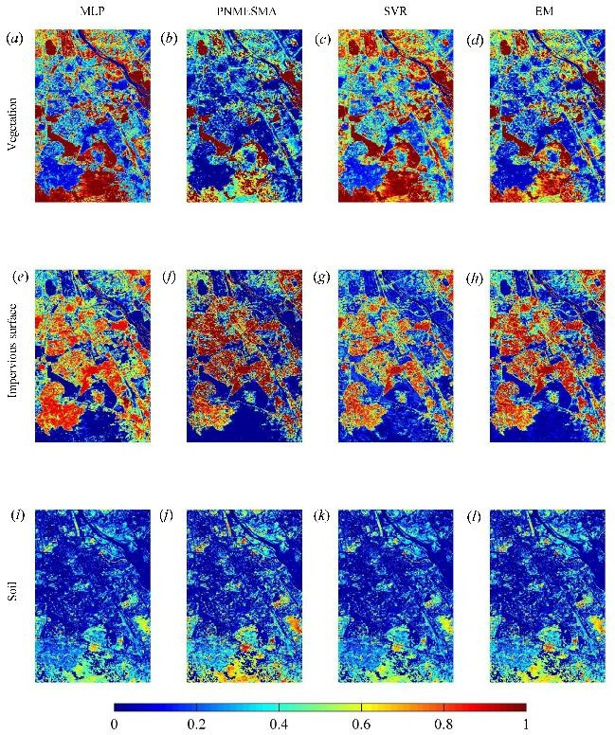
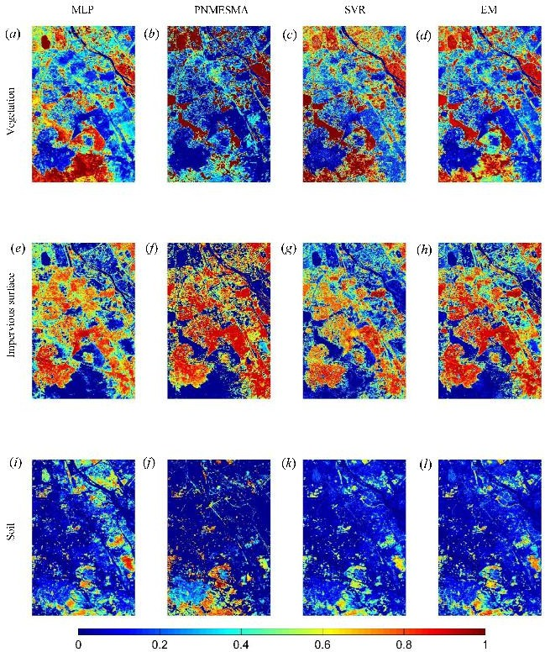
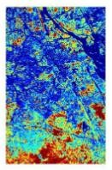
Ensemble model: Improving sub-pixel land cover estimation
© Prof. (Dr.) Ashok K. Keshari/Dept. of Civil and Environmental Engg./IIT Delhi
using Bayesian model averaging, spectral mixture analysis and machine learning techniques
Landsat ETM+
PNMESMA SVR
ASTER
MLP: Multi-layer Perceptron PNMESMA: Pre-
screened and Normalized Multiple Endmember Spectral Analysis SVR: Support Vector Regression EM: Ensemble Model
IS: Impervious Surface
MLP
EM
MLP PNMESMA SVR EM
Vegetation
IS
Soil

Slide 23
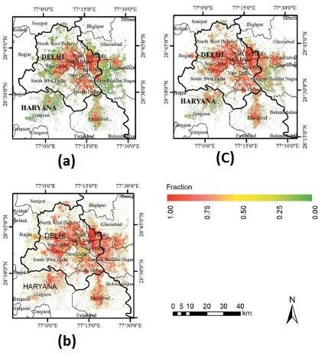
Temporal dynamics of impervious surface in NCR
© Prof. (Dr.) Ashok K. Keshari/Dept. of Civil and Environmental Engg./IIT Delhi
Impervious surface fraction in 1992 (a), 2004 (b), and 2017 (c);
obtained from Landsat satellite images using Rule Based Spectral Unmixing Algorithm developed by Patidar and Keshari (2020)

Slide 24
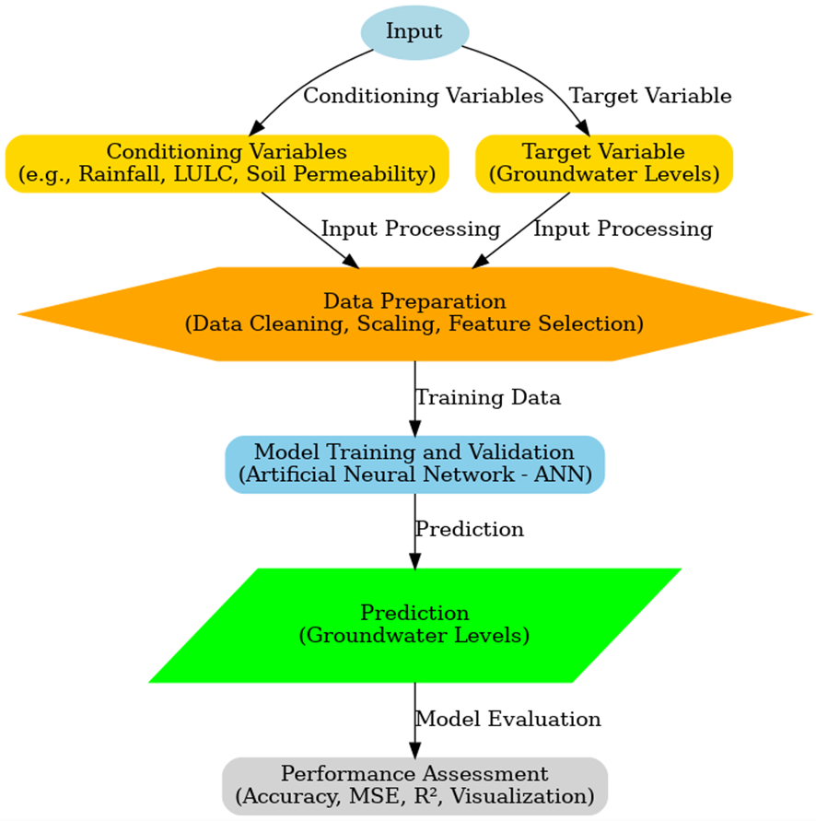
GW LEVEL PREDICTION USING ANN: METHODOLOGY
© Prof. (Dr.) Ashok K. Keshari/Dept. of Civil and Environmental Engg./IIT Delhi
Data Preprocessing
Addressing incomplete data, feature engineering, data normalization, temporal alignment, and data splitting.
Model Selection
Choosing an appropriate machine learning model, in this case, an
Artificial Neural Network (ANN).
Model Training
Training the ANN model using the preprocessed data to learn relationships between input features and GWLs.
Model Evaluation
Evaluating the model's performance using metrics like Mean
Squared Error (MSE) and R².
Prediction
Using the trained model to predict groundwater levels for future periods.

Slide 25
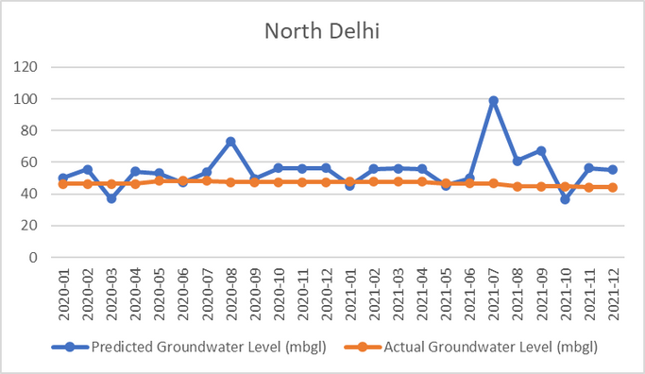
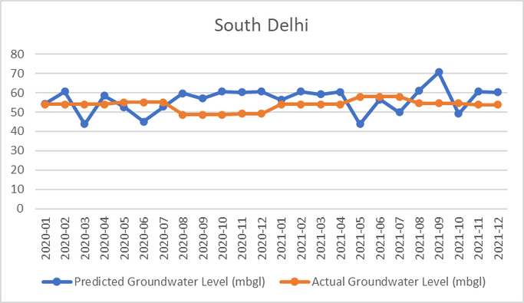
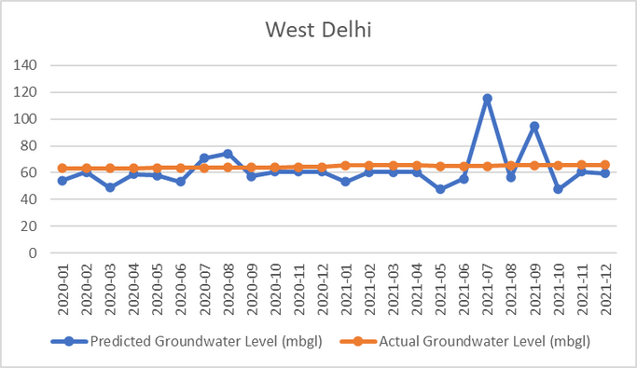
© Prof. (Dr.) Ashok K. Keshari/Dept. of Civil and Environmental Engg./IIT Delhi
MODEL PERFORMANCE
Data Period: 2020-2021:
North Delhi: Accounts for 53% of groundwater variance with modest prediction error.
South Delhi: Moderate R² and high MSE indicate comparable performance but increased inaccuracy due to complex interactions like land use and soil conditions.
West Delhi: Comparatively high accuracy with
R² = 0.5694 and MSE = 0.15.

Slide 26
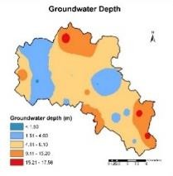
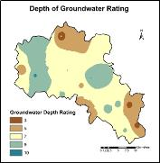
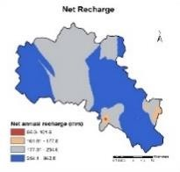
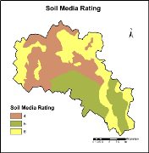
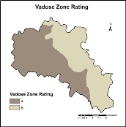
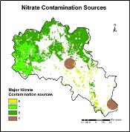
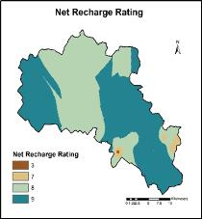
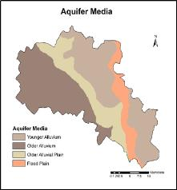









Groundwater Vulnerability Assessment
© Prof. (Dr.) Ashok K. Keshari/Dept. of Civil and Environmental Engg./IIT Delhi
Feb. 2, 2026
4th National Power-Gen Water Management Summit & Awards, Feb. 2, 2026, New Delhi,
India, organized by Council of Enviro Excellence
25/30

Slide 27


Flood Inundation Mapping (FIM) Using Random Forest (Machine
© Prof. (Dr.) Ashok K. Keshari/Dept. of Civil and Environmental Engg./IIT Delhi
Learning Algorithm) in Google Earth Engine (GGE)
Study Area
Feb. 2, 2026
4th National Power-Gen Water Management Summit & Awards, Feb. 2, 2026, New Delhi, India, organized by Council of Enviro Excellence
26/30

Slide 28









Flood Vulnerability & Management
© Prof. (Dr.) Ashok K. Keshari/Dept. of Civil and Environmental Engg./IIT Delhi
Groundwater Vulnerability
Ranjan and Keshari (2022)
Features extraction at pixel level: Ranjan and Keshari (2023), Best paper award at UASG23 Malaysia.
Ecological
Vulnerability
Riparian vegetation
Riparian zones of river Kali Sindh. Source: Sentinel 2 MSI, Level 2A
Fragmentation in the riparian zones due to urban and agricultural land use. Developed using Landsat 7 C2 L2 surface reflectance
CMIP 5 Climate data analysis of Lower Ganga basin, Bihar
4th National Power-Gen Water Management Summit & Awards, Feb. 2, 2026, New Delhi,
India, organized by Council of Enviro Excellence
Feb. 2, 2026
27/30

Slide 29








Digital Twin Snapshots:
© Prof. (Dr.) Ashok K. Keshari/Dept. of Civil and Environmental Engg./IIT Delhi
Top: Ponds in 2008, 2023
Bottom: River Yamuna in Delhi: Sep. 2010, 2015, 2020, 2025
Feb. 2, 2026
4th National Power-Gen Water Management Summit & Awards, Feb. 2, 2026, New Delhi, India, organized by Council of Enviro Excellence
28/30

Slide 30
CONCLUSIONS
© Prof. (Dr.) Ashok K. Keshari/Dept. of Civil and Environmental Engg./IIT Delhi
Water sustainability is becoming a major concern due to growing water demand from various sectors, increasing water pollution, changing landscape, hydrological uncertainties, and climate change.
Specific Water Consumption, Water Footprint, Water Use Efficiency, EIA, SIA, and Hydro-Environmental Risk can play major role in water and environmental sustainability for Industries
Embracing geospatial, AI or machine learning, and Digital Twin technologies for digitalization and real-time monitoring, simulation, prediction and optimization of processes, operations, planning, and informed decision-making or management.
These technologies can immensely help in enhancing monitoring, visualization, performance, supply chain management, life cycle management, scalability, water and environmental sustainability, and social acceptability in dynamic environments and real-world settings.
Feb. 2, 2026
4th National Power-Gen Water Management Summit & Awards, Feb. 2, 2026, New Delhi, India, organized by Council of Enviro Excellence
29/30

Slide 31


© Prof. (Dr.) Ashok K. Keshari/Dept. of Civil and Environmental Engg./IIT Delhi
4th National Power-Gen Water Management Summit & Awards, Feb. 2, 2026, New Delhi, India, organized by Council of Enviro Excellence
Feb. 2, 2026
30/30

